Slide 1


Slide 2
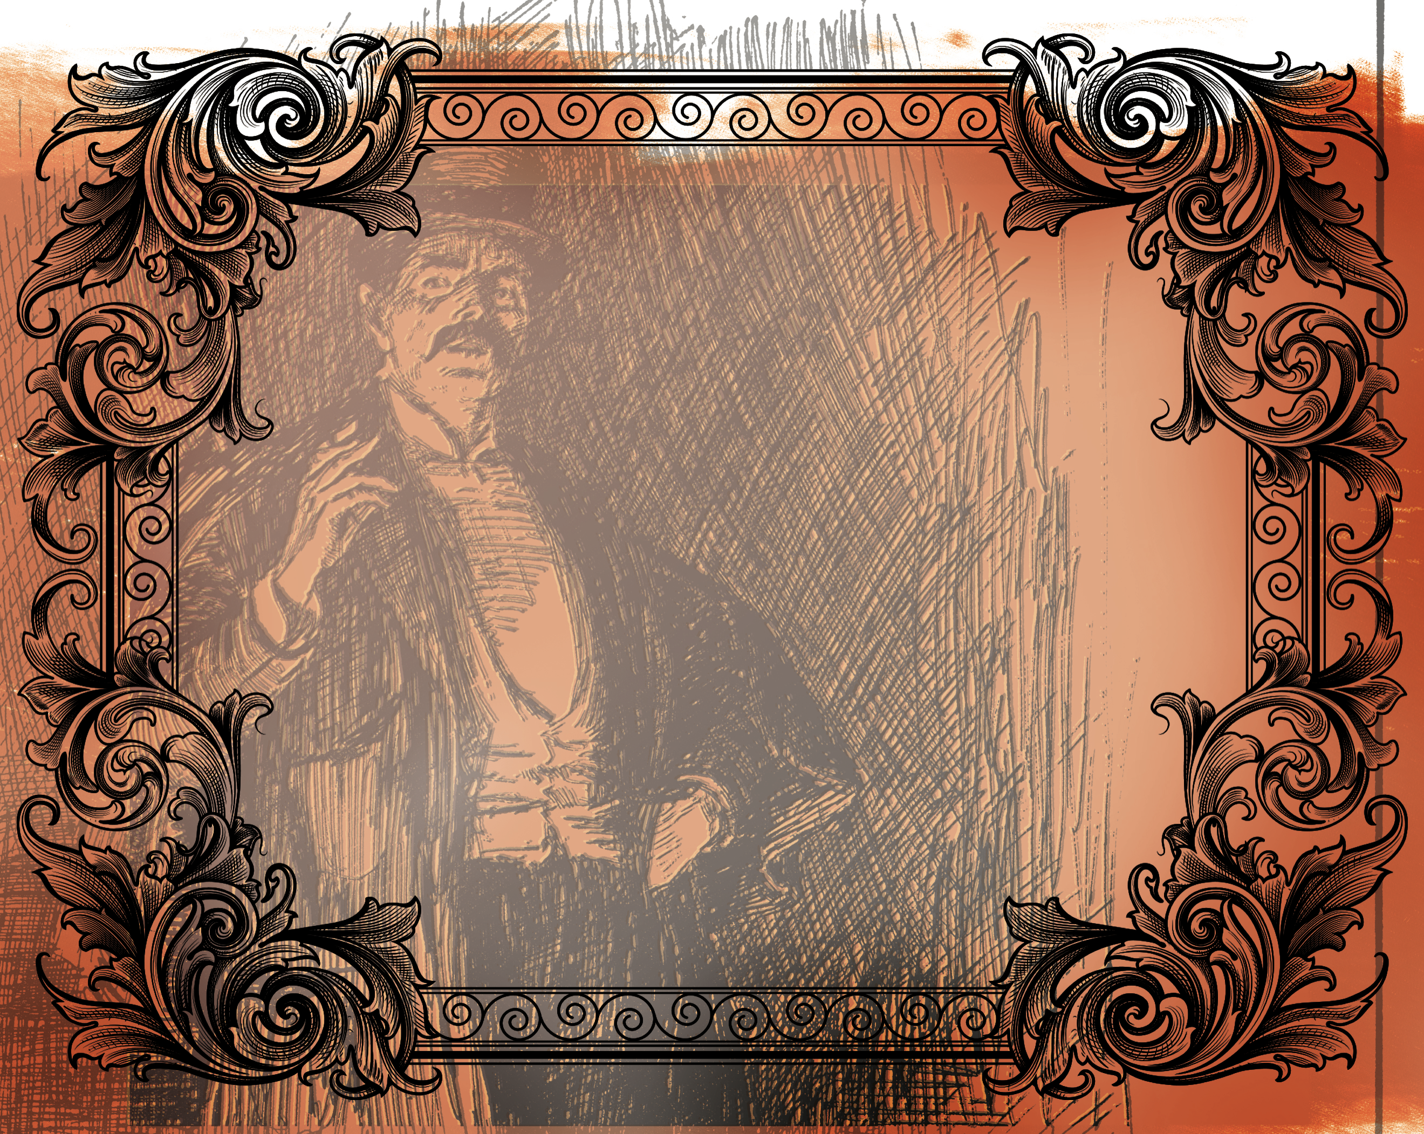
But love your enemies, and do good, and lend, expecting nothing in return, and your reward will be great, and you will be sons of the Most High, for He is kind to the ungrateful and the evil. Be merciful, even as your Father is merciful.
^{Luke 6:35-36}

Slide 3
Jesus said to love our enemies.
Show your enemies compassion.
Show your enemies grace as you have been shown grace.

Slide 4
Enter Content Here.
Enter content here.
Enter content here
Enter content here

