Slide 1
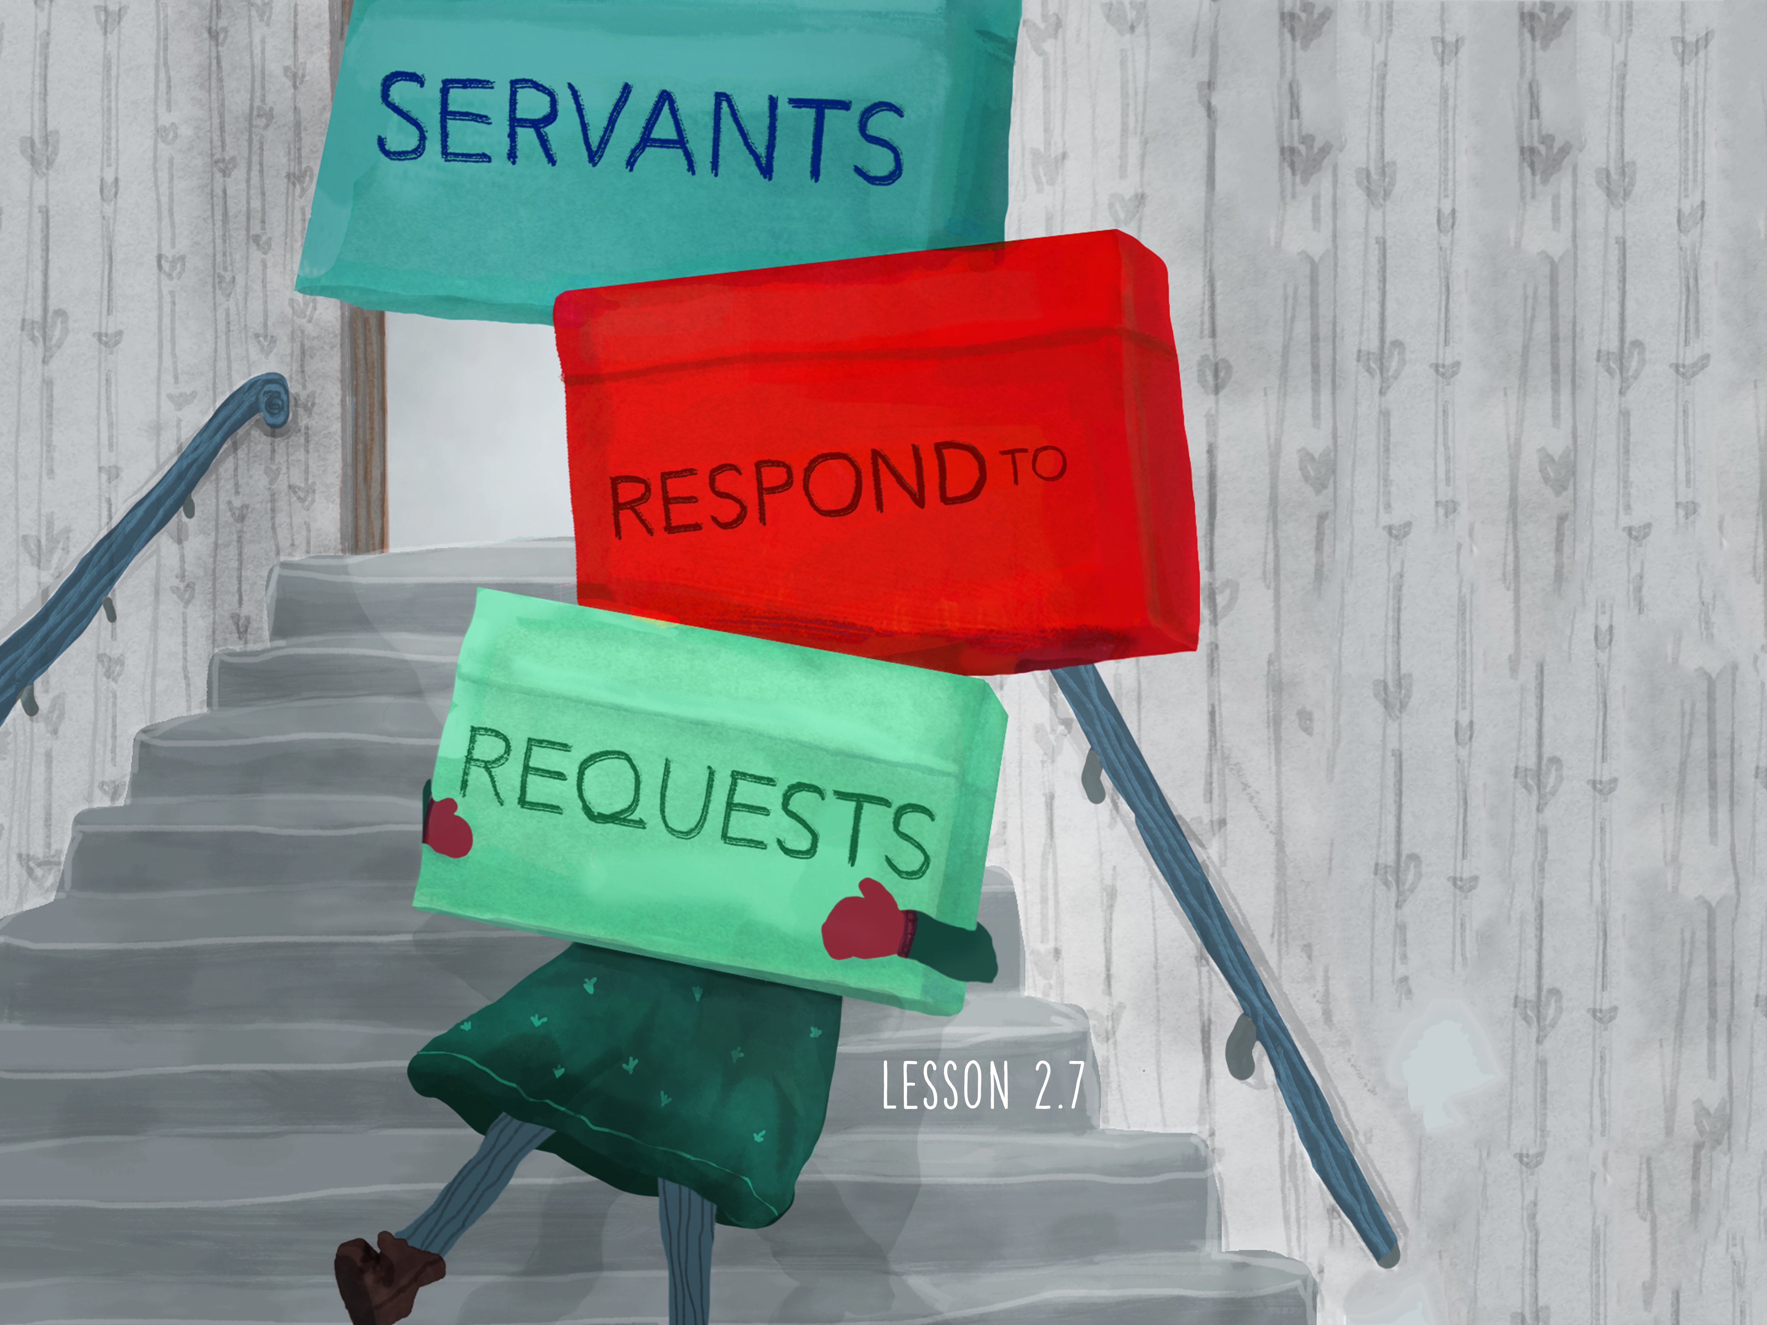

Slide 2

When Jesus heard these things, He marveled at him, and turning to the crowd that followed Him, said, “I tell you, not even in Israel have I found such faith.” And when those who had been sent returned to the house, they found the servant well.
^{Luke 7:9-10}

Slide 3
Jesus is requested to serve.
Jesus is amazed by faith.
Jesus heals the servant.

Slide 4
Enter Content Here.
Enter content here.
Enter content here
Enter content here

