Slide 1


Slide 2
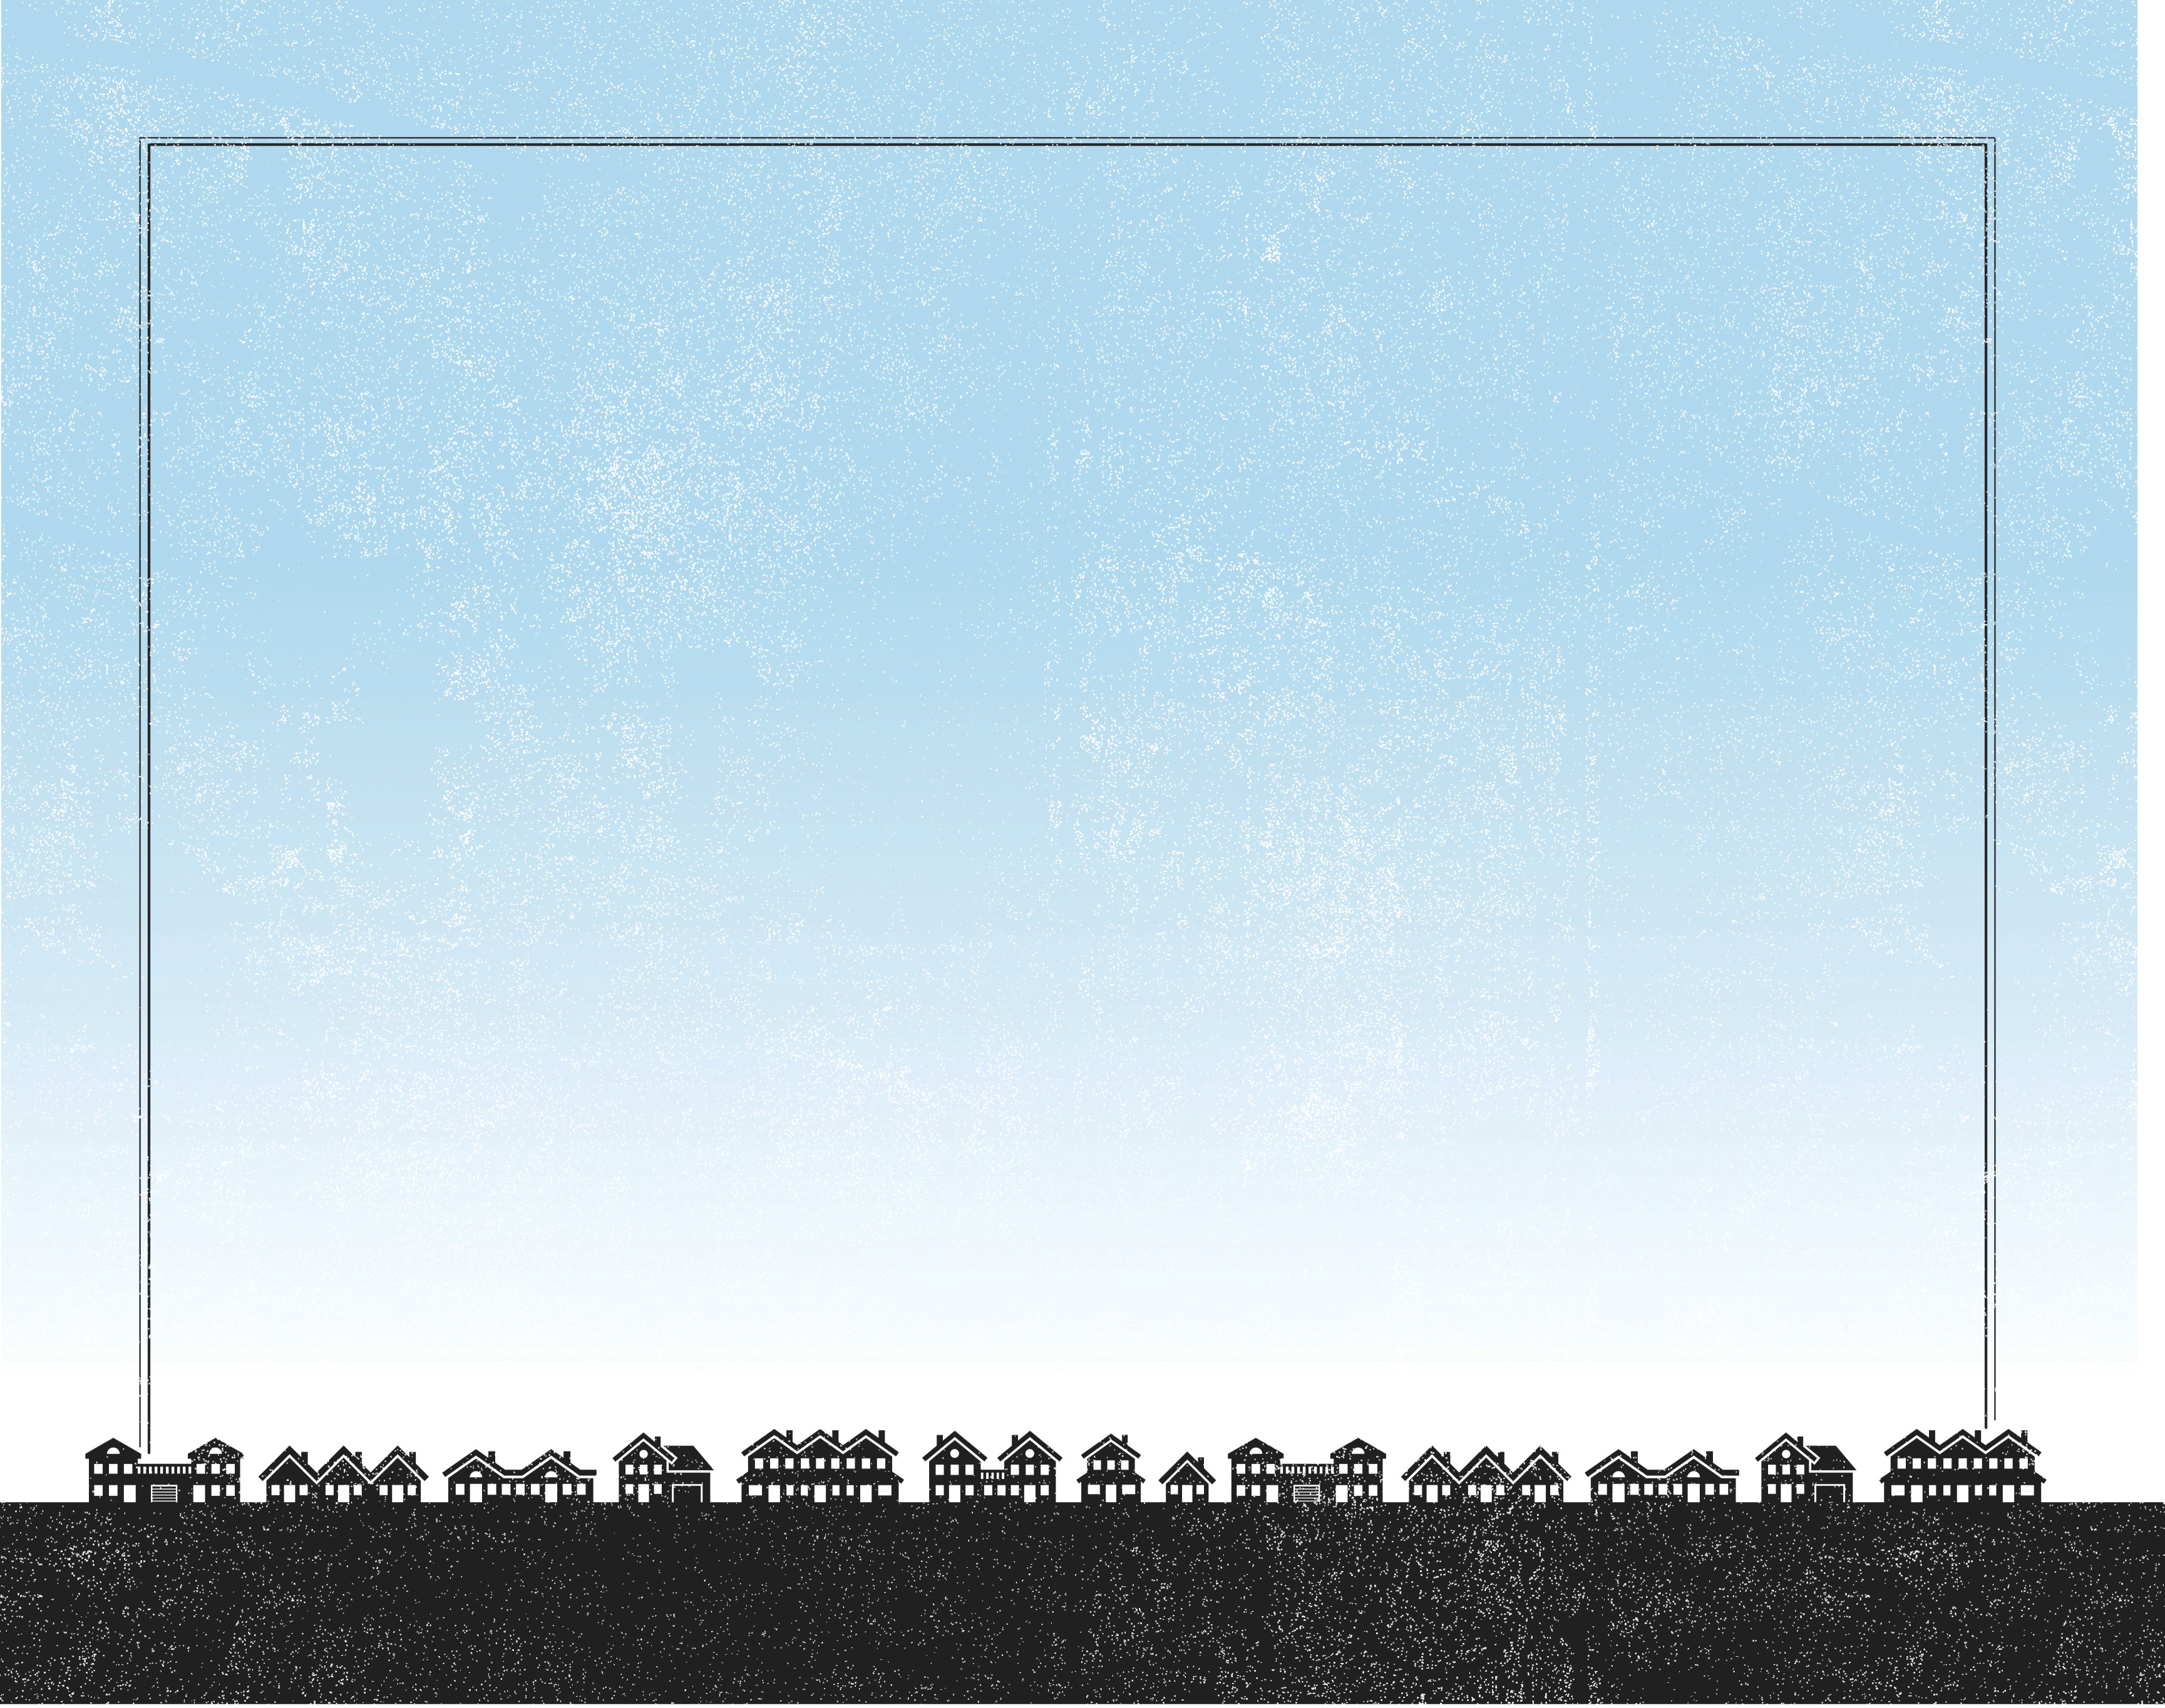
And taking the five loaves and the two fish, He looked up to heaven and said a blessing over them. Then He broke the loaves and gave them to the disciples to set before the crowd. And they all ate and were satisfied. And what was left over was picked up, twelve baskets of broken pieces.
^{Luke 9:16-17}

Slide 3
The crowd had a need.
The disciples had an impossible mission.
Jesus had the solution.

Slide 4
Enter Content Here.
Enter content here.
Enter content here
Enter content here

