Slide 1
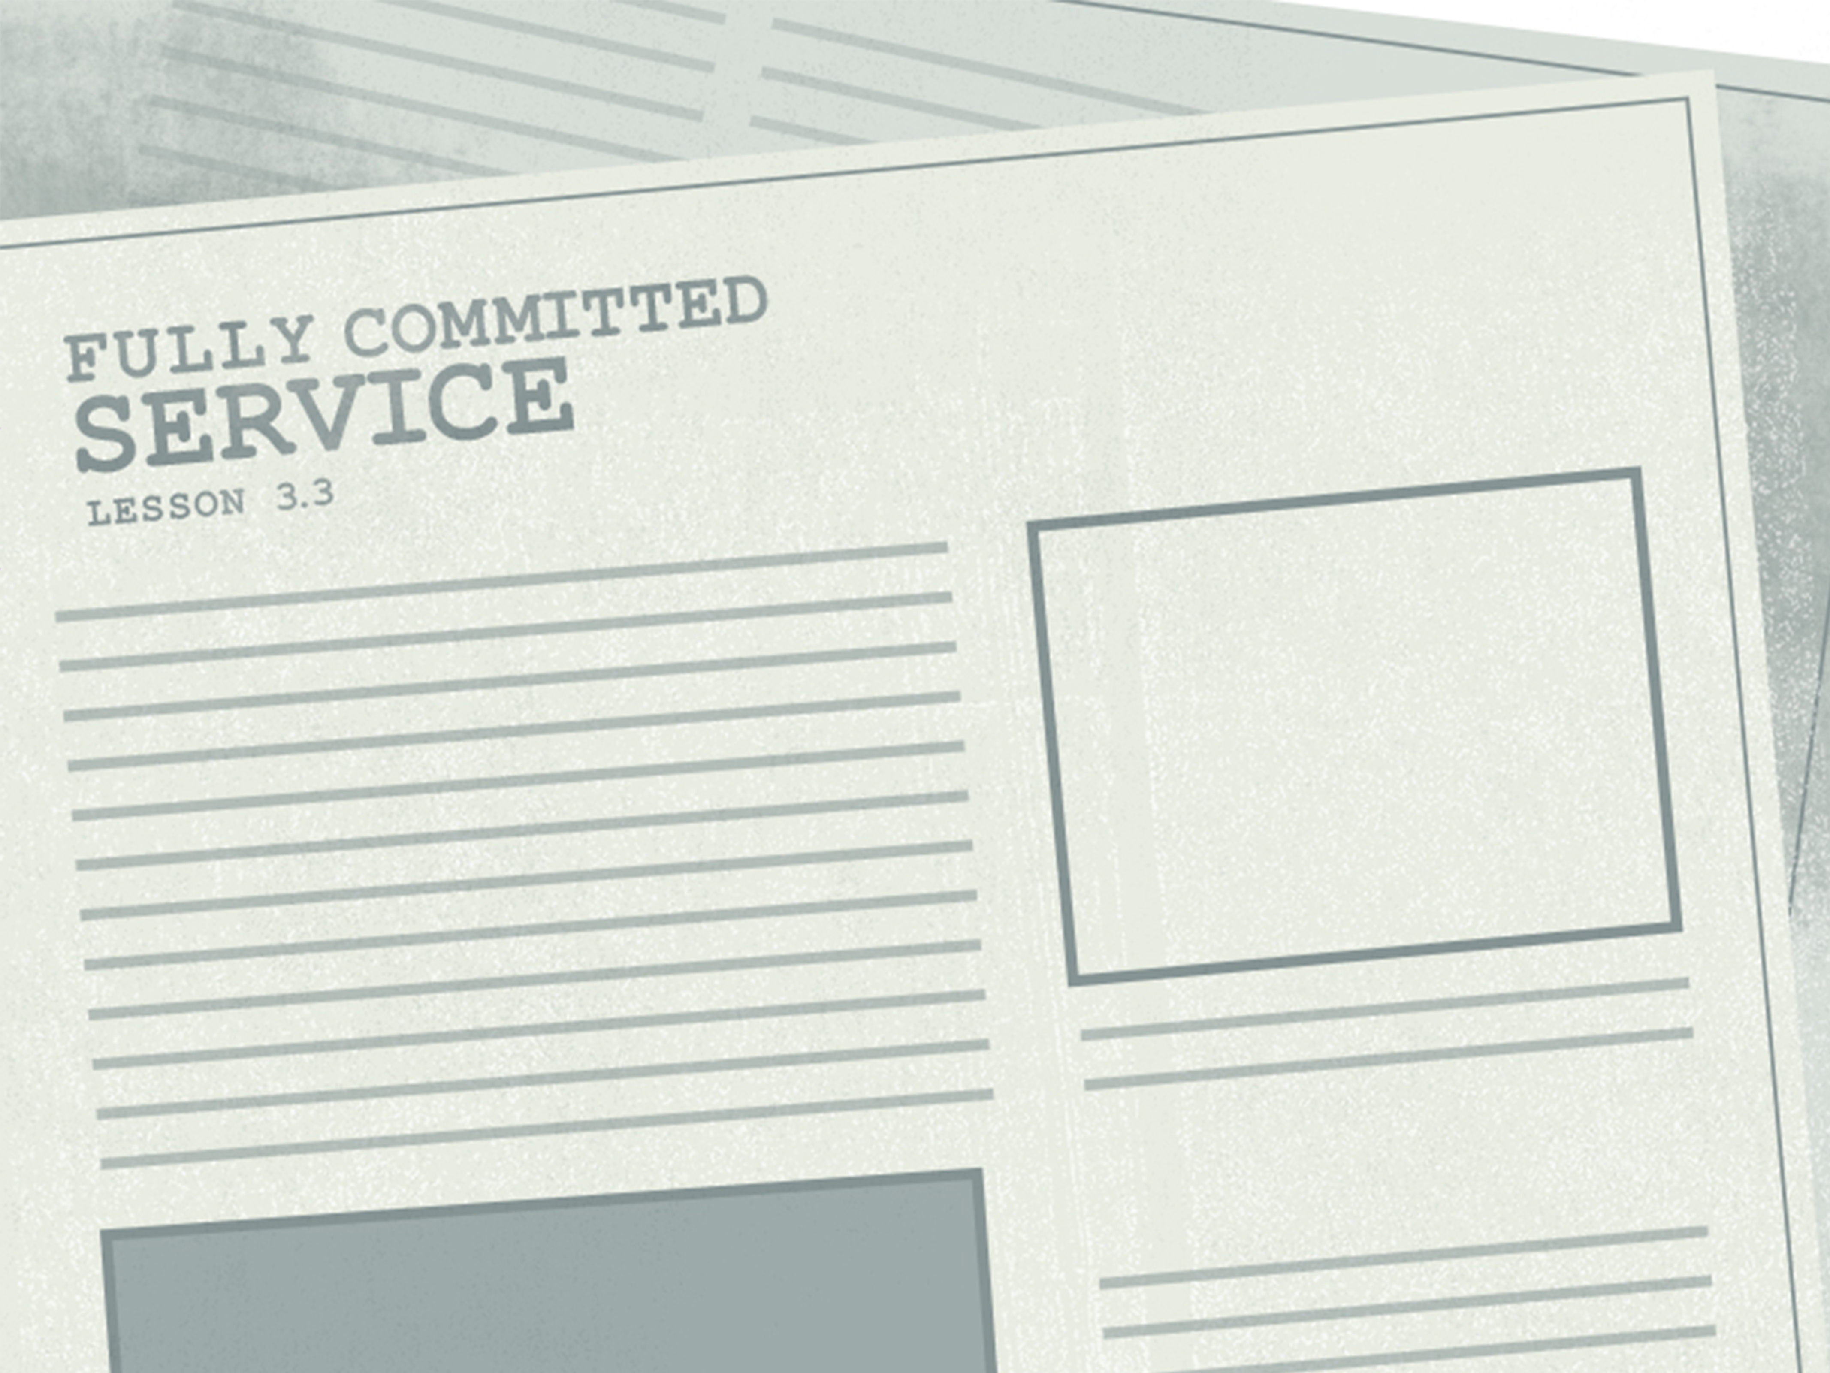

Slide 2

Jesus said to him, “No one who puts his hand to the plow and looks back is fit for the kingdom of God.”
^{Luke 9:62}

Slide 3
Following Jesus means giving up earthly security.
No buts
Following Jesus is going to cost something.

Slide 4
Enter Content Here.
Enter content here.
Enter content here
Enter content here

