Slide 1
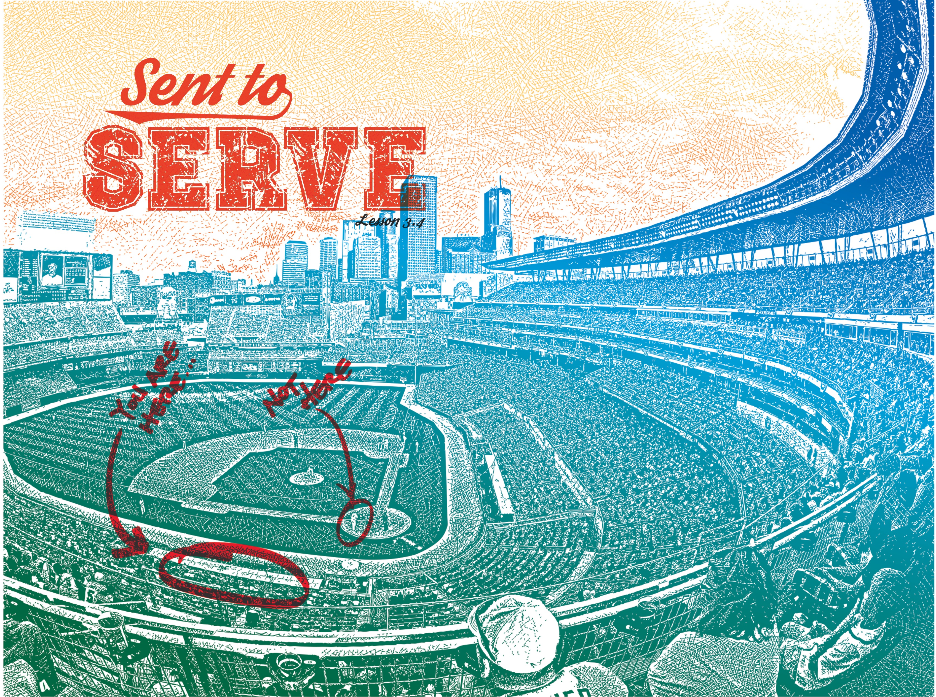

Slide 2

And He said to them, “The harvest is plentiful, but the laborers are few. Therefore pray earnestly to the Lord of the harvest to send out laborers into His harvest.”
^{Luke 10:2}

Slide 3
Servants have a mission.
Serving isn’t always safe.
Serving brings great joy!

Slide 4
Enter Content Here.
Enter content here.
Enter content here
Enter content here

