Slide 1
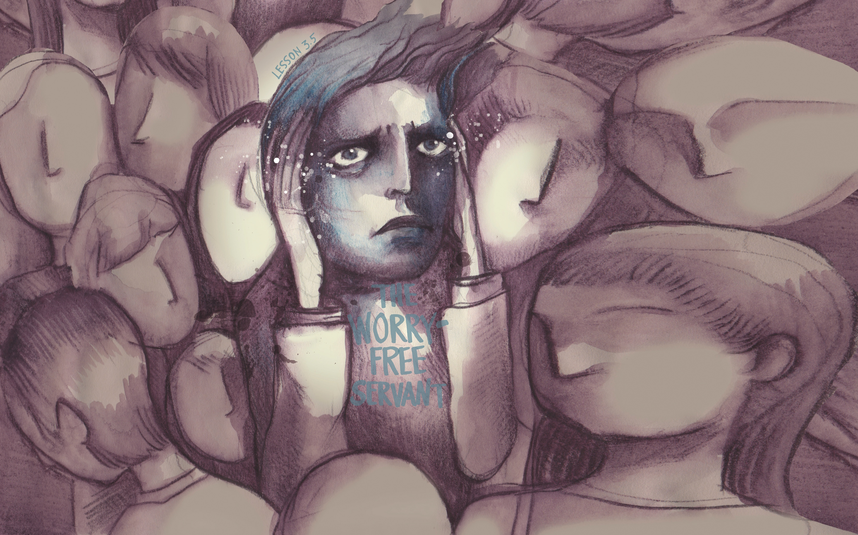

Slide 2
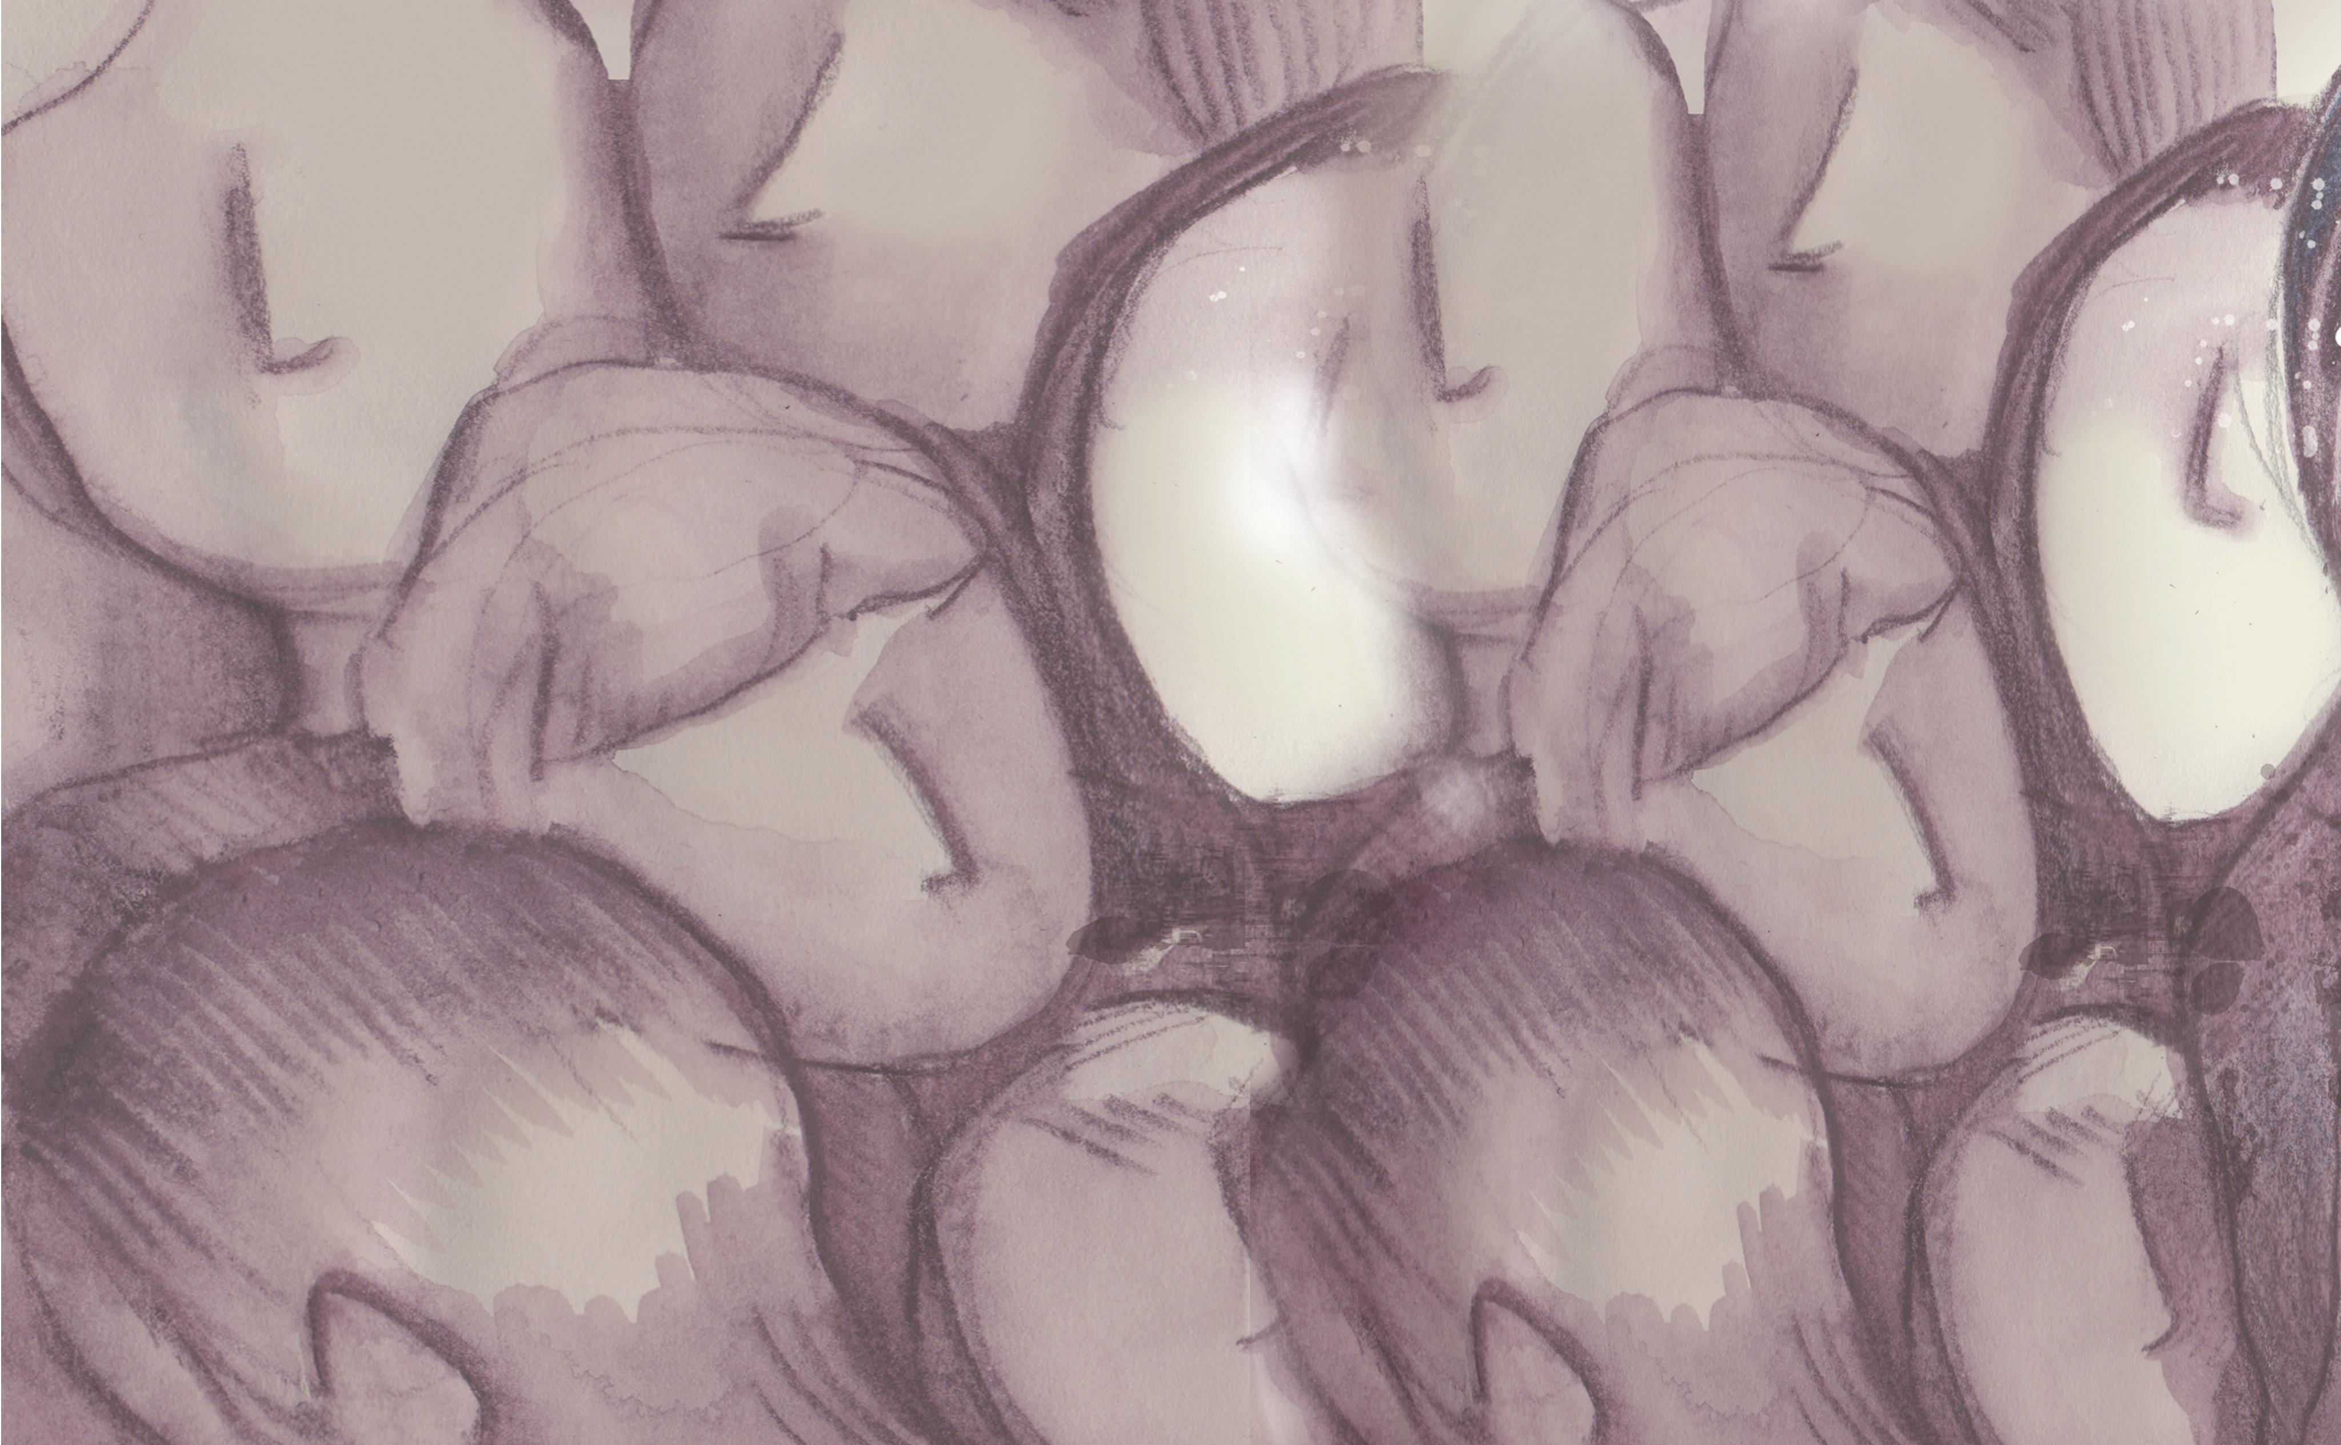
But the Lord answered her, “Martha, Martha, you are anxious and troubled about many things, but one thing is necessary. Mary has chosen the good portion, which will not be taken away from her.”
^{Luke 10:41-42}

Slide 3
Mary listened to Jesus.
Martha was distracted.
Choose Jesus, not your worries.

Slide 4
Enter Content Here.
Enter content here.
Enter content here
Enter content here

