Slide 1
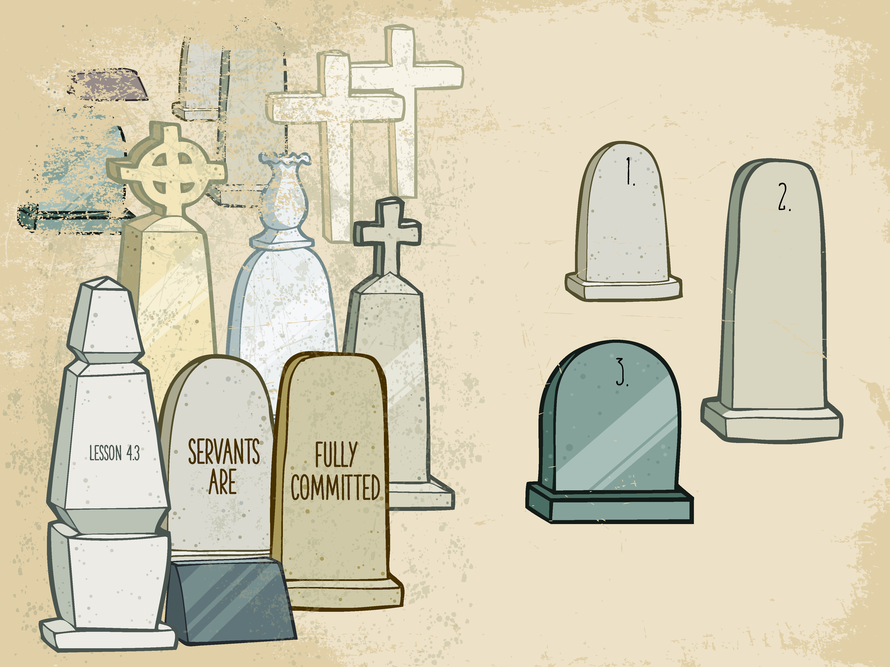

Slide 2

And Jesus said, “Father, forgive them,
for they know not what they do.” And they cast lots to divide His garments.
^{Luke 23:34}

Slide 3
Jesus was crucified.
Jesus was fully committed..

Slide 4
Enter Content Here.
Enter content here.
Enter content here
Enter content here

