Slide 1
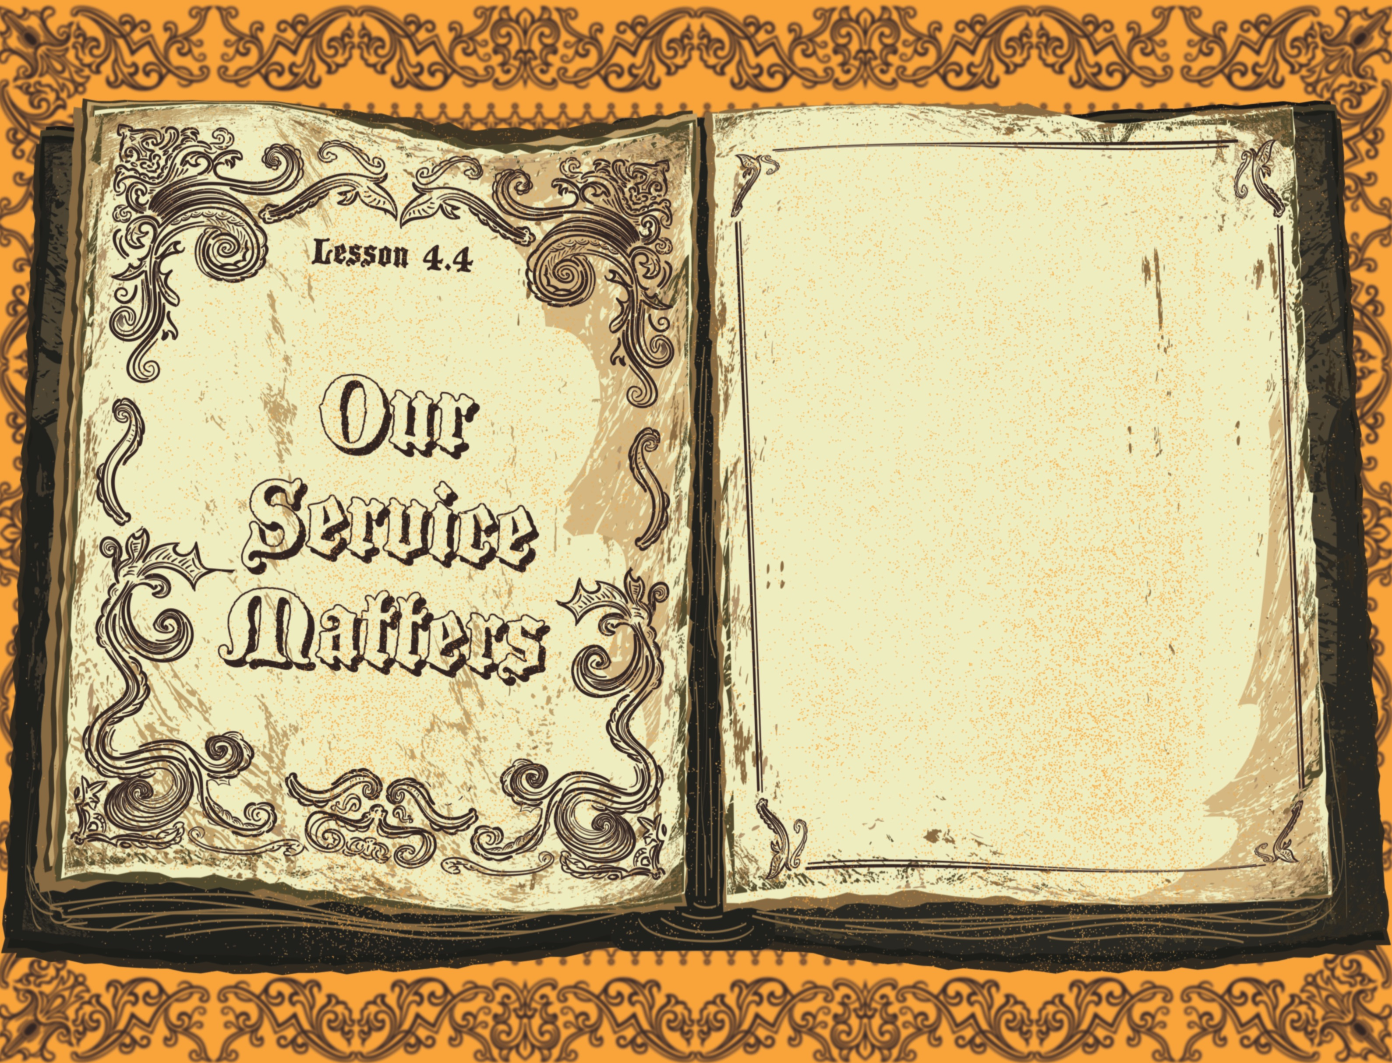

Slide 2

It was now about the sixth hour, and there was darkness over the whole land until the ninth hour, while the sun’s light failed. And the curtain of the temple was torn in two. Then Jesus, calling out with a loud voice, said, “Father, into Your hands I commit My spirit!” And having said this He breathed His last.
^{Luke 23:44-46}

Slide 3
Jesus died on the cross.
Jesus was buried.
Jesus’ service mattered.

Slide 4
Enter Content Here.
Enter content here.
Enter content here
Enter content here

