Slide 1
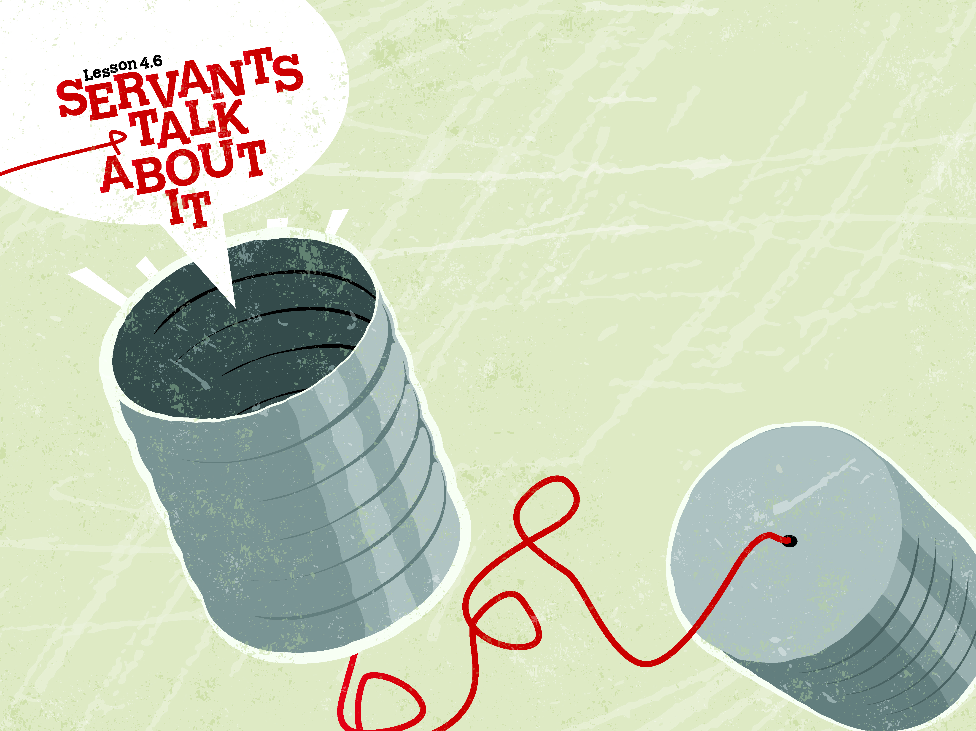

Slide 2

And He said to them, “O foolish ones, and slow of heart to believe all that the prophets have spoken! Was it not necessary that the Christ should suffer these things and enter into His glory?”
^{Luke 24:25-26}

Slide 3
Two men were walking toward Emmaus.
A stranger met up with them.
They found out that Jesus is alive and left to tell others.

Slide 4
Enter Content Here.
Enter content here.
Enter content here
Enter content here

