Slide 1
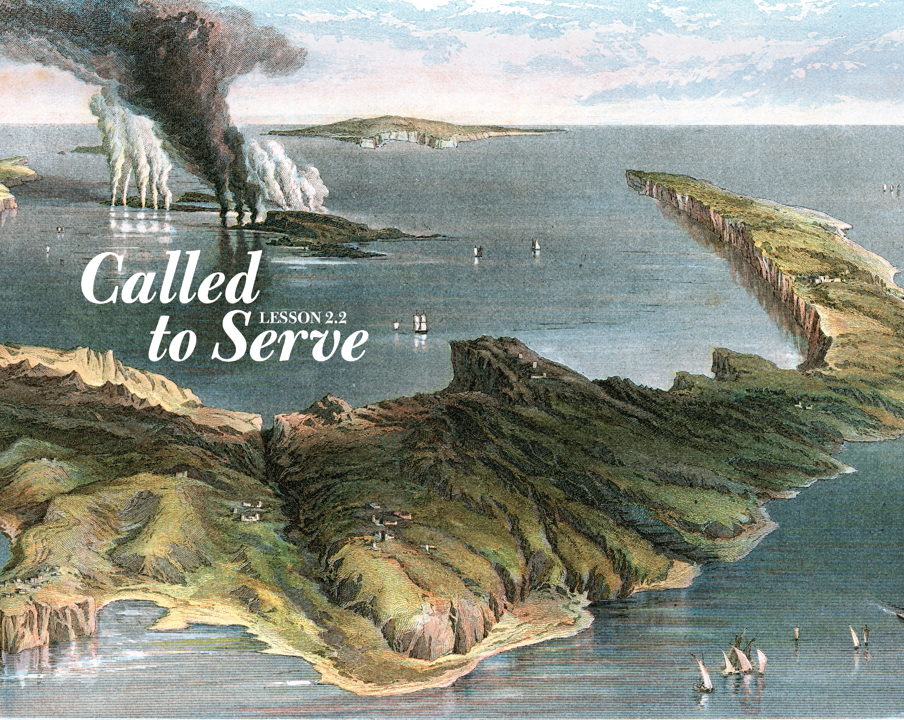

Slide 2
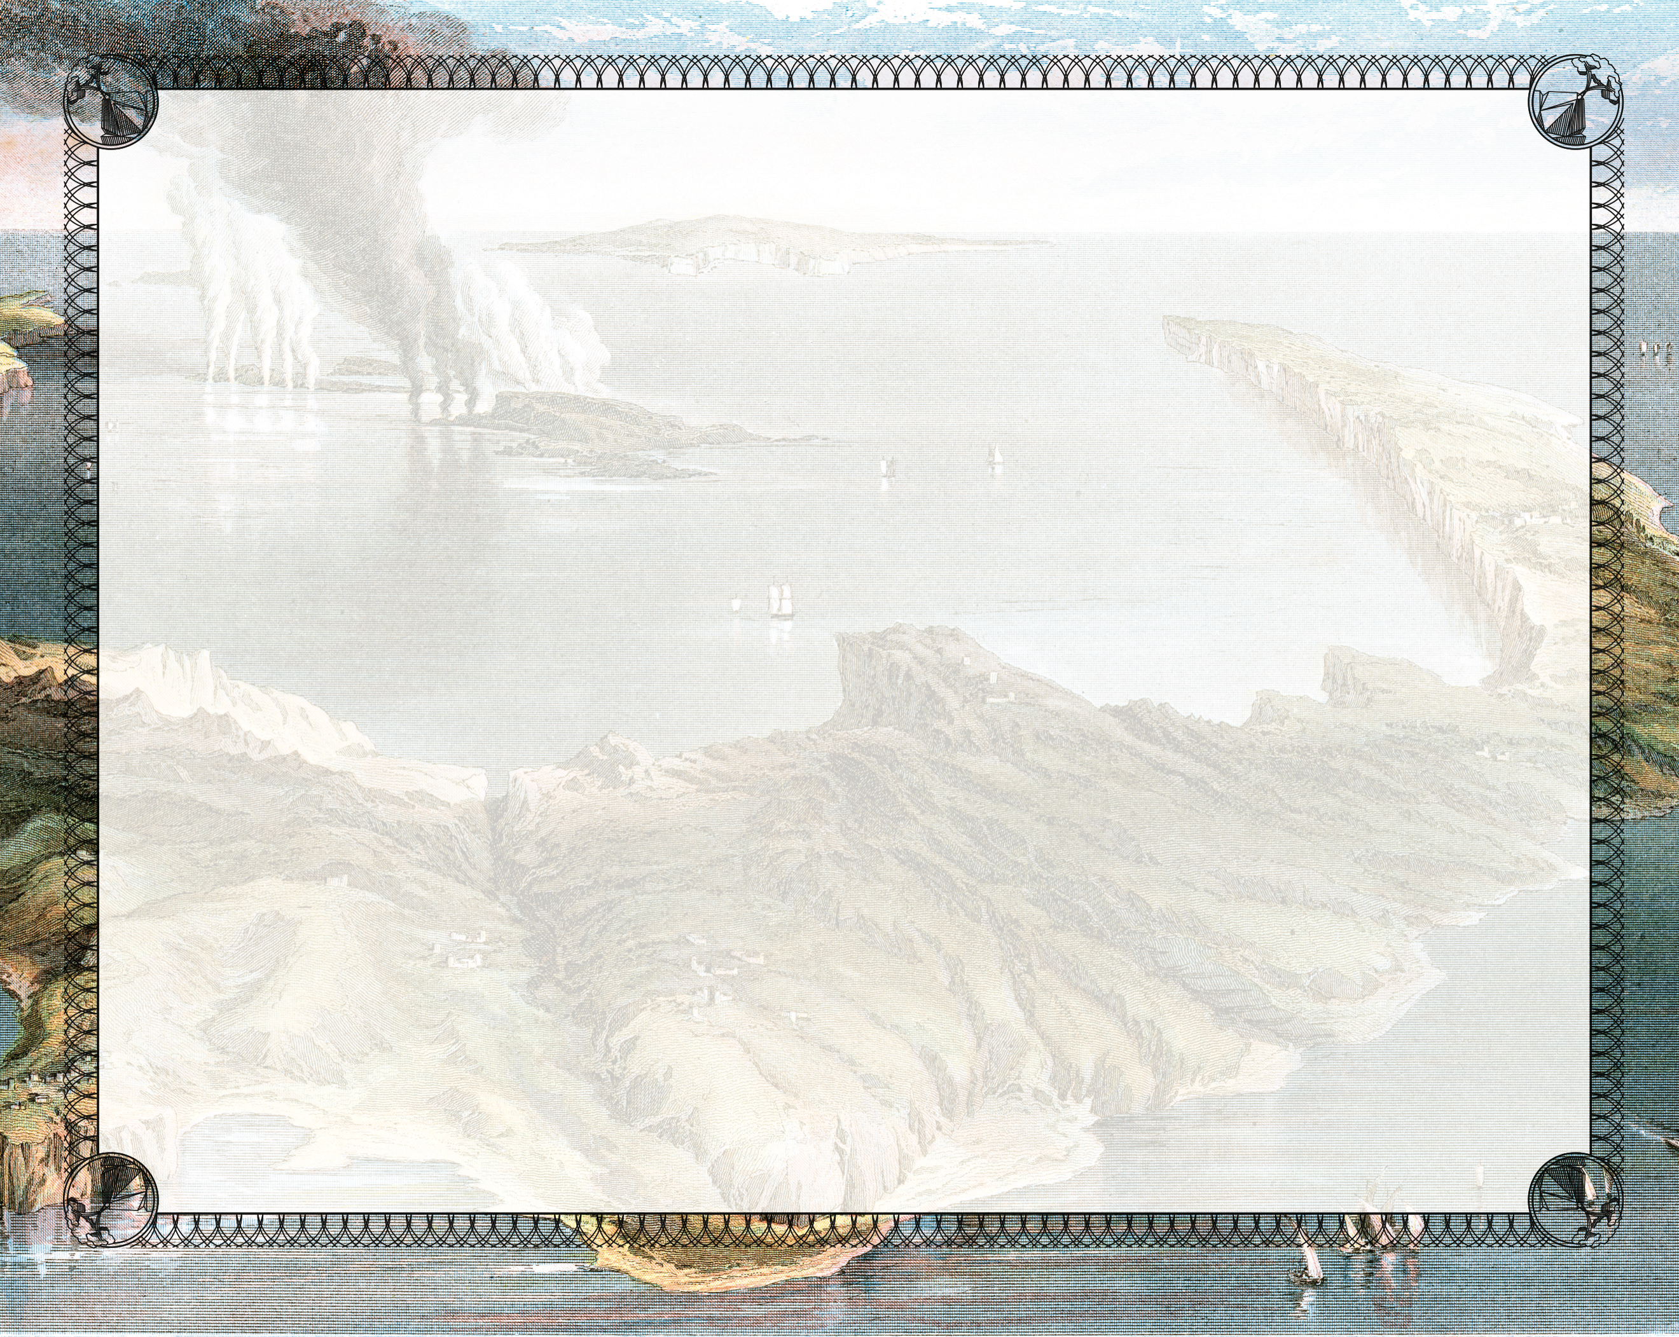
And so was also James, and John, the sons of Zebedee, which were partners with Simon. And Jesus said unto Simon, “Fear not; from henceforth thou shalt catch men.” And when they had brought their ships to land, they forsook all, and followed Him.
^{Luke 5:10-11}

Slide 3
Jesus engaged with Peter.
Jesus instructed Peter.
Jesus enlisted Peter.

Slide 4
Enter Content Here.
Enter content here.
Enter content here
Enter content here

