Slide 1


Slide 2
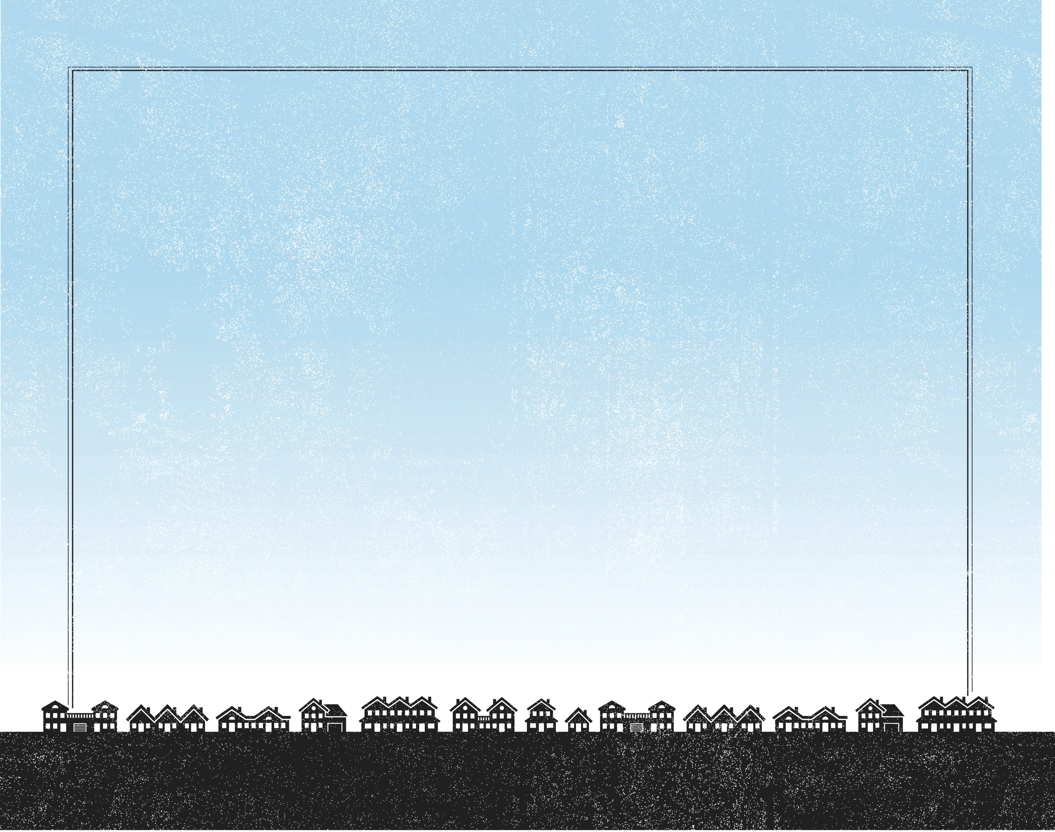
Then He took the five loaves and the two fishes, and looking up to heaven, He blessed them, and brake, and gave to the disciples to set before the multitude. And they did eat, and were all filled: and there was taken up of fragments that remained to them twelve baskets.
^{Luke 9:16-17}

Slide 3
The crowd had a need.
The disciples had an impossible mission.
Jesus had the solution.

Slide 4
Enter Content Here.
Enter content here.
Enter content here
Enter content here

