Slide 1
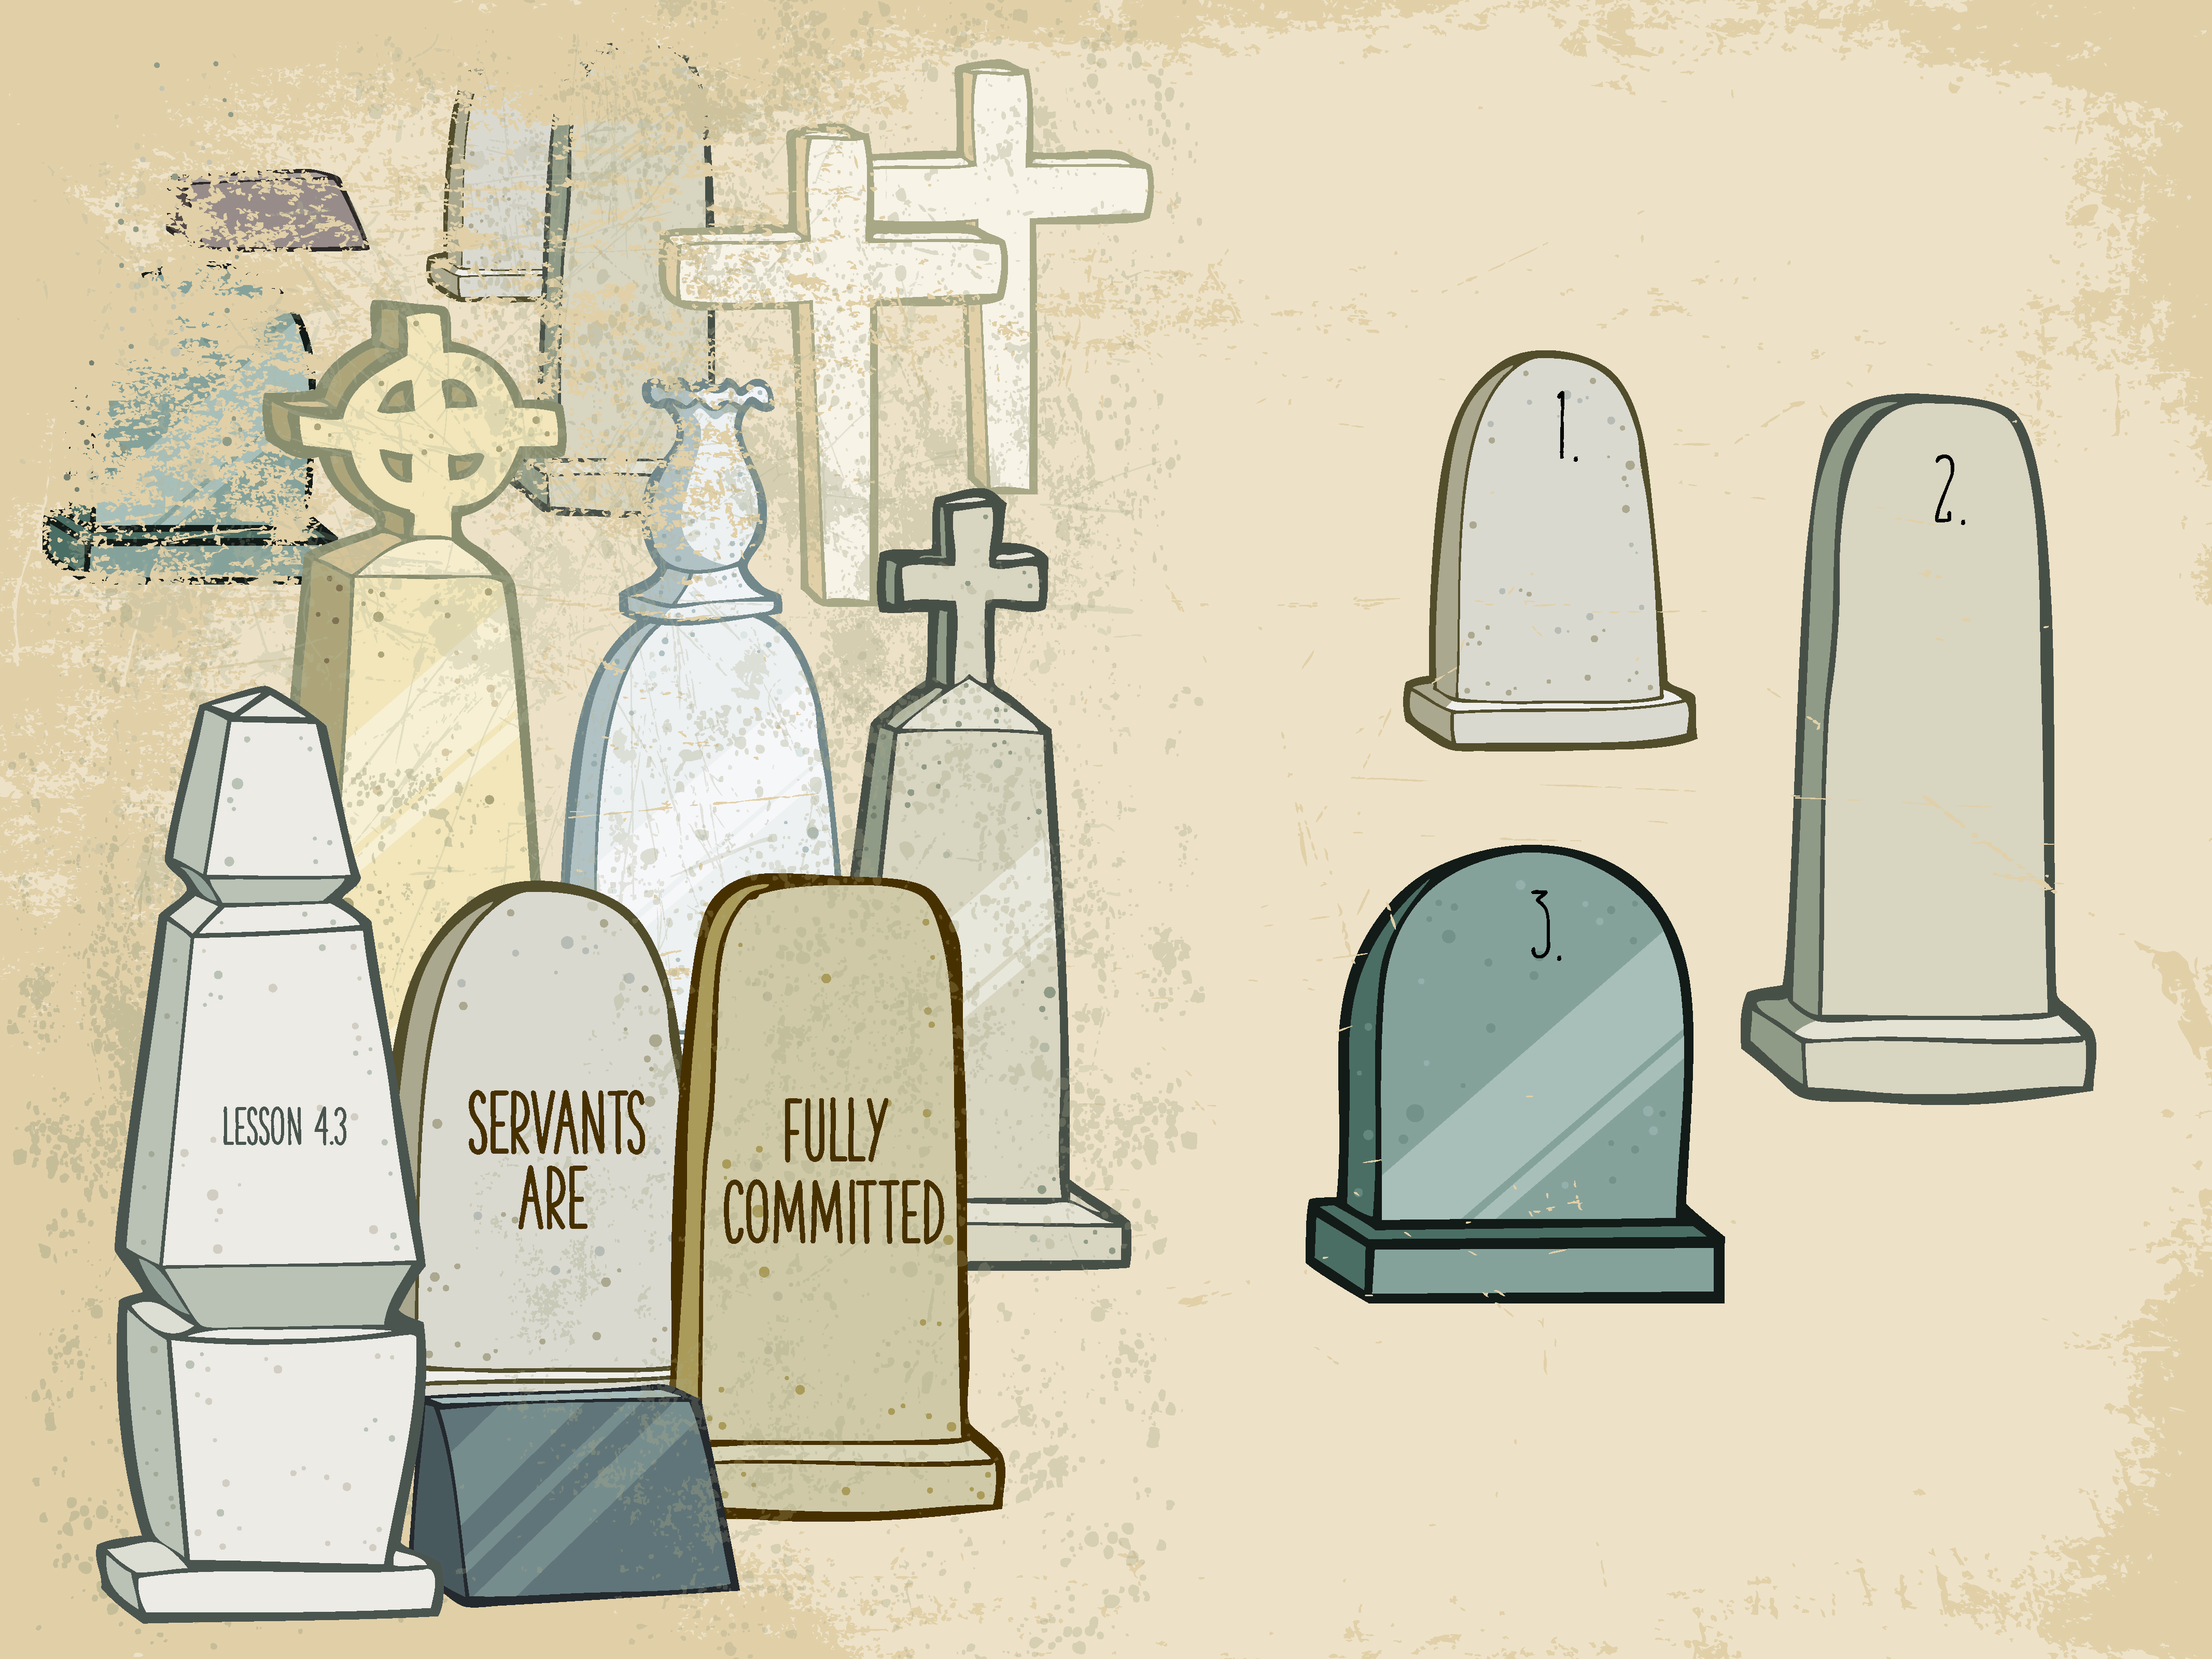

Slide 2

Then said Jesus, “Father, forgive them; for they know not what they do.” And they parted His raiment, and cast lots.
^{Luke 23:34}

Slide 3
Jesus was crucified.
Jesus was fully committed..

Slide 4
Enter Content Here.
Enter content here.
Enter content here
Enter content here

