Slide 1
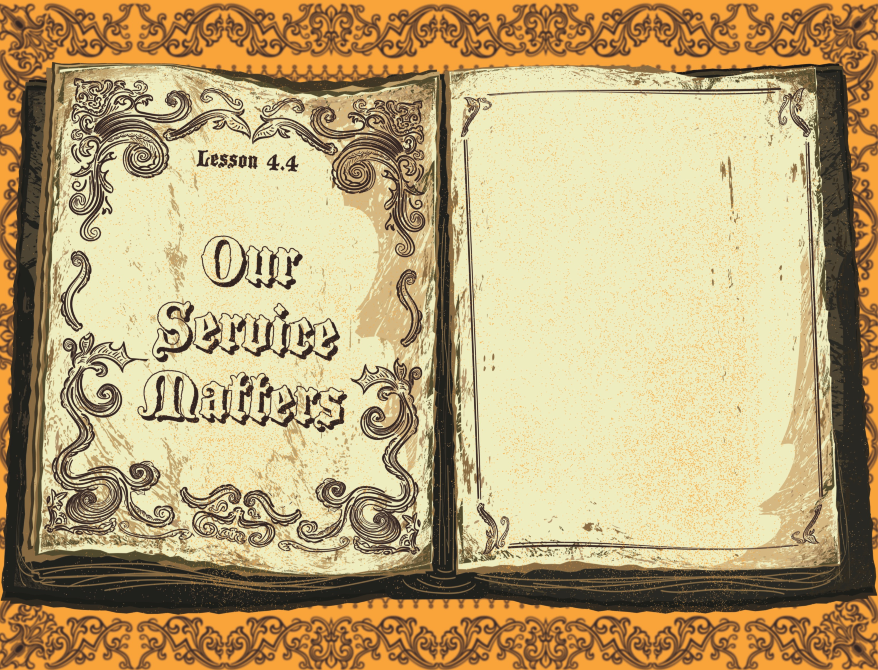

Slide 2

And it was about the sixth hour, and there was a darkness over all the earth until the ninth hour. And the sun was darkened, and the veil of the temple was rent in the midst. And when Jesus had cried with a loud voice, He said, “Father, into Thy hands I commend My spirit:” and having said thus, He gave up the ghost.
^{Luke 23:44-46}

Slide 3
Jesus died on the cross.
Jesus was buried.
Jesus’ service mattered.

Slide 4
Enter Content Here.
Enter content here.
Enter content here
Enter content here

