Slide 1
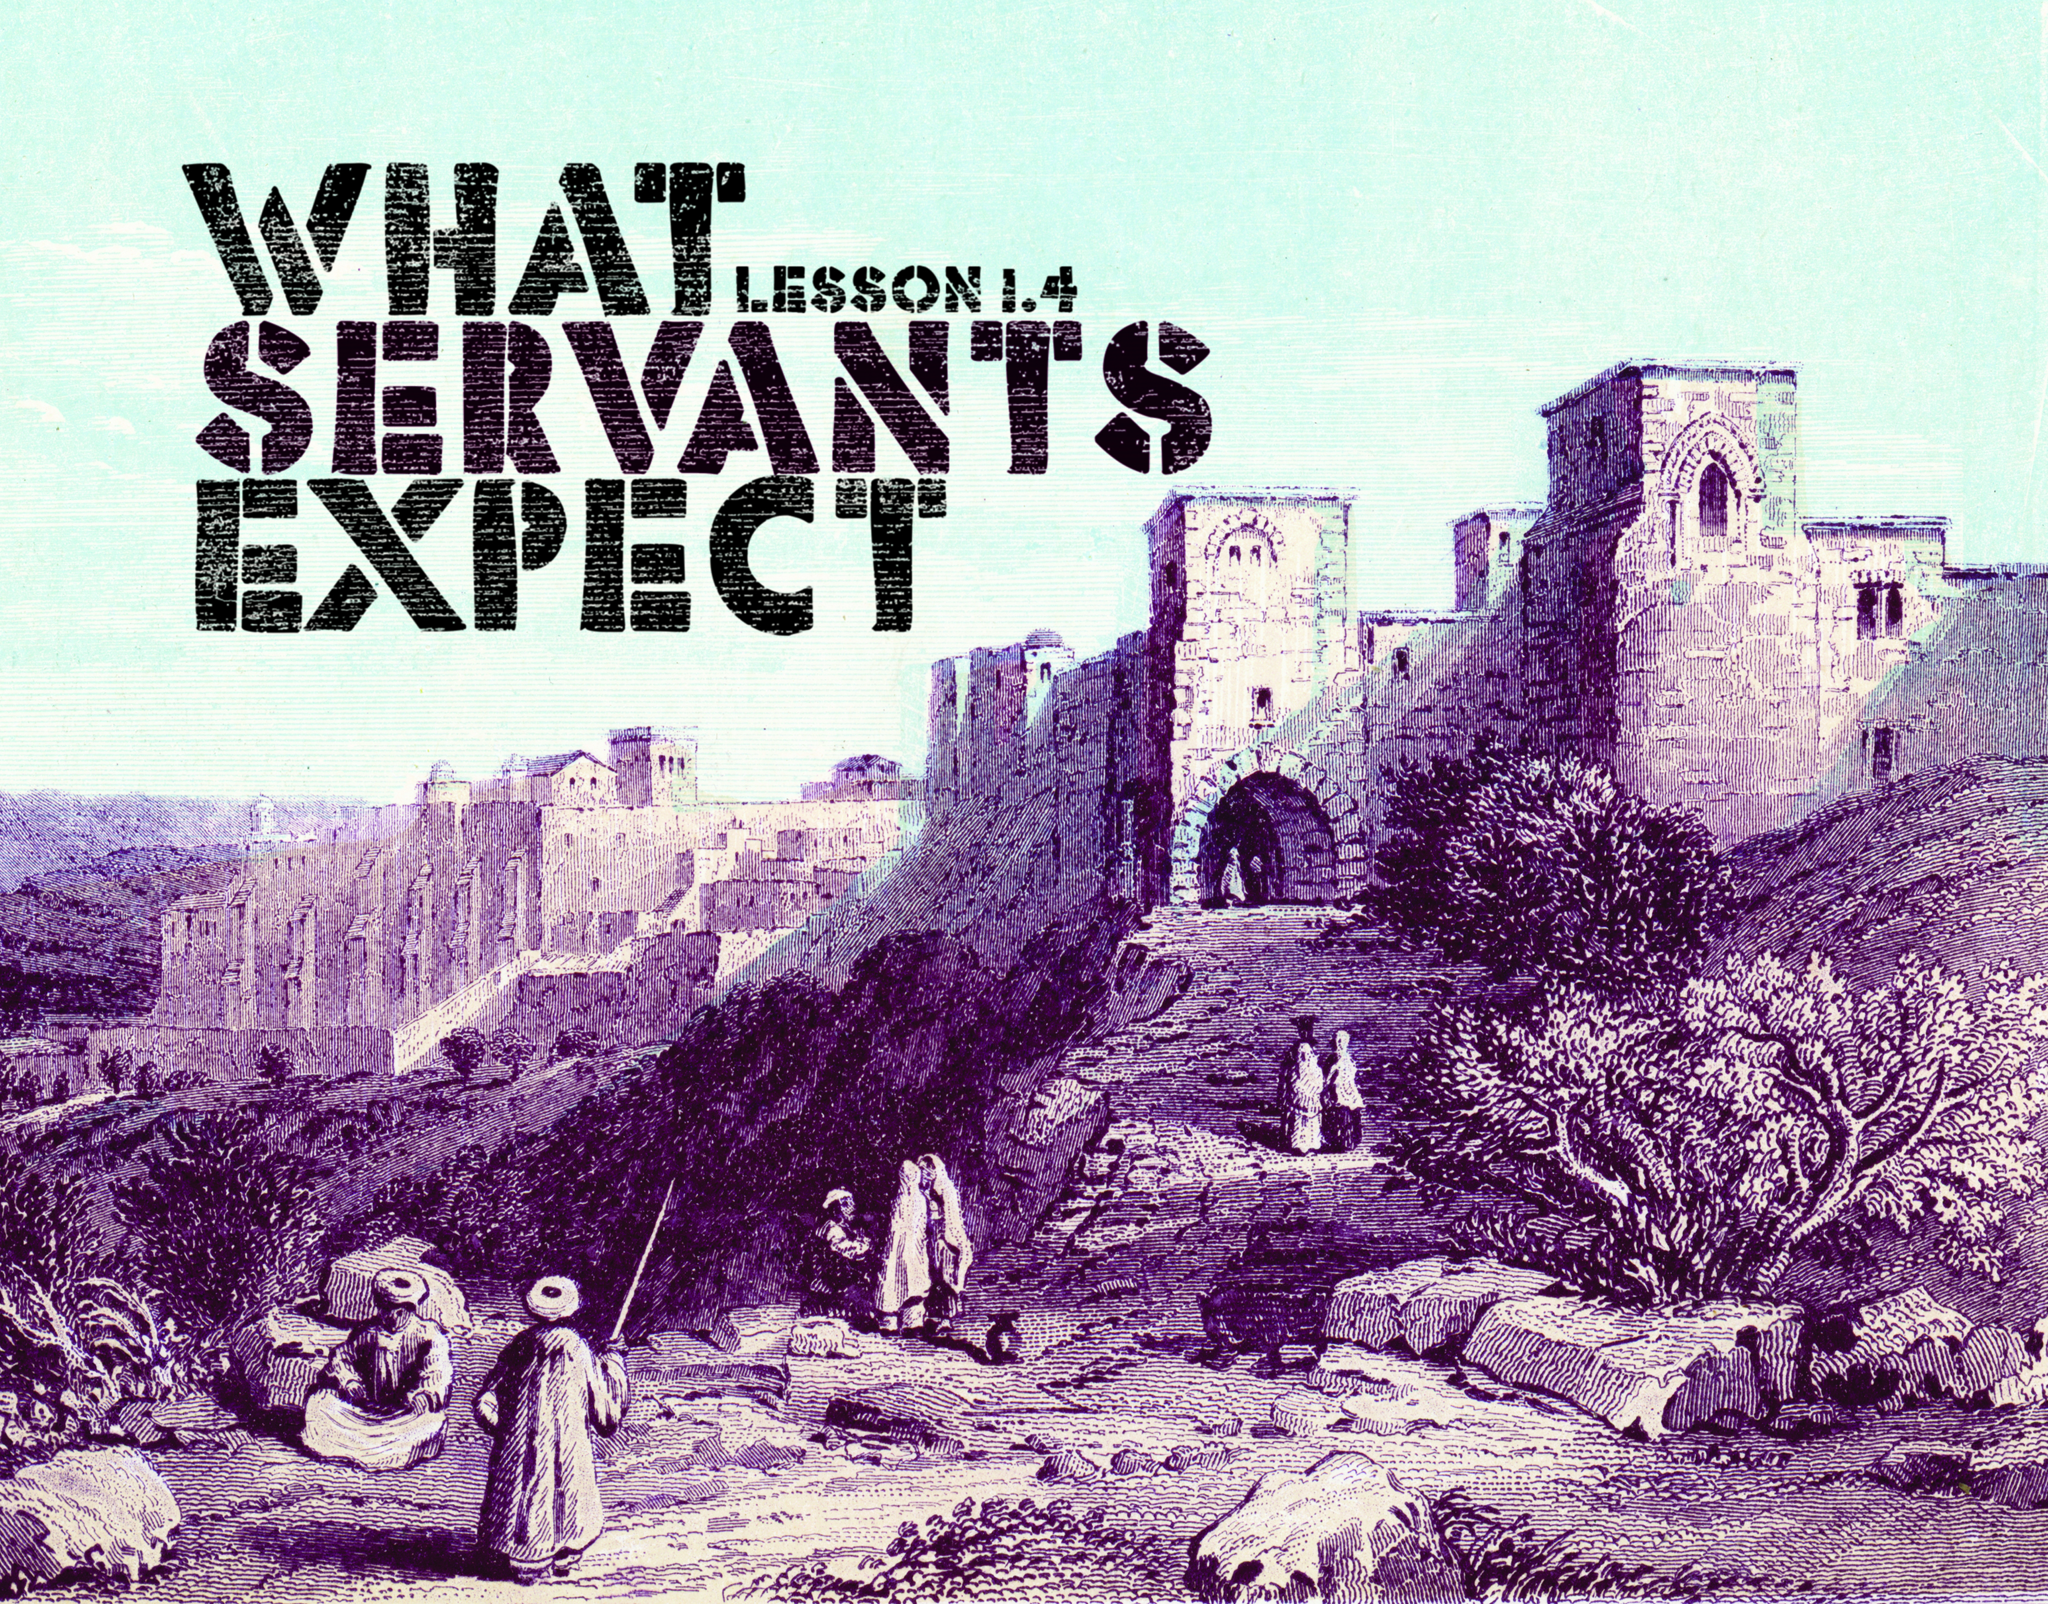

Slide 2
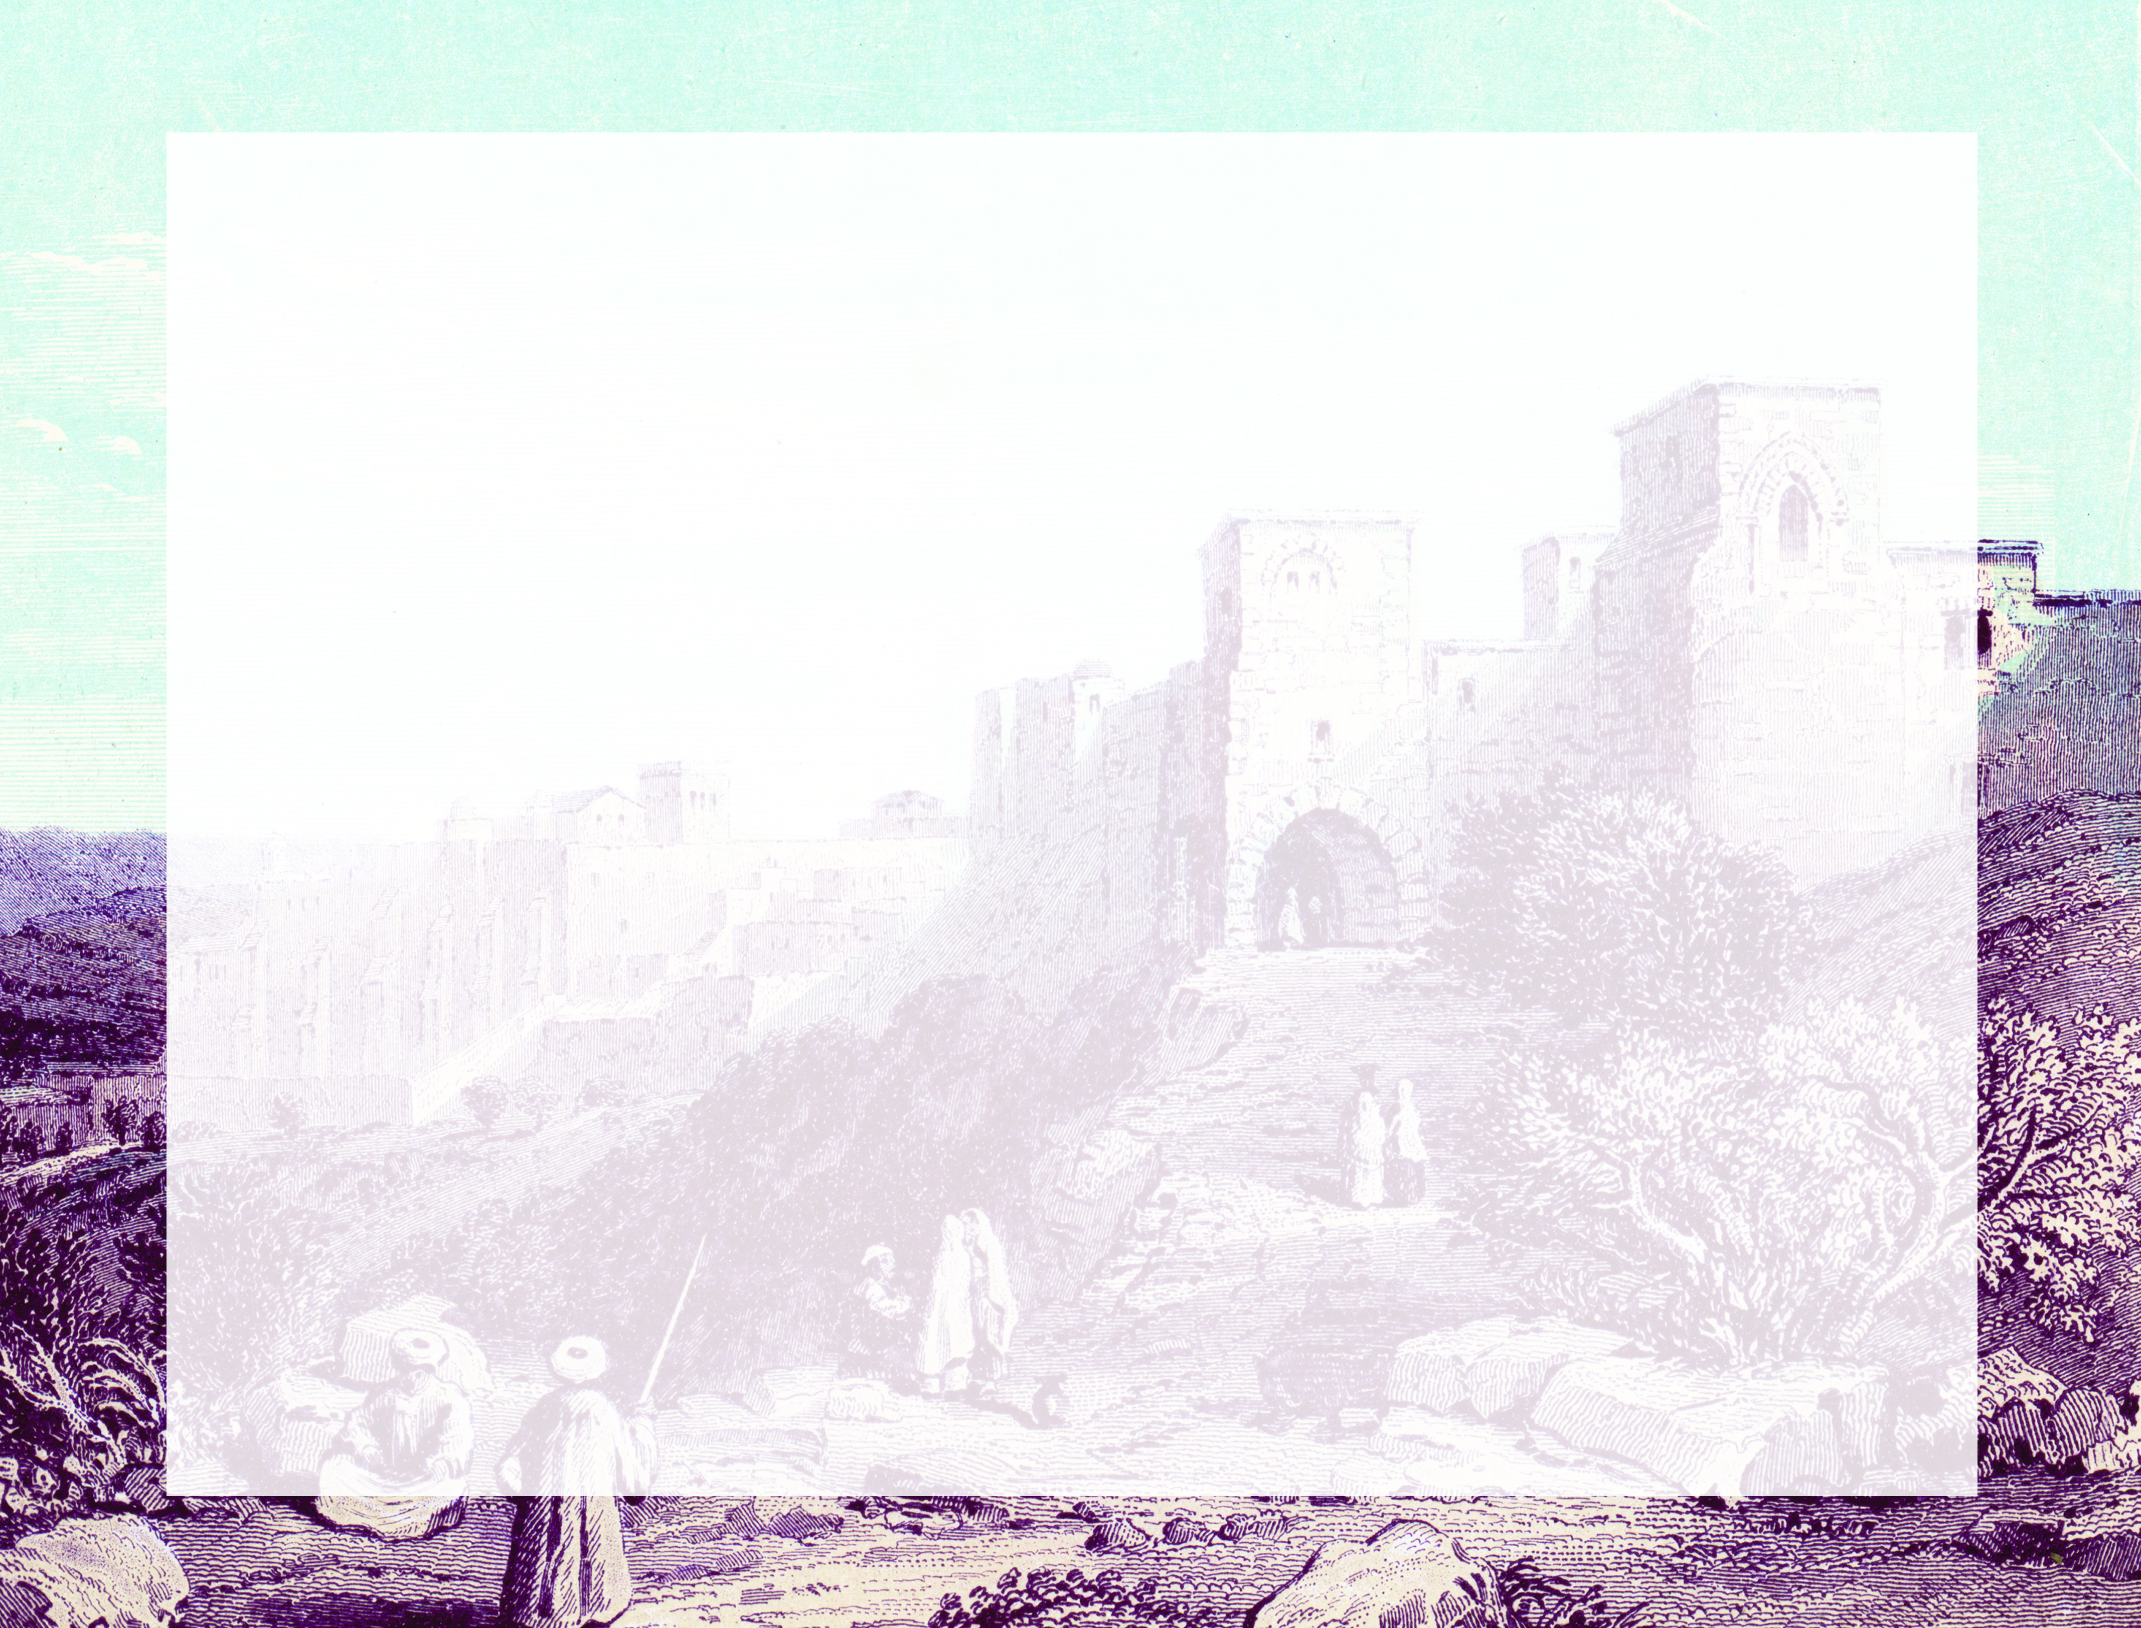
So Joseph also went up from the town of Nazareth in Galilee to Judea, to Bethlehem the town of David, because he belonged to the house and line of David. He went there to register with Mary, who was pledged to be married to him and was expecting a child.
^{Luke 2:4-5}

Slide 3
God surprised Mary and Joseph.
God surprised the shepherds.
God surprises His servants.

Slide 4
Enter Content Here.
Enter content here.
Enter content here
Enter content here

