Slide 1
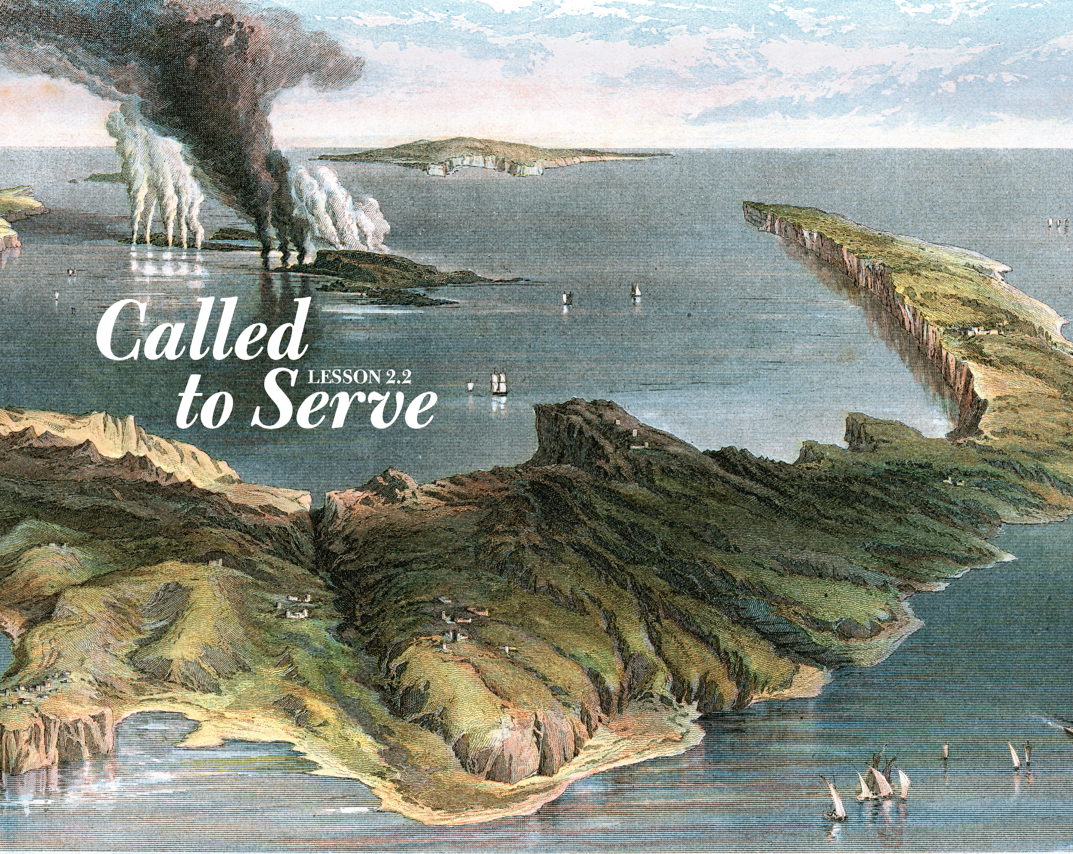

Slide 2
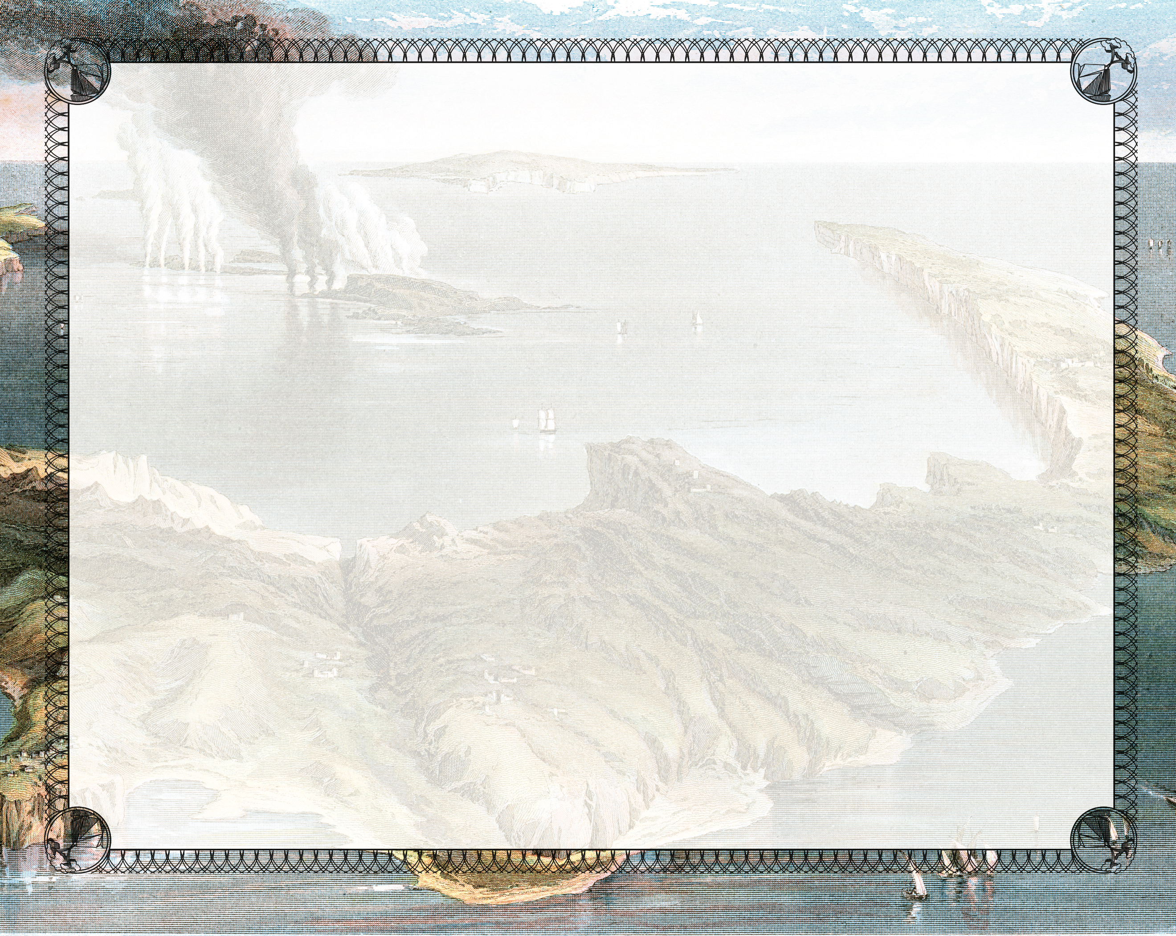
And so were James and John, the sons of Zebedee, Simon’s partners. Then Jesus said to Simon, “Don’t be afraid; from now on you will catch men.” So they pulled their boats up on shore, left everything and followed Him.
^{Luke 5:10-11}

Slide 3
Jesus engaged with Peter.
Jesus instructed Peter.
Jesus enlisted Peter.

Slide 4
Enter Content Here.
Enter content here.
Enter content here
Enter content here

