Slide 1
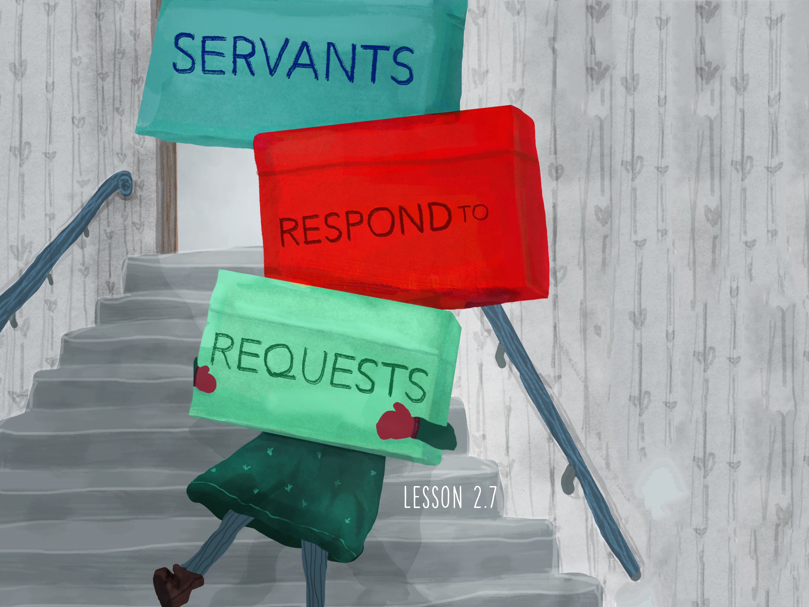

Slide 2

When Jesus heard this, He was amazed at him, and turning to the crowd following Him, He said, “I tell you, I have not found such great faith even in Israel.” Then the men who had been sent returned to the house and found the servant well.
^{Luke 7:9-10}

Slide 3
Jesus is requested to serve.
Jesus is amazed by faith.
Jesus heals the servant.

Slide 4
Enter Content Here.
Enter content here.
Enter content here
Enter content here

