Slide 1


Slide 2
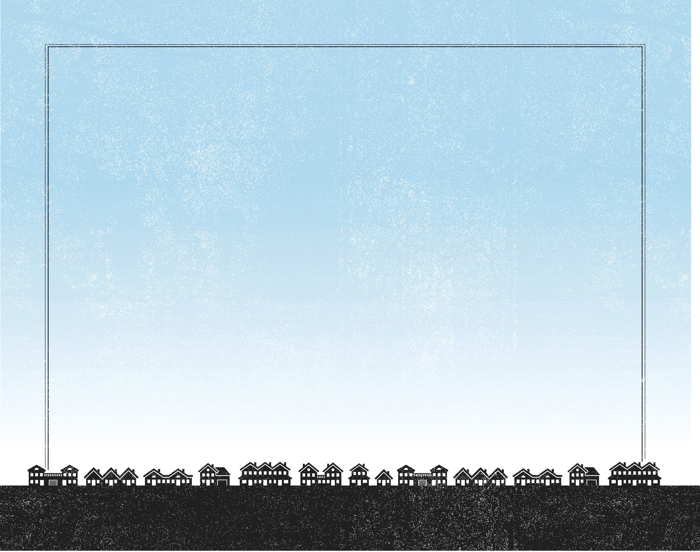
Taking the five loaves and the two fish and looking up to heaven, He gave thanks and broke them. Then He gave them to the disciples to set before the people. They all ate and were satisfied, and the disciples picked up twelve basketfuls of broken pieces that were left over.
^{Luke 9:16-17}

Slide 3
The crowd had a need.
The disciples had an impossible mission.
Jesus had the solution.

Slide 4
Enter Content Here.
Enter content here.
Enter content here
Enter content here

