Slide 1
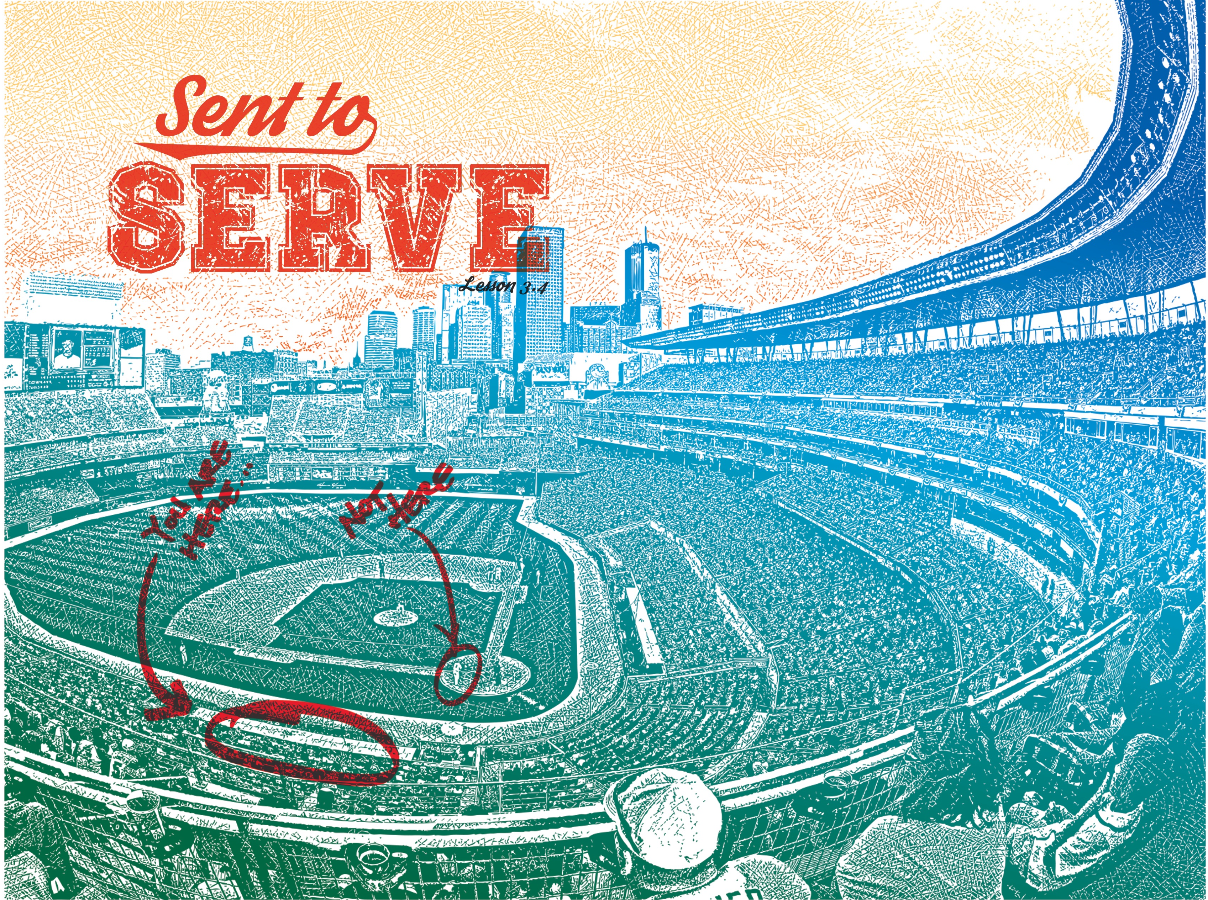

Slide 2

He told them, “The harvest is plentiful, but the workers are few. Ask the Lord of the harvest, therefore, to send out workers into His harvest field.”
^{Luke 10:2}

Slide 3
Servants have a mission.
Serving isn’t always safe.
Serving brings great joy!

Slide 4
Enter Content Here.
Enter content here.
Enter content here
Enter content here

