Slide 1
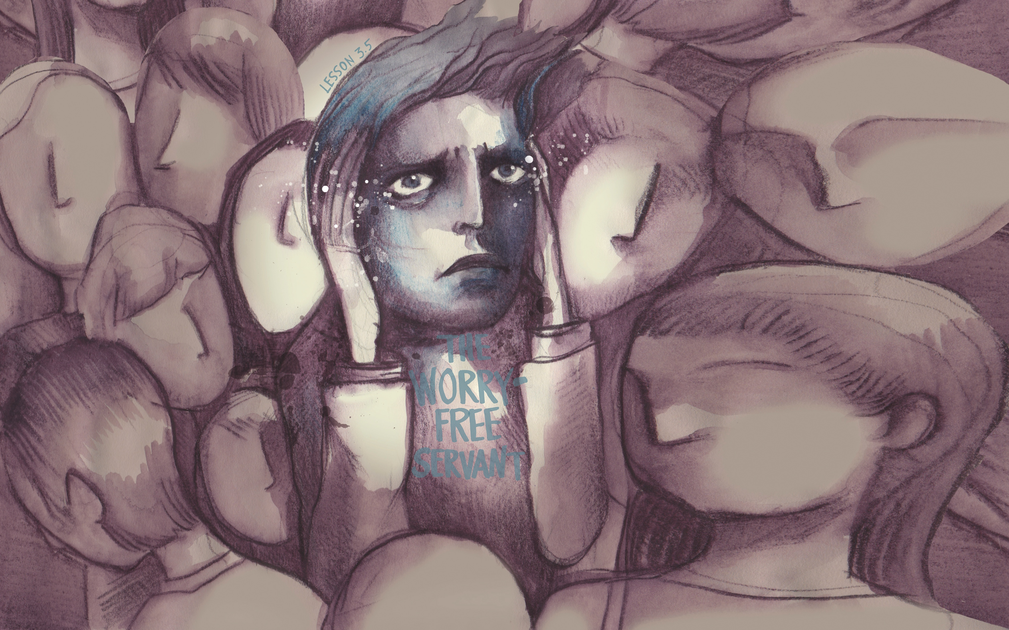

Slide 2
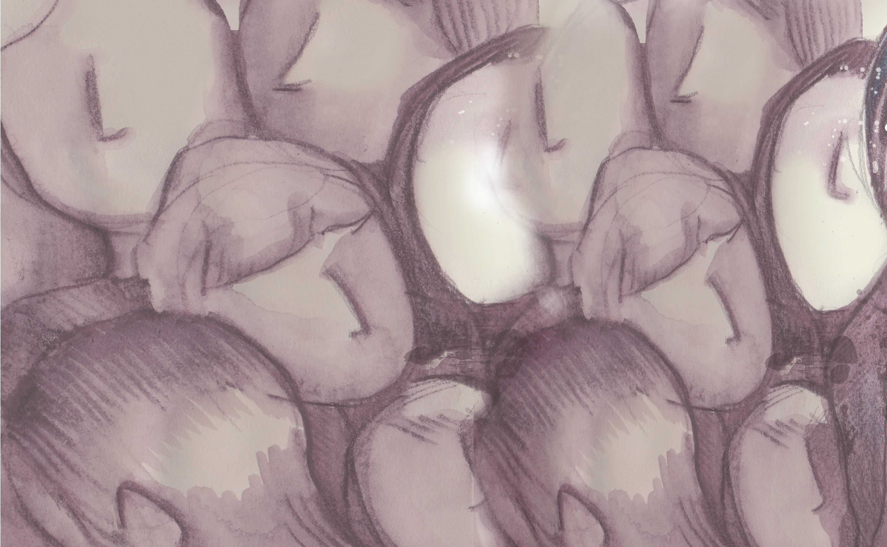
“Martha, Martha,” the Lord answered, “you are worried and upset about many things, but only one thing is needed. Mary has chosen what is better, and it will not be taken away from her.”
^{Luke 10:41-42}

Slide 3
Mary listened to Jesus.
Martha was distracted.
Choose Jesus, not your worries.

Slide 4
Enter Content Here.
Enter content here.
Enter content here
Enter content here

