Slide 1
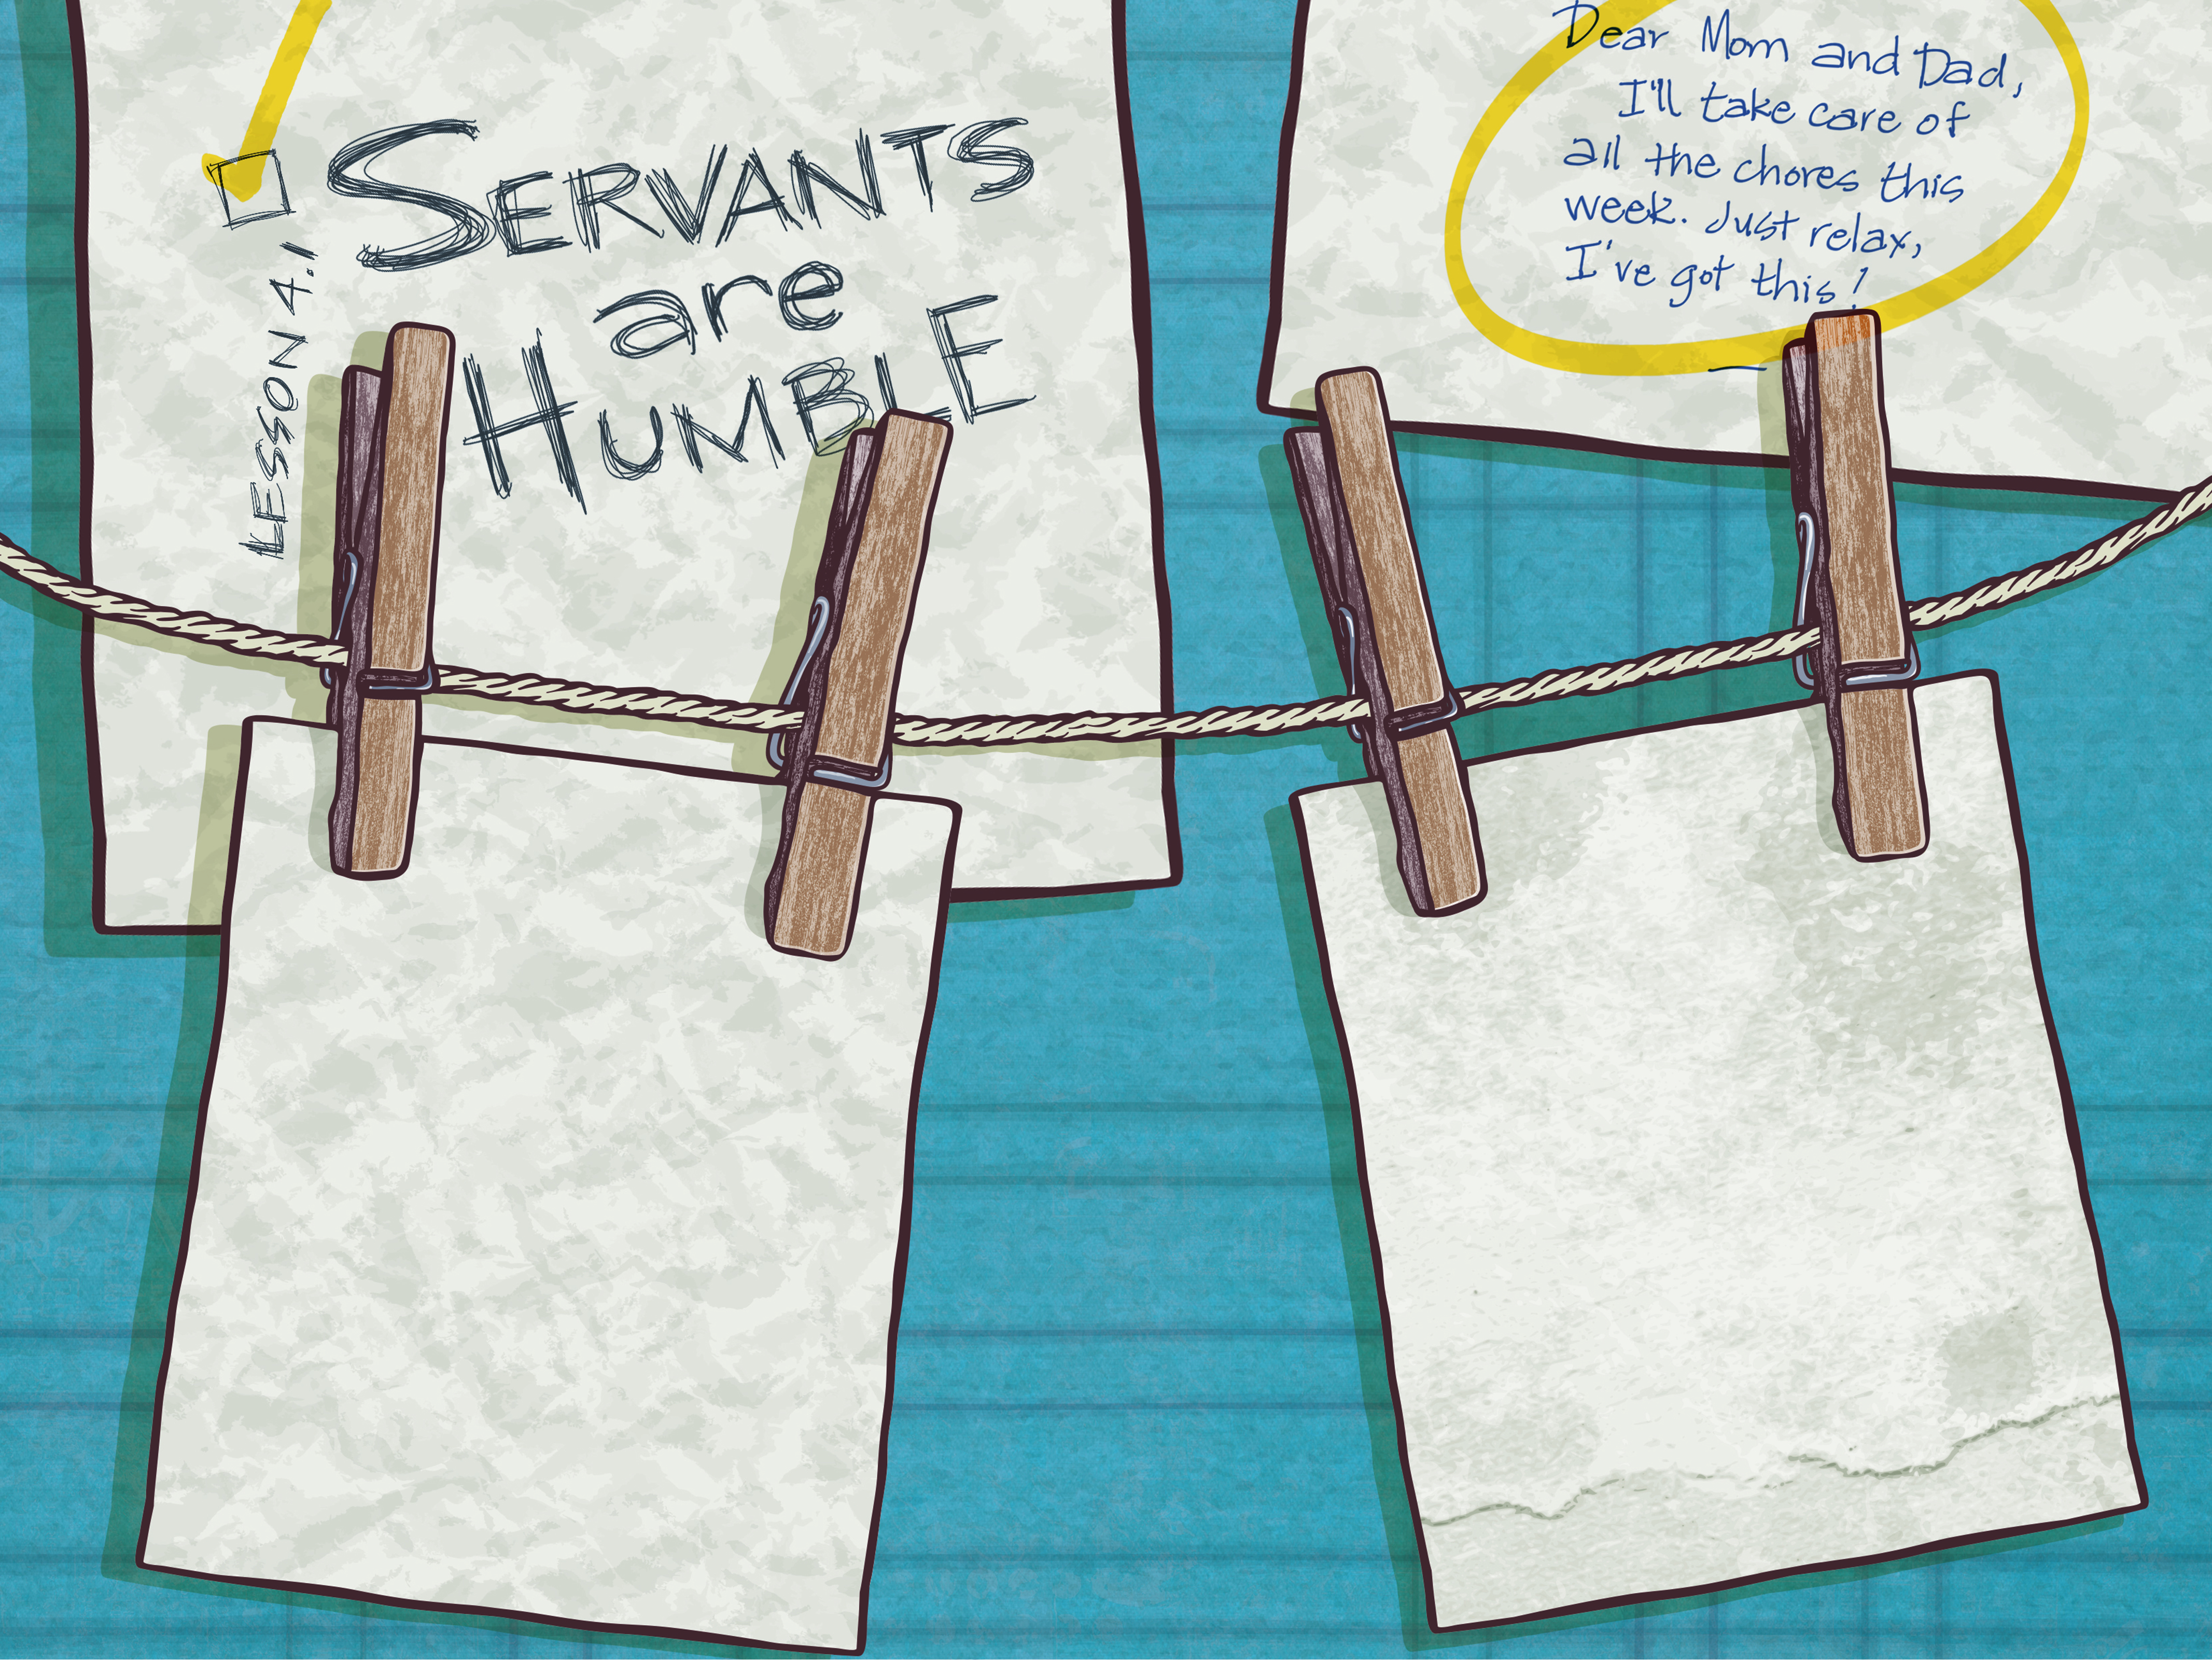

Slide 2

But you are not to be like that. Instead, the greatest among you should be like the youngest, and the one who rules like the one who serves. For who is greater, the one who is at the table or the one who serves? Is it not the one who is at the table? But I am among you as one who serves.
^{Luke 22:26-27}

Slide 3
Jesus and His disciples celebrate Passover.
The disciples don’t get it.
Jesus demonstrates humility.

Slide 4
Enter Content Here.
Enter content here.
Enter content here
Enter content here

