Slide 1
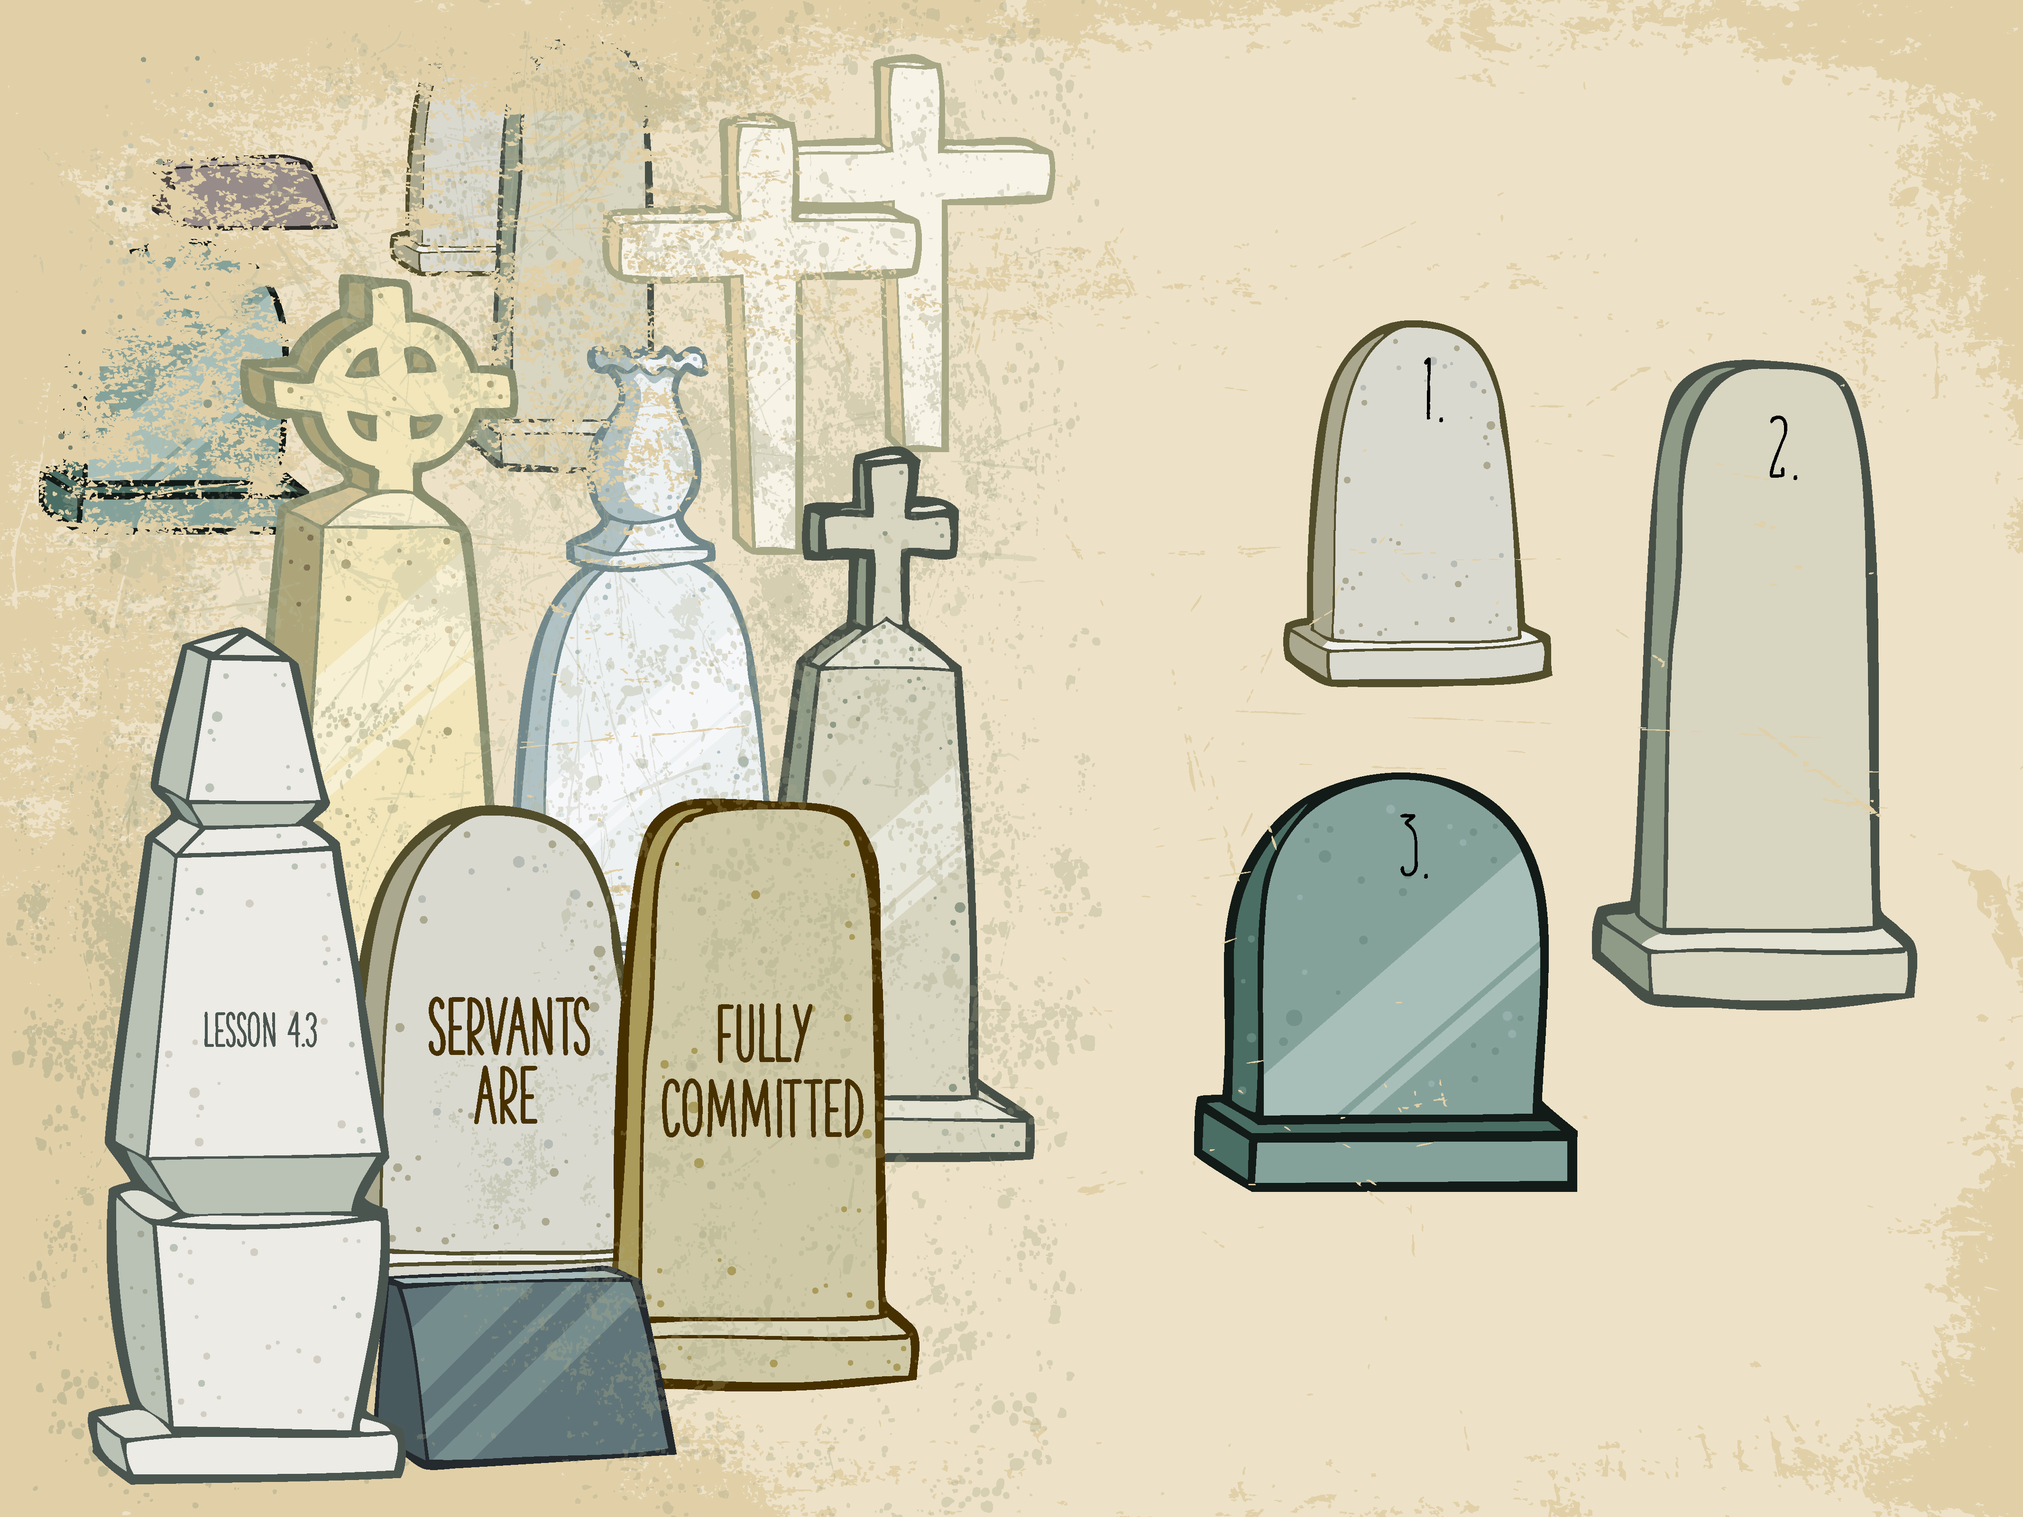

Slide 2

Jesus said, “Father, forgive them, ^{for they do not know what they} are doing.” And they divided up ^{His clothes by casting lots.}
^{Luke 23:34}

Slide 3
Jesus was crucified.
Jesus was fully committed..

Slide 4
Enter Content Here.
Enter content here.
Enter content here
Enter content here

