Slide 1
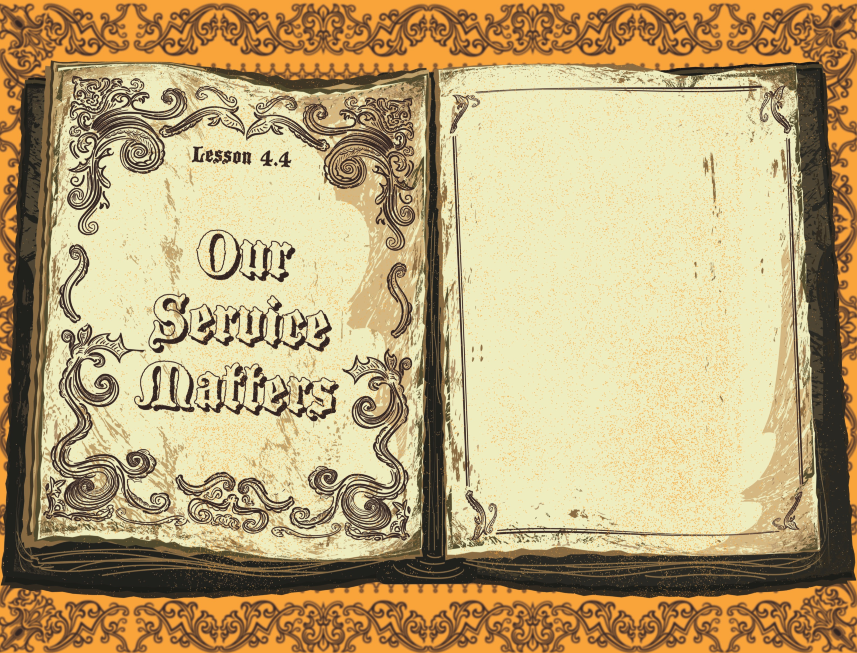

Slide 2

It was now about the sixth hour, and darkness came over the whole land until the ninth hour, for the sun stopped shining. And the curtain of the temple was torn in two. Jesus called out with a loud voice, “Father, into Your hands I commit My spirit.” When He had said this, He breathed His last.
^{Luke 23:44-46}

Slide 3
Jesus died on the cross.
Jesus was buried.
Jesus’ service mattered.

Slide 4
Enter Content Here.
Enter content here.
Enter content here
Enter content here

