Slide 1
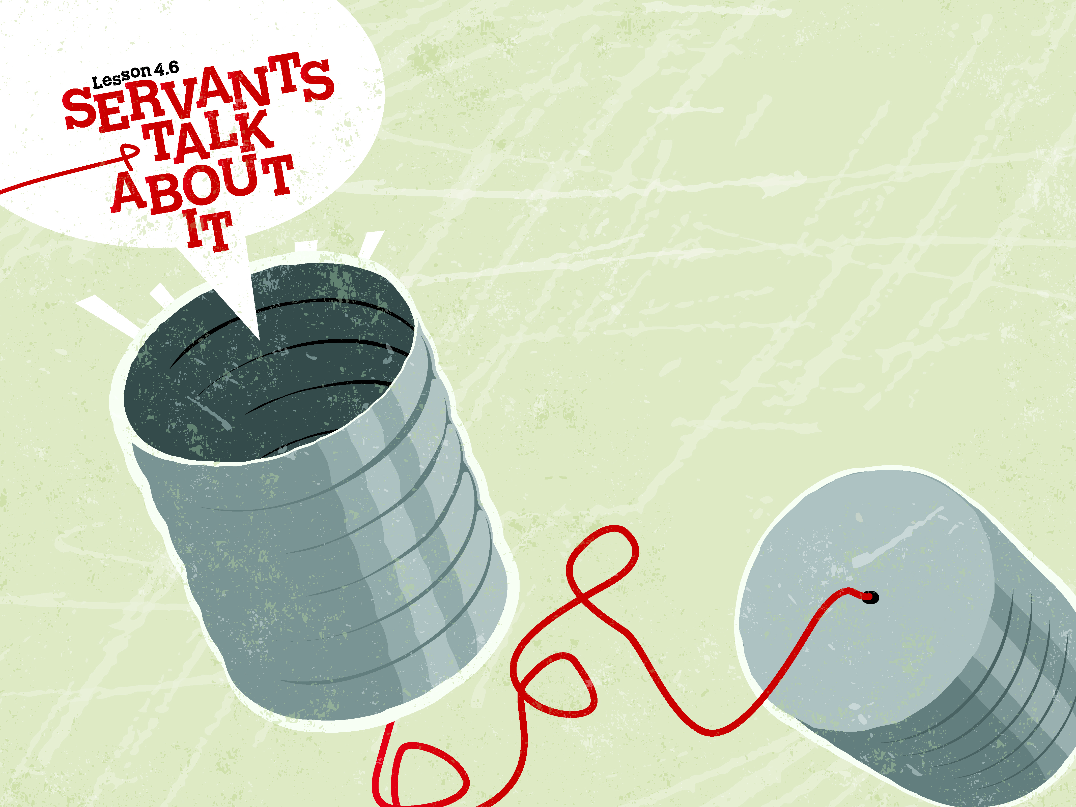

Slide 2

He said to them, “How foolish you are, and how slow of heart to believe all that the prophets have spoken! Did not the Christ have to suffer these things and then enter His glory?”
^{Luke 24:25-26}

Slide 3
Two men were walking toward Emmaus.
A stranger met up with them.
They found out that Jesus is alive and left to tell others.

Slide 4
Enter Content Here.
Enter content here.
Enter content here
Enter content here

