Slide 1
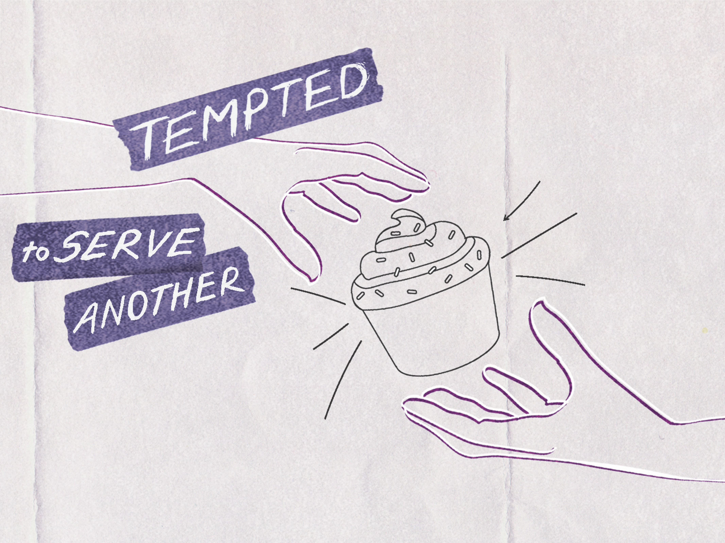

Slide 2

And Jesus answered and said to him, “Get behind Me, Satan! For it is written, ‘You shall worship the Lord your God, and Him only you shall serve.’ ”
^{Luke 4:8}

Slide 3
The Holy Spirit led Jesus into the wilderness.
Jesus was tempted.
Jesus was victorious.

Slide 4
Enter Content Here.
Enter content here.
Enter content here
Enter content here

