Slide 1
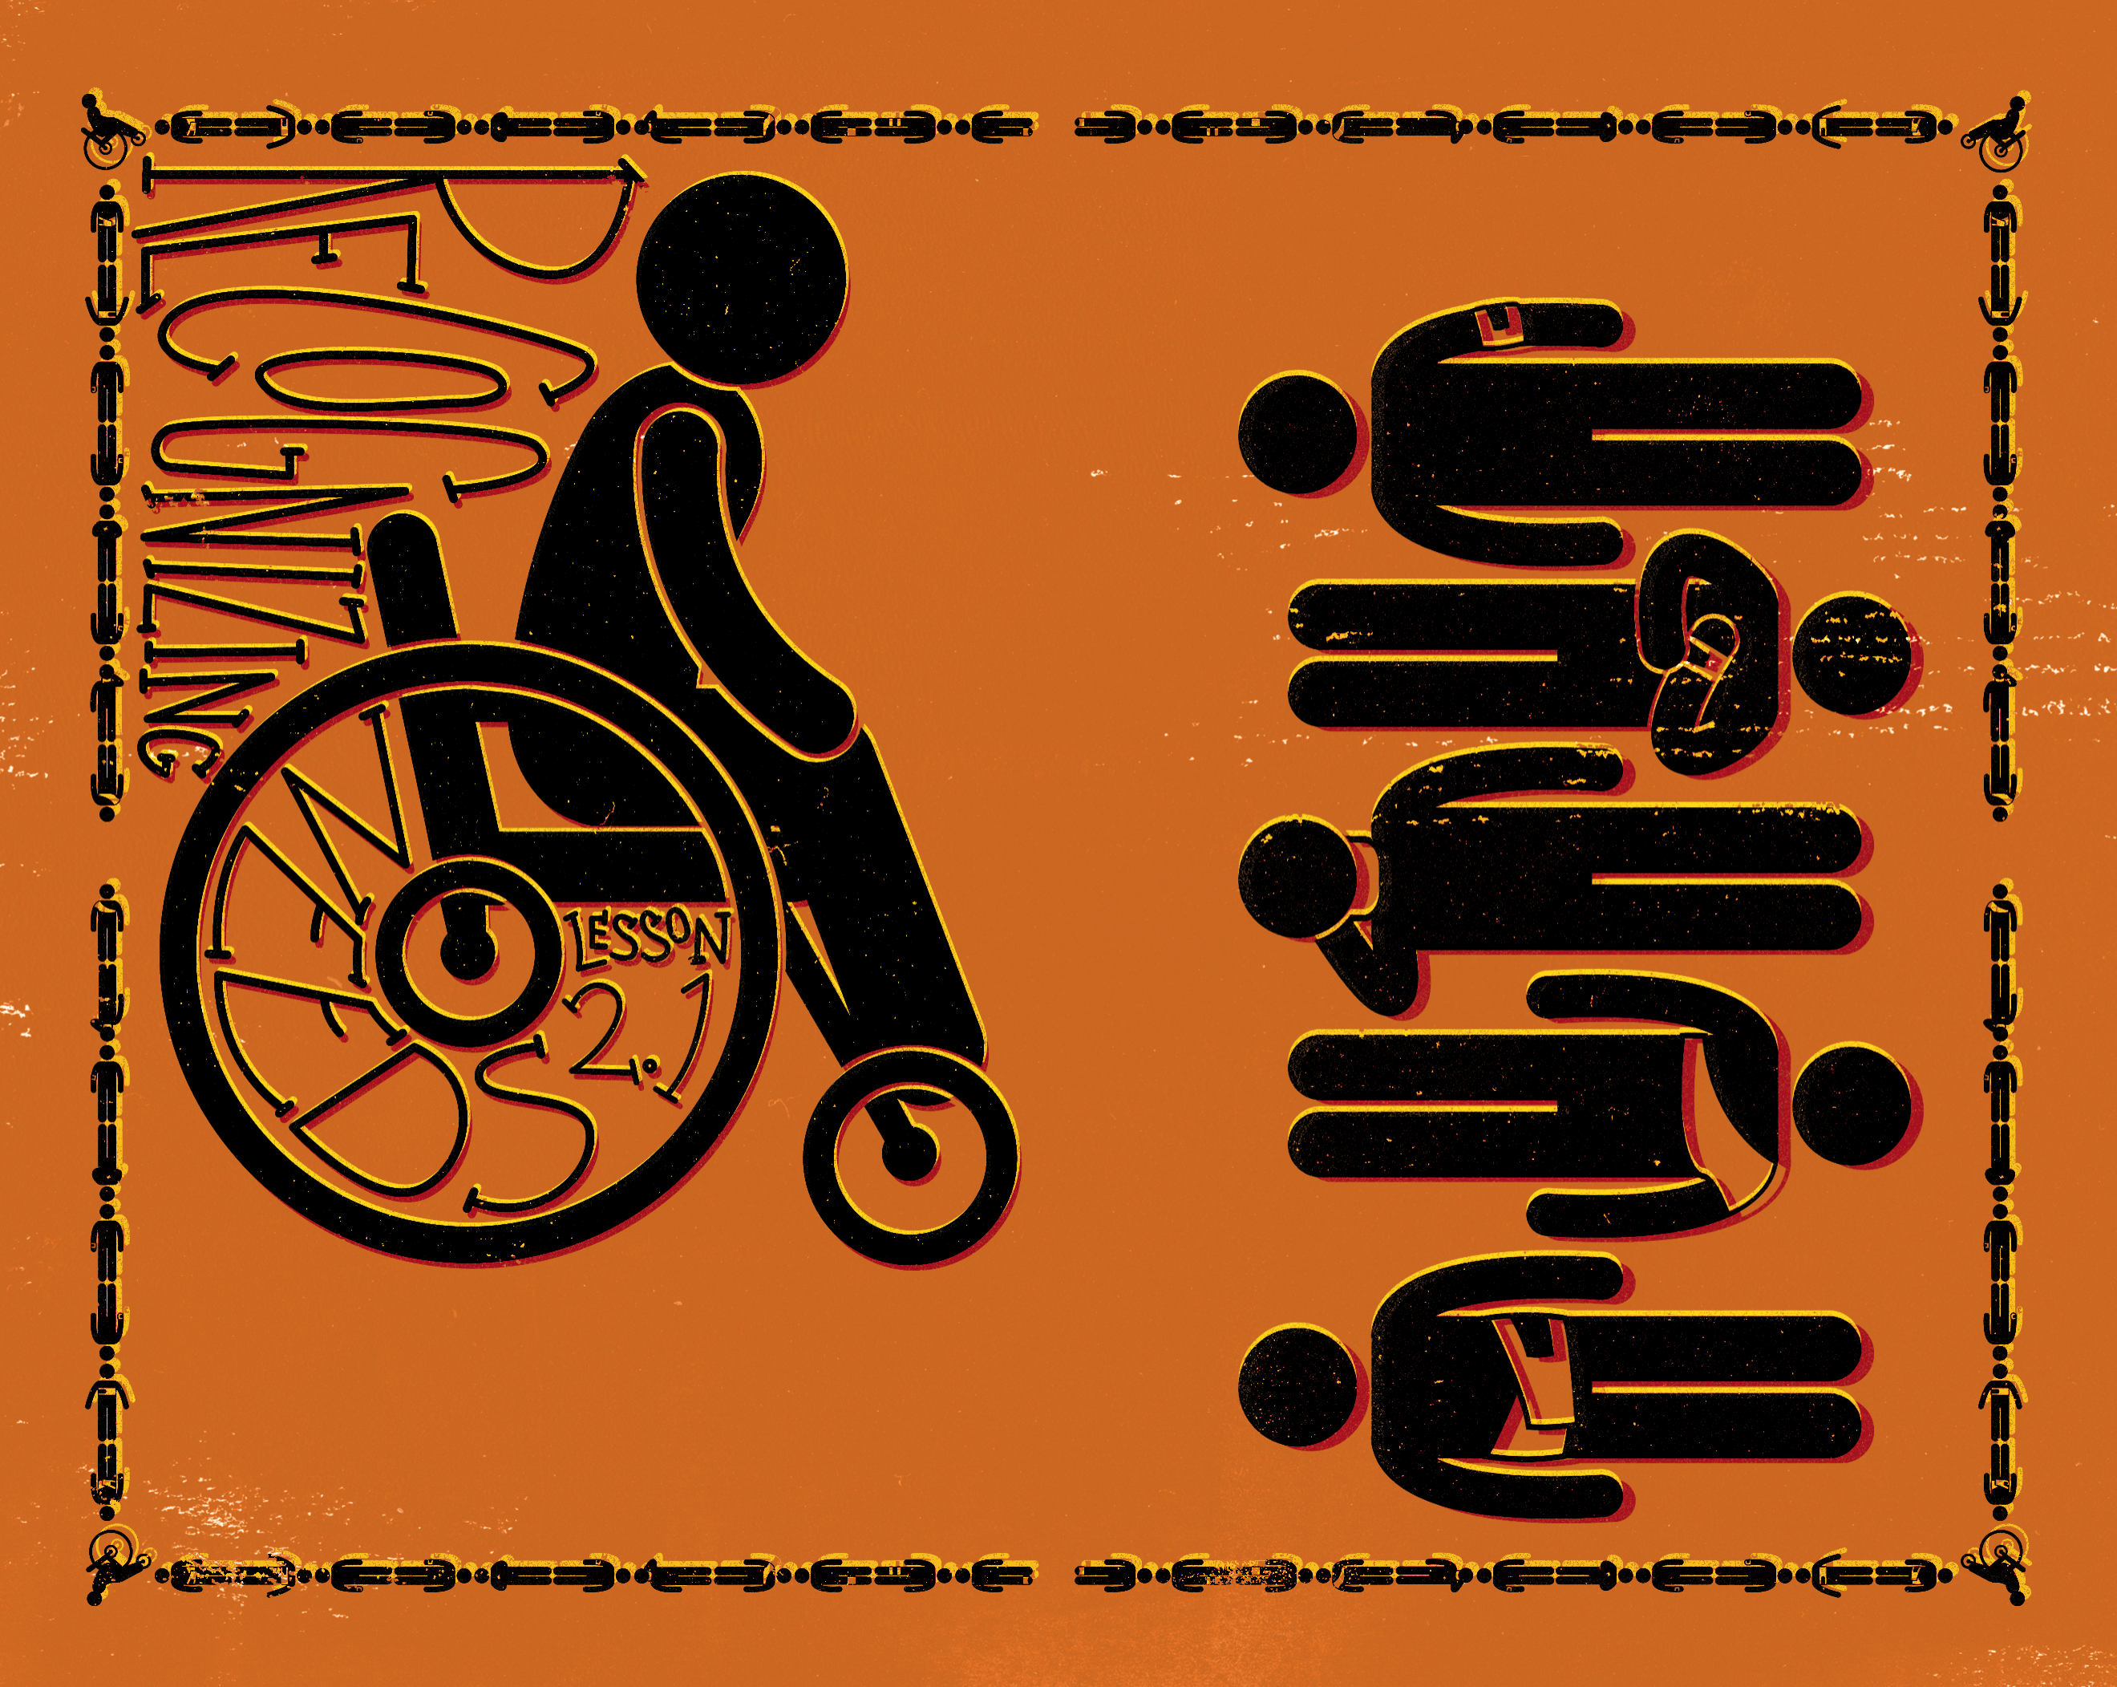

Slide 2

When the sun was setting, all those who had any that were sick with various diseases brought them to Him; and He laid His hands on every one of them and healed them.
^{Luke 4:40}

Slide 3
Jesus recognized needs.
Jesus responded to needs.
Jesus served and met a variety of needs.

Slide 4
Enter Content Here.
Enter content here.
Enter content here
Enter content here

