Slide 1
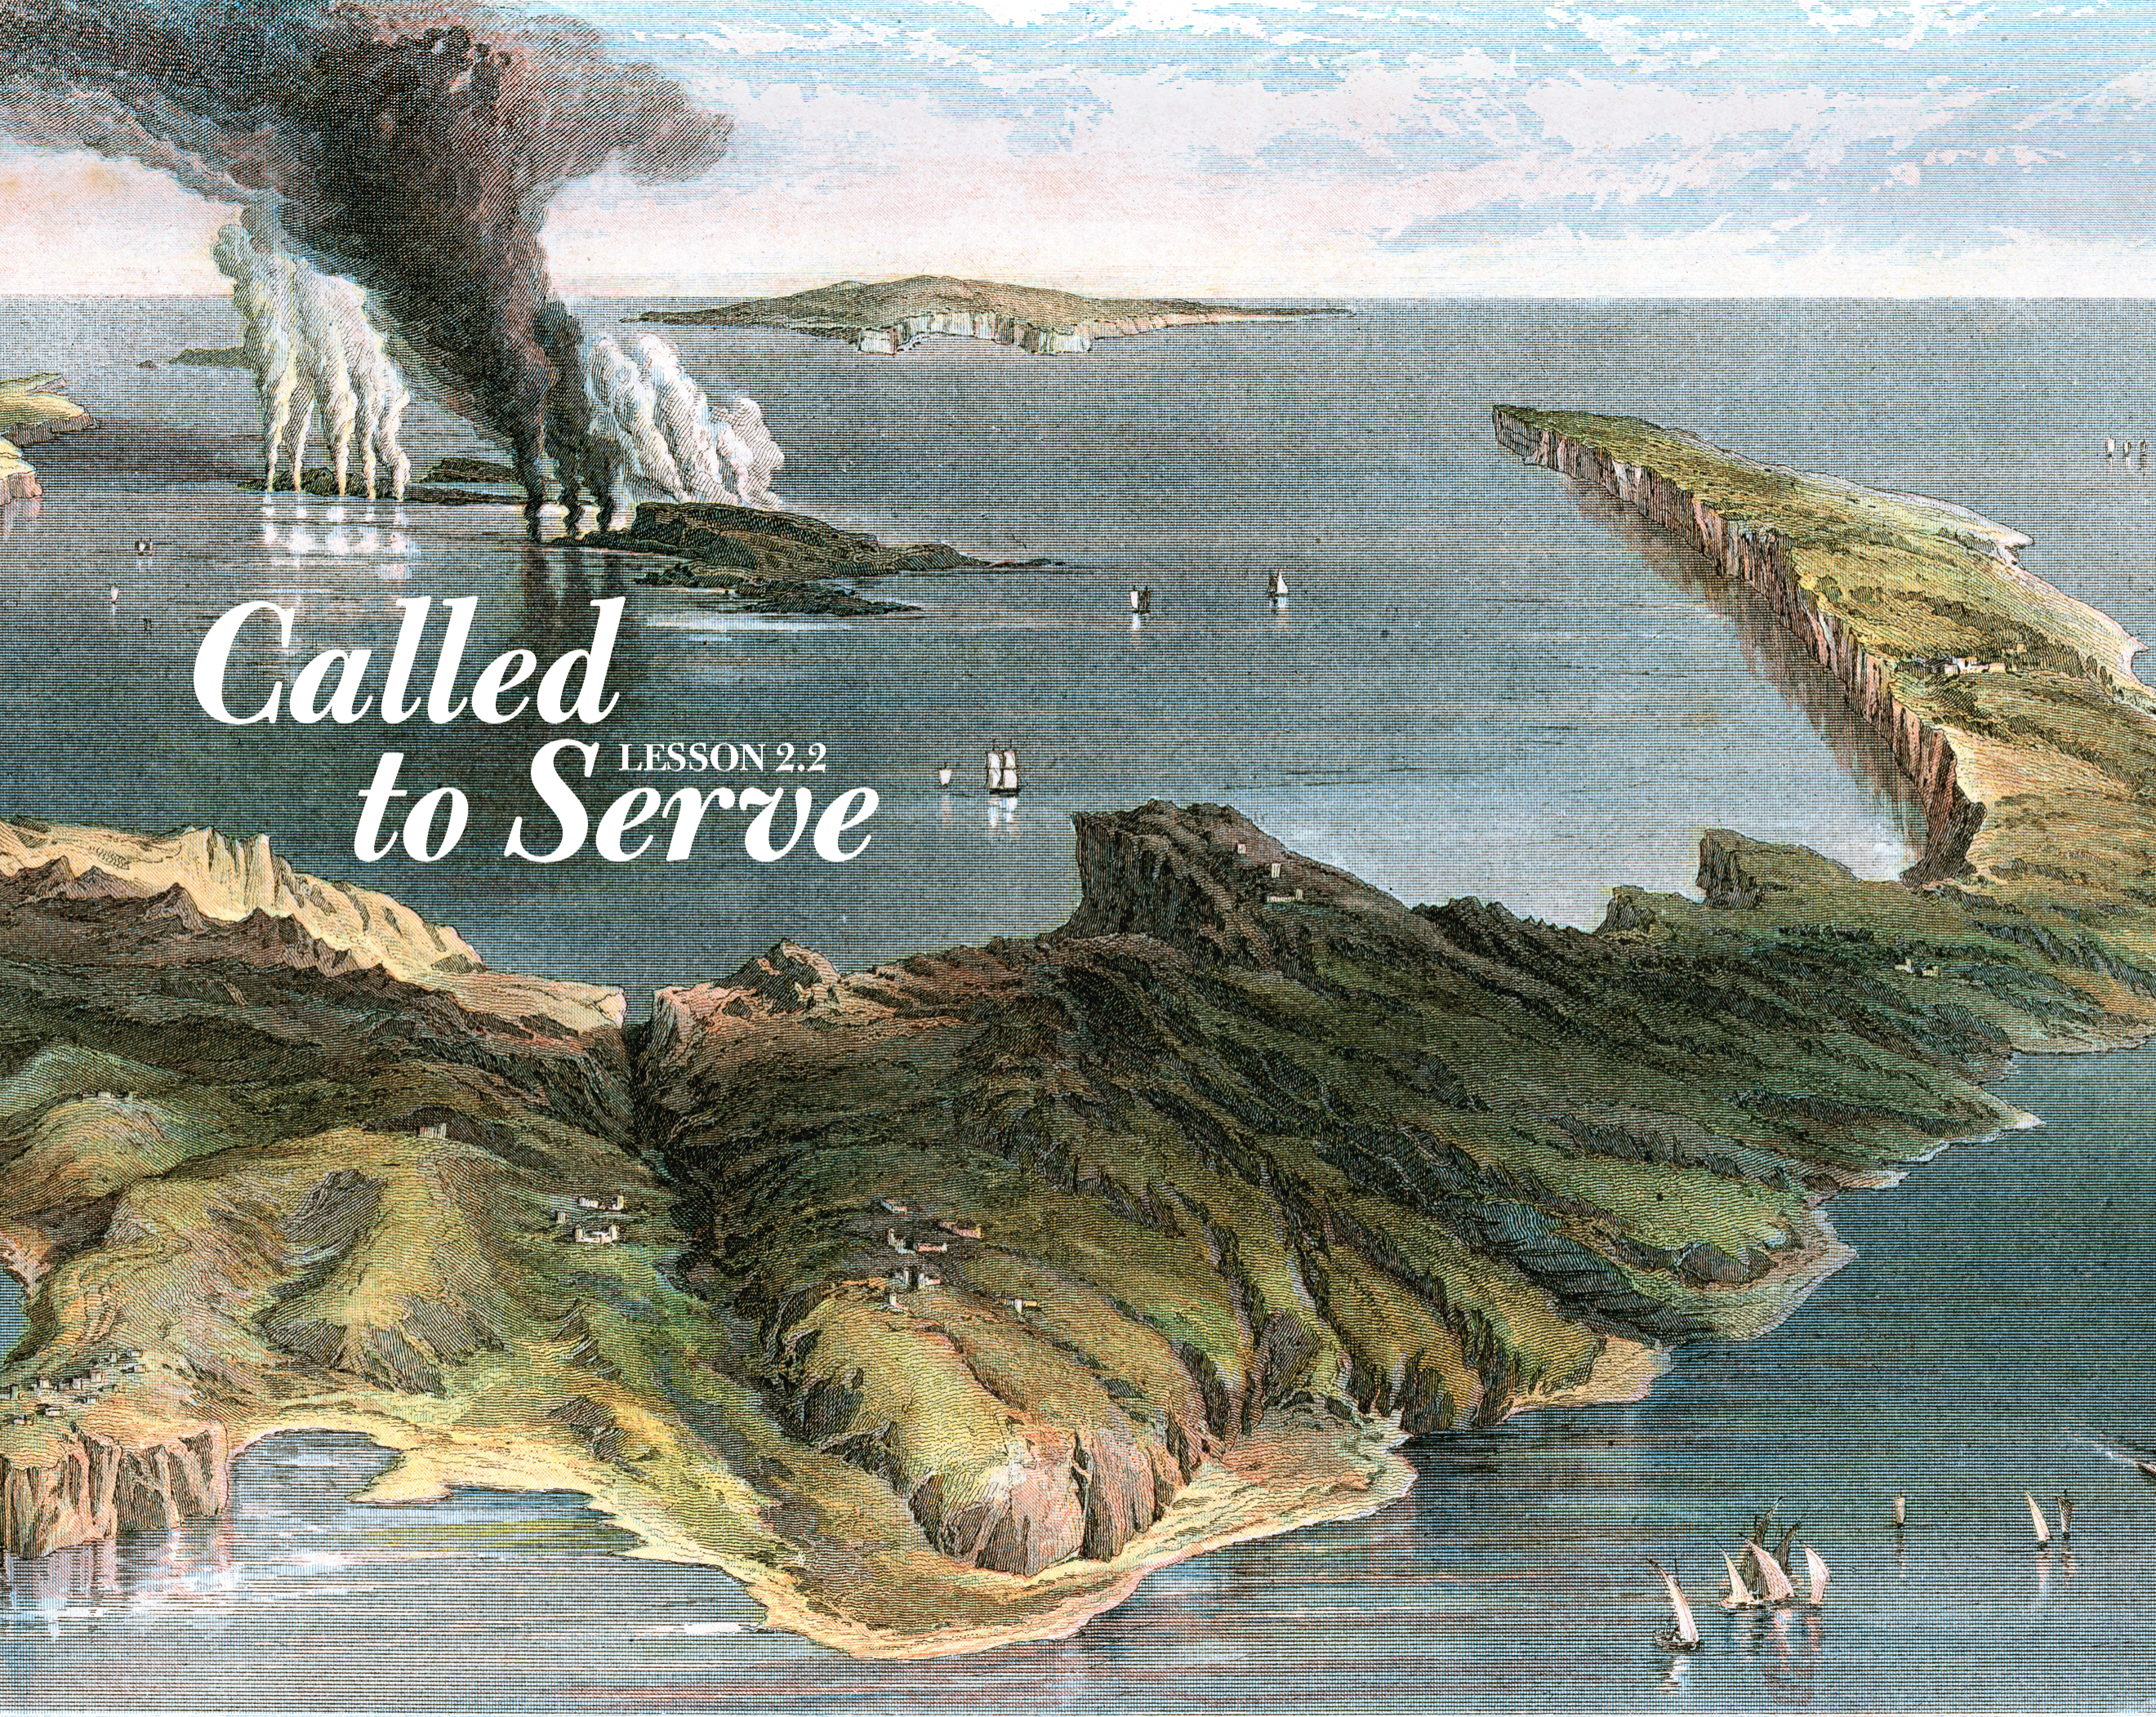

Slide 2
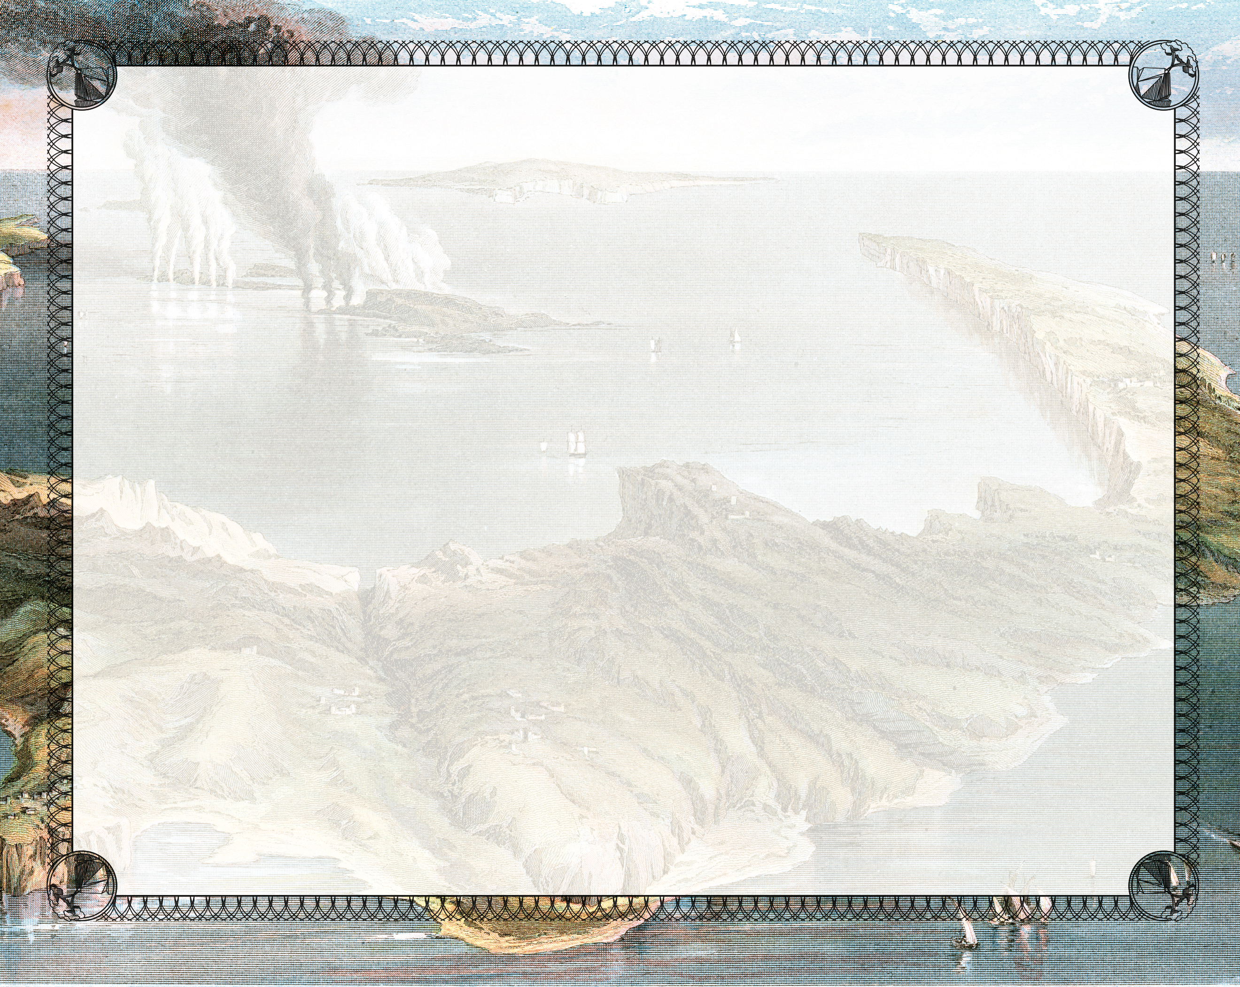
And so also were James and John, the sons of Zebedee, who were partners with Simon. And Jesus said to Simon, “Do not be afraid. From now on you will catch men.” So when they had brought their boats to land, they forsook all and followed Him.
^{Luke 5:10-11}

Slide 3
Jesus engaged with Peter.
Jesus instructed Peter.
Jesus enlisted Peter.

Slide 4
Enter Content Here.
Enter content here.
Enter content here
Enter content here

