Slide 1


Slide 2
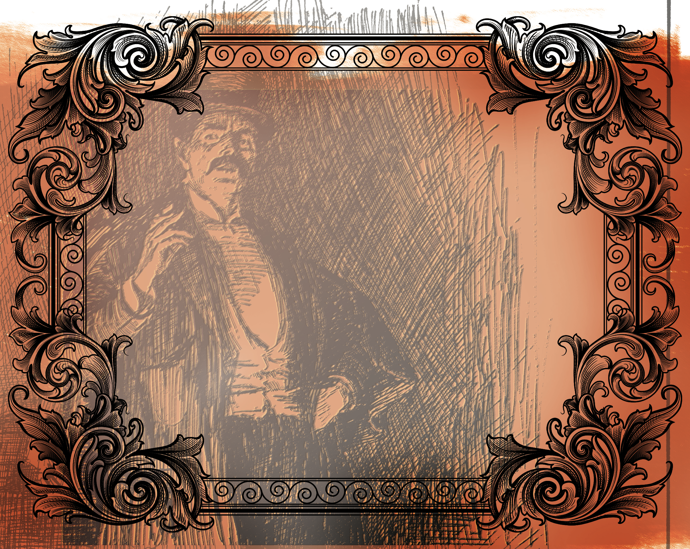
But love your enemies, do good, and lend, hoping for nothing in return; and your reward will be great, and you will be sons of the Most High. For He is kind to the unthankful and evil. Therefore be merciful, just as your Father also is merciful.
^{Luke 6:35-36}

Slide 3
Jesus said to love our enemies.
Show your enemies compassion.
Show your enemies grace as you have been shown grace.

Slide 4
Enter Content Here.
Enter content here.
Enter content here
Enter content here

