Slide 1
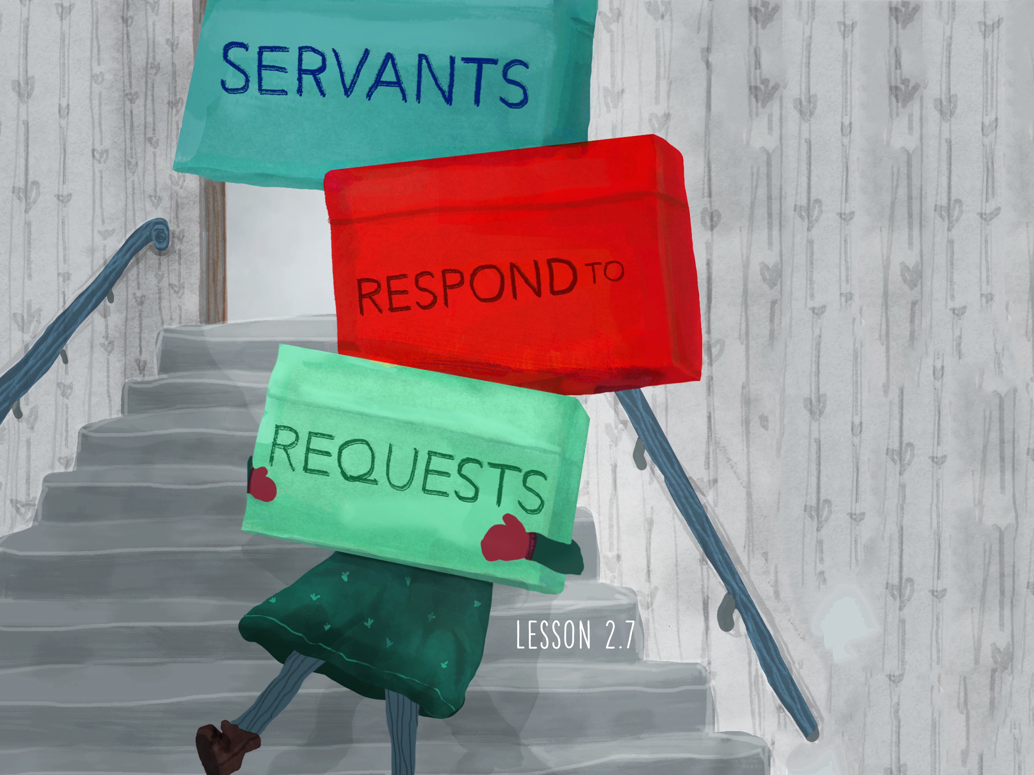

Slide 2

When Jesus heard these things, He marveled at him, and turned around and said to the crowd that followed Him, “I say to you, I have not found such great faith, not even in Israel!” And those who were sent, returning to the house, found the servant well who had been sick.
^{Luke 7:9-10}

Slide 3
Jesus is requested to serve.
Jesus is amazed by faith.
Jesus heals the servant.

Slide 4
Enter Content Here.
Enter content here.
Enter content here
Enter content here

