Slide 1


Slide 2
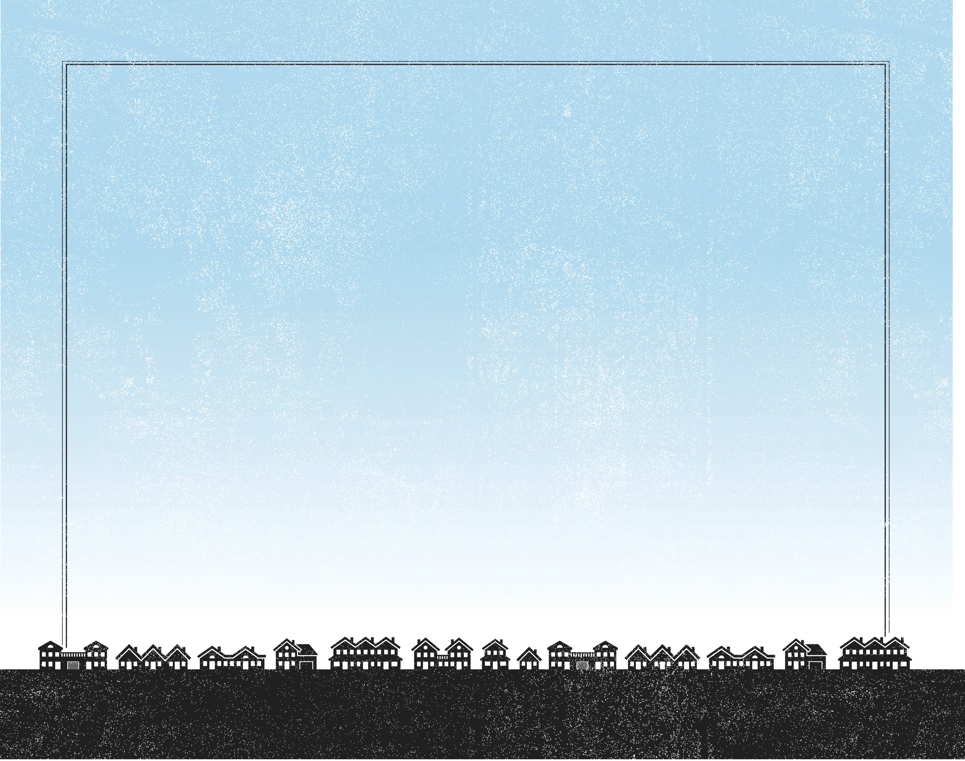
Then He took the five loaves and the two fish, and looking up to heaven, He blessed and broke them, and gave them to the disciples to set before the multitude. So they all ate and were filled, and twelve baskets of the leftover fragments were taken up by them.
^{Luke 9:16-17}

Slide 3
The crowd had a need.
The disciples had an impossible mission.
Jesus had the solution.

Slide 4
Enter Content Here.
Enter content here.
Enter content here
Enter content here

