Slide 1
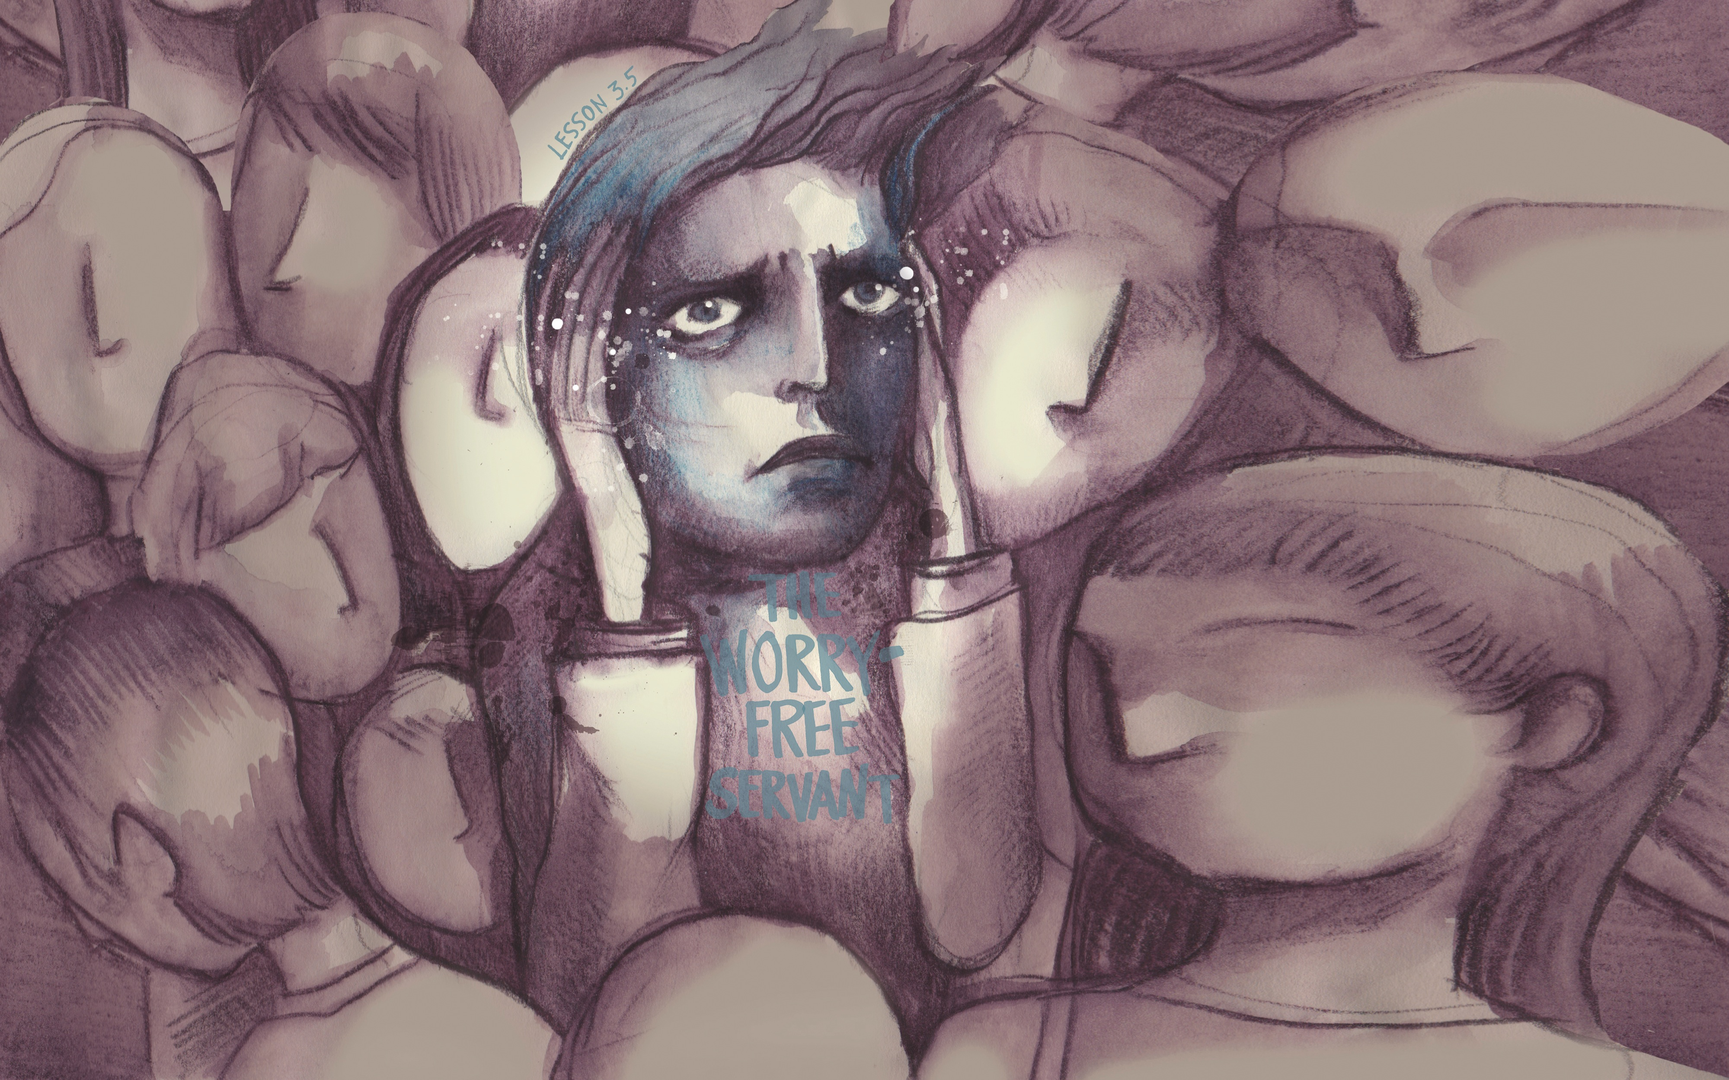

Slide 2
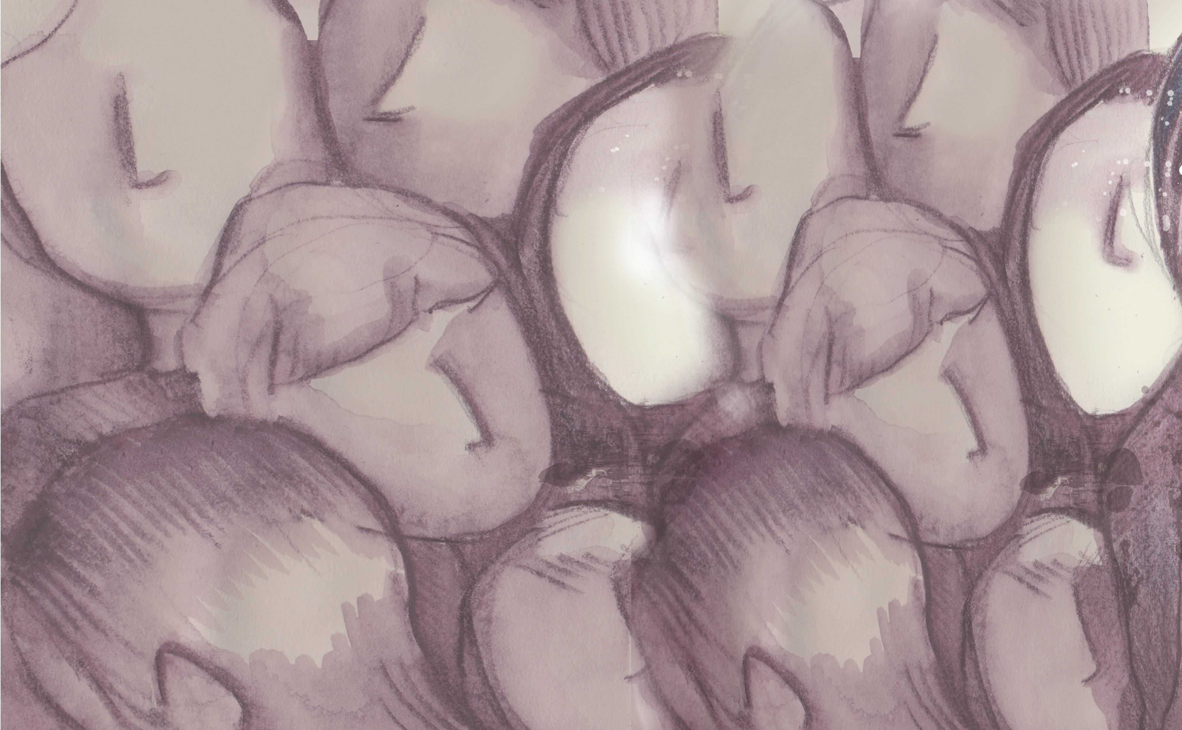
And Jesus answered and said to her, “Martha, Martha, you are worried and troubled about many things. But one thing is needed, and Mary has chosen that good part, which will not be taken away from her.”
^{Luke 10:41-42}

Slide 3
Mary listened to Jesus.
Martha was distracted.
Choose Jesus, not your worries.

Slide 4
Enter Content Here.
Enter content here.
Enter content here
Enter content here

