Slide 1
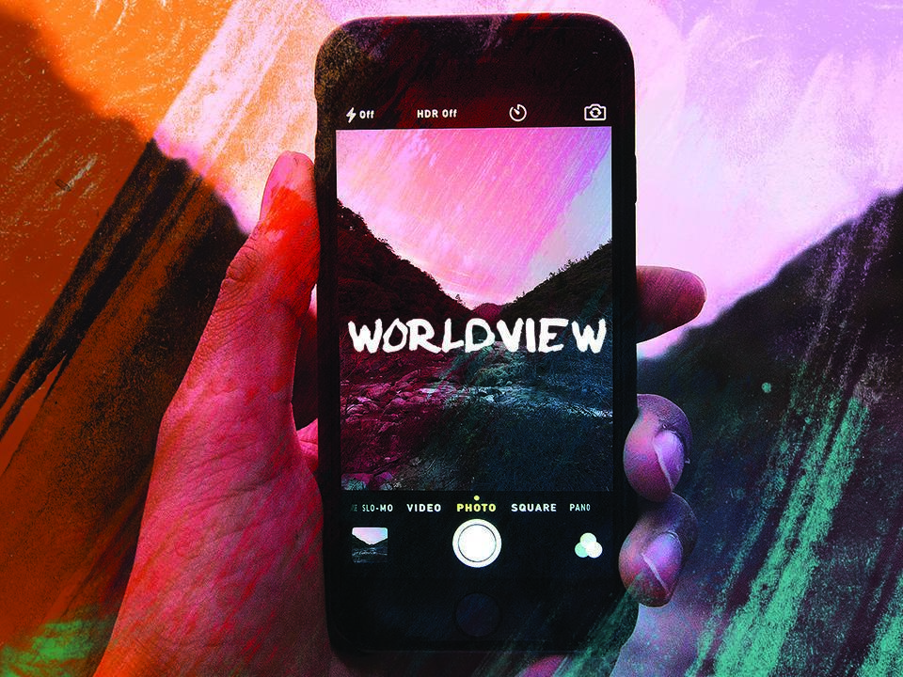
ESV

Slide 2


^{Romans 12:2}

Slide 3

My worldview has no bearing on my everyday life.

Slide 4

A biblical worldview transforms the way we relate to all of life.

Slide 5
TEMPLATE
•
•
•

