Slide 1
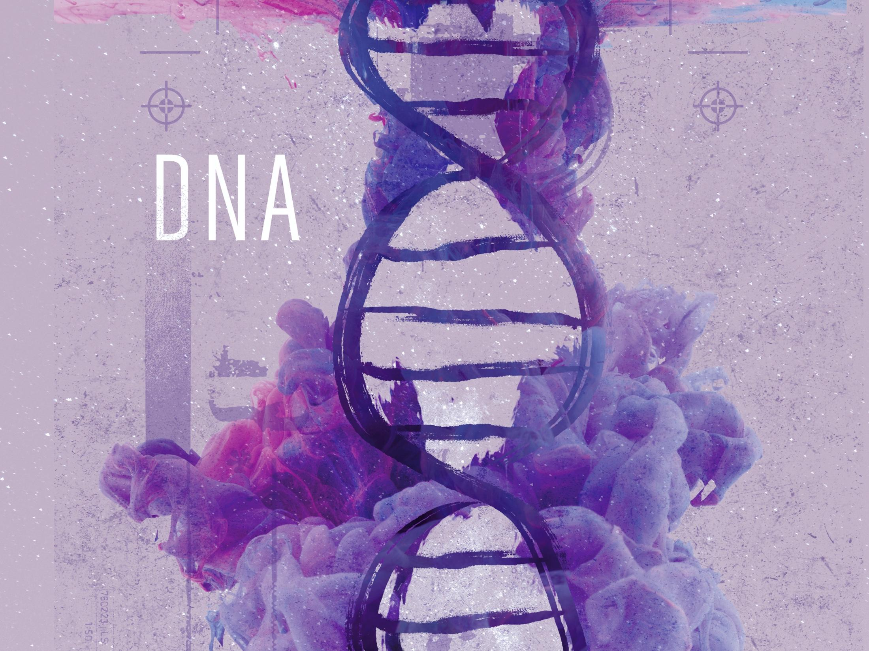
ESV

Slide 2


^{Psalm 139:13-14}

Slide 3

The information in DNA could result from a process of pure chance.

Slide 4

The information in DNA points to an author of life.

Slide 5
TEMPLATE
•
•
•

