Slide 1
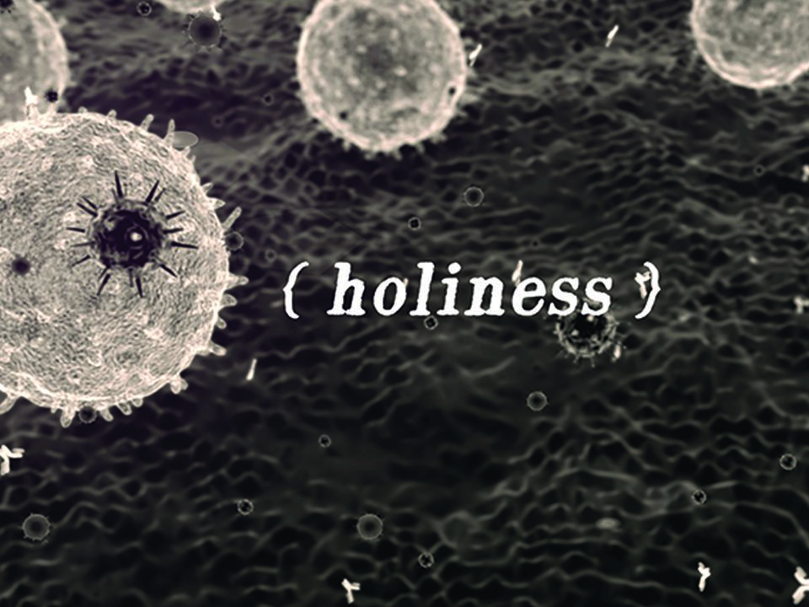

Slide 2
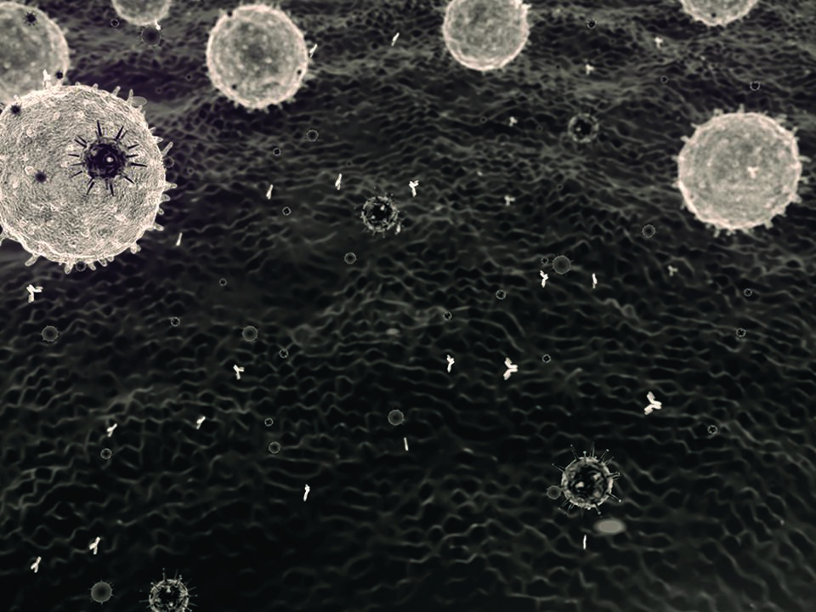

1 Peter 1:15-16

Slide 3

AN OUTWARD SET
OF ACTIONS MAKES US GOOD.

Slide 4

HOLINESS IS A STATE OF BEING THAT IS ESTABLISHED AND GOVERNED BY THE FINISHED WORK OF CHRIST TO BRING MANKIND BACK INTO UNITY WITH HIMSELF.

Slide 5
TEMPLATE
•
•
•

