Slide 1


Slide 2
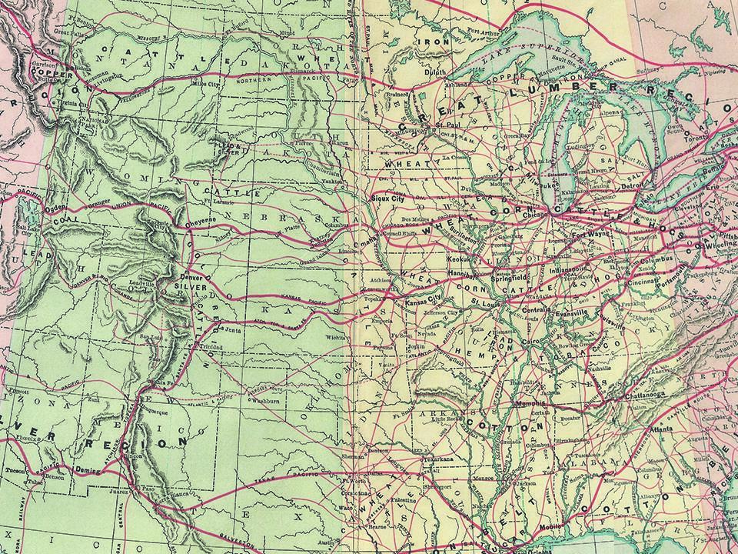

Hebrews 11:6

Slide 3

I OBEY GOD BECAUSE
I HAVE TO DO WHAT
HE SAYS.

Slide 4

I OBEY GOD BECAUSE I TRUST HIM.

Slide 5
TEMPLATE
•
•
•

