Slide 1
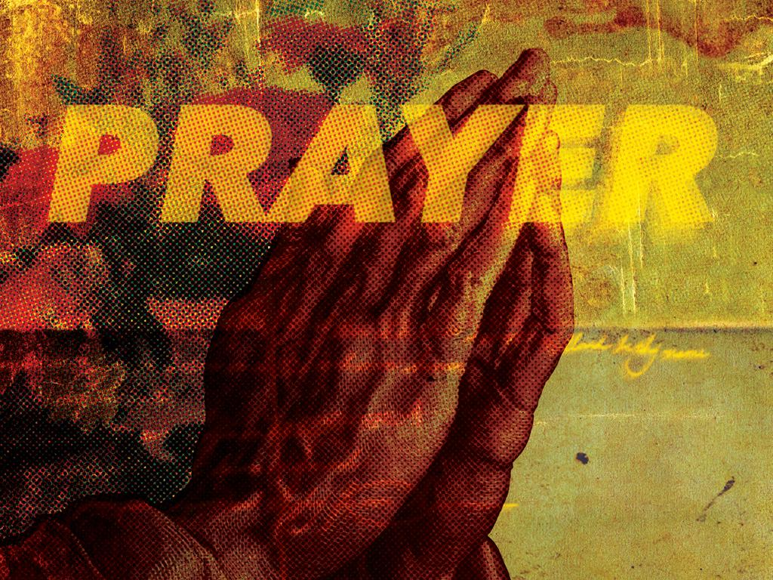

Slide 2


Matthew 6:9-13

Slide 3

I ONLY TALK TO GOD WHEN I NEED SOMETHING.

Slide 4

PRAYER IS A CONVERSATION. IT’S MORE THAN JUST TALKING. WE LISTEN TO GOD’S RESPONSES IN HIS WORD.

Slide 5
TEMPLATE
•
•
•

