Slide 1
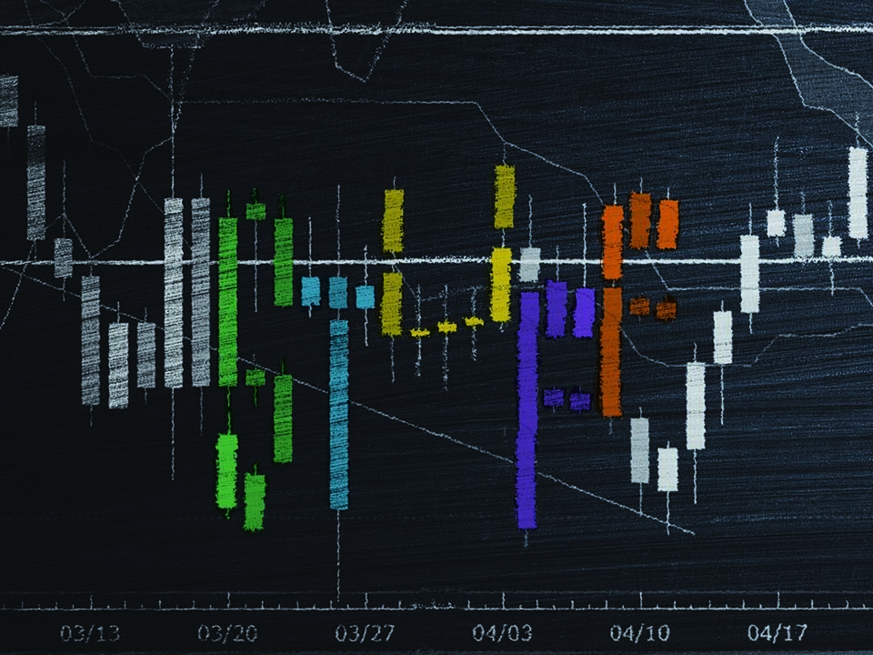

Slide 2
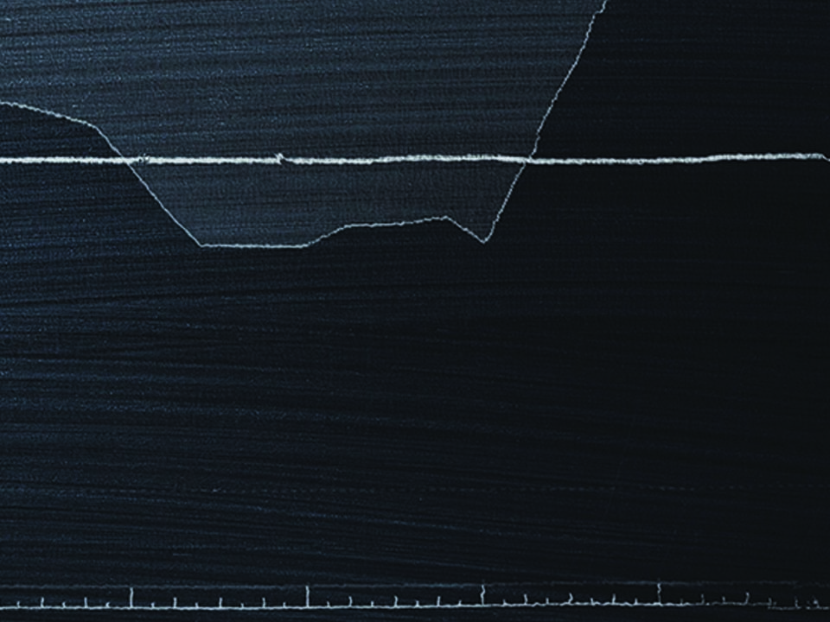

Matthew 6:20-21

Slide 3

I DETERMINE THE VALUE OF EVERYTHING.

Slide 4

GOD DOES NOT VALUE WHAT THE WORLD VALUES.

Slide 5
TEMPLATE
•
•
•

