Slide 1
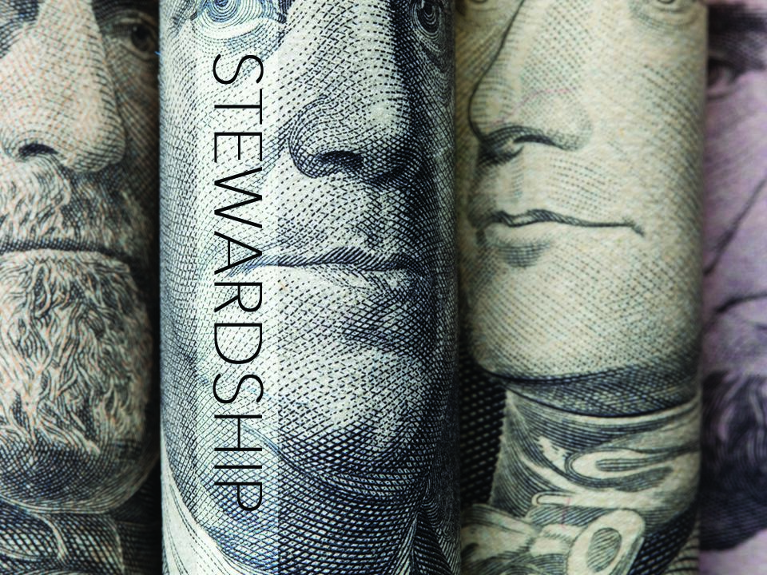

Slide 2
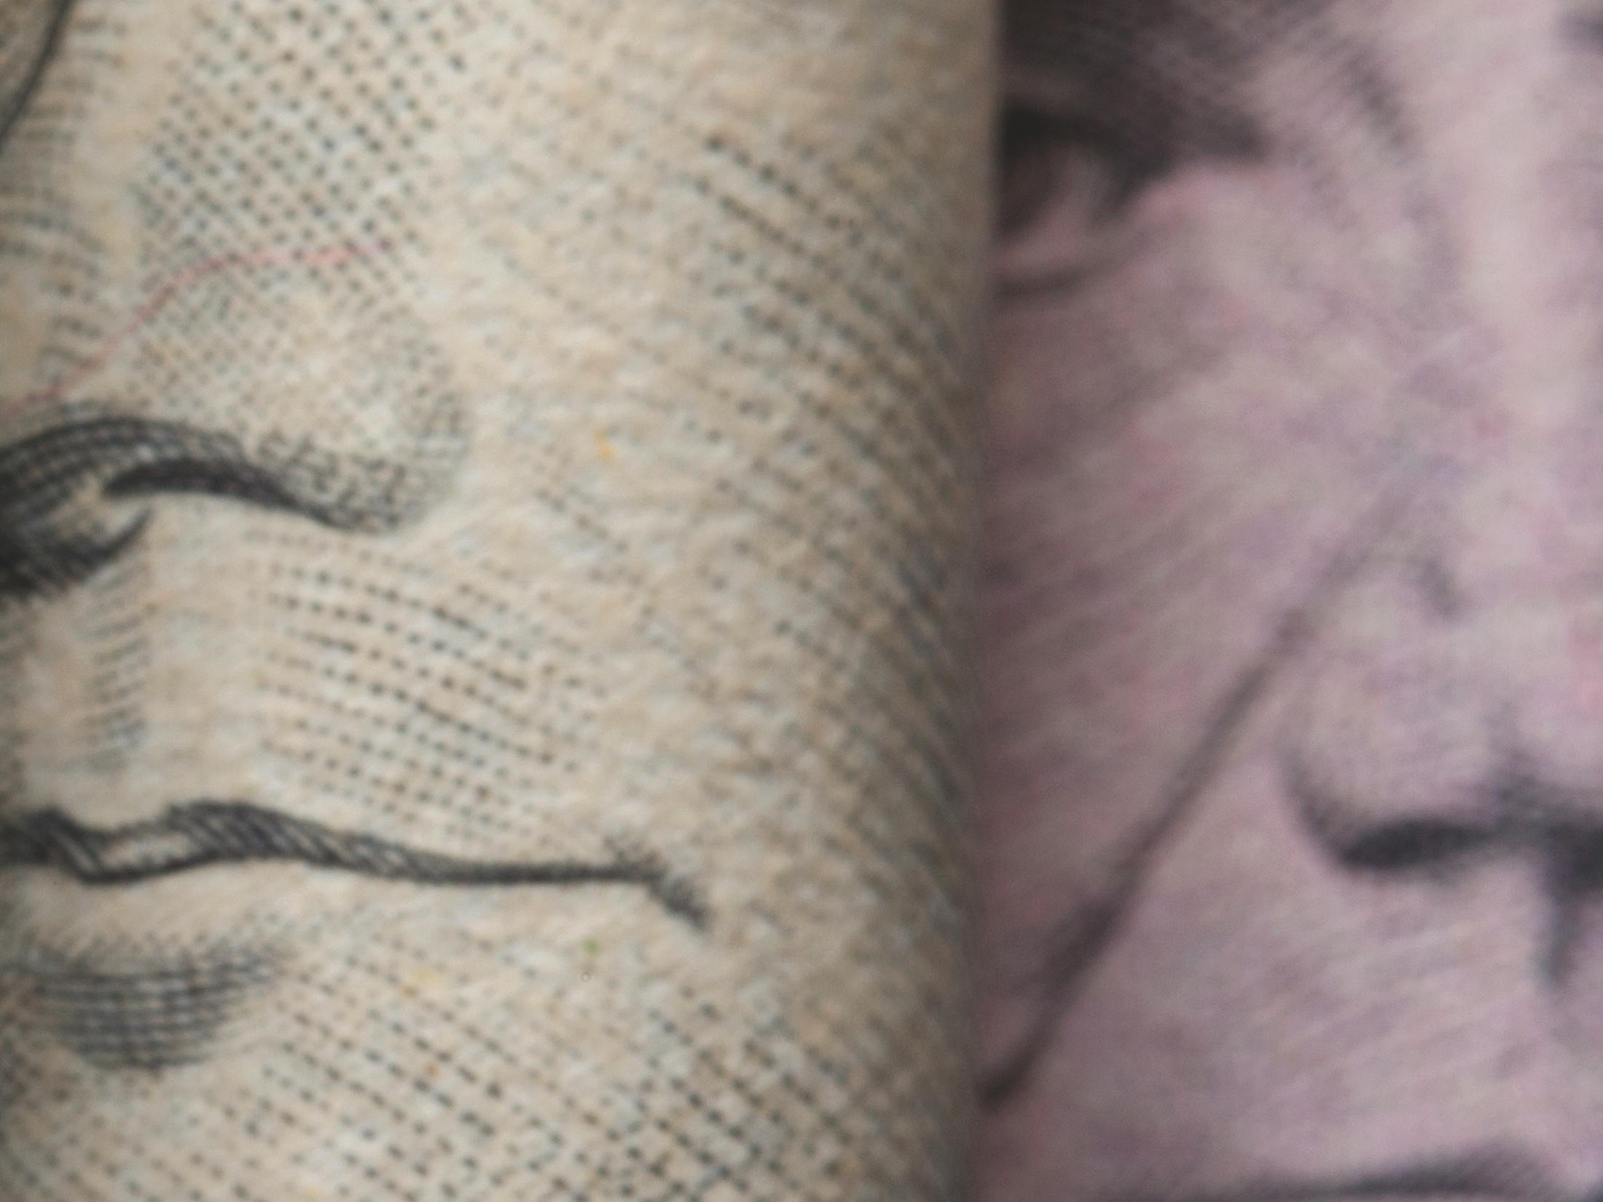

Matthew 25:29

Slide 3

MY PURPOSE AND MY TREASURE BELONG TO ME.

Slide 4

GOD EXPECTS US TO TAKE RESPONSIBILITY FOR ALL THAT HE
GAVE US.

Slide 5
TEMPLATE
•
•
•

