Slide 1


Slide 2
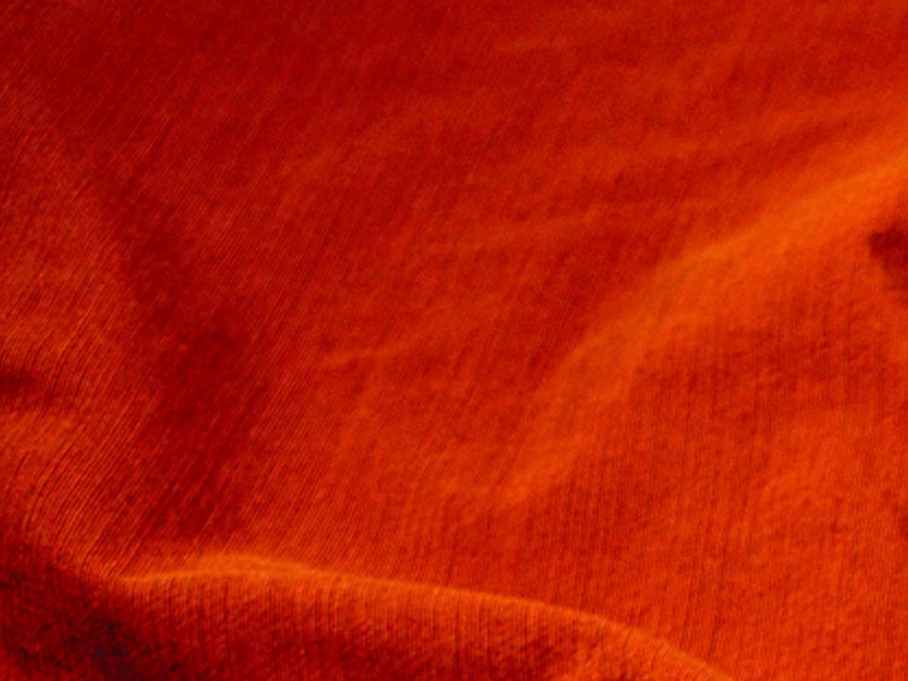

Matthew 5:11-12

Slide 3

PERSECUTION DOESN’T HAPPEN ANYMORE.

Slide 4

IF YOU FOLLOW JESUS, YOU SHOULD EXPECT TO FACE PERSECUTION.

Slide 5
TEMPLATE
•
•
•

