Slide 1
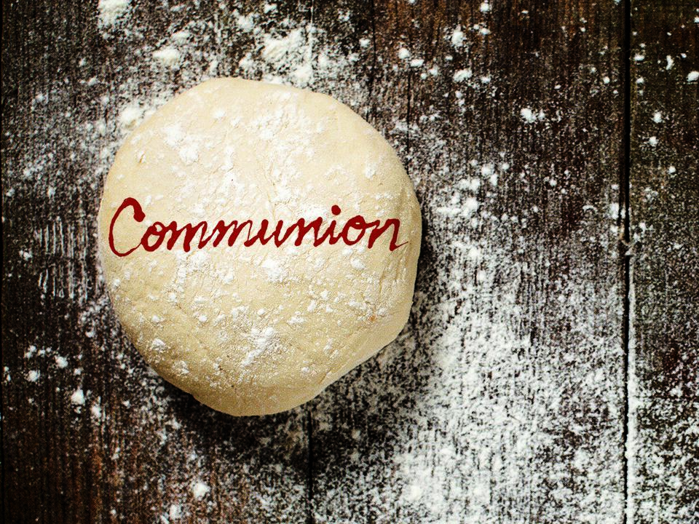

Slide 2
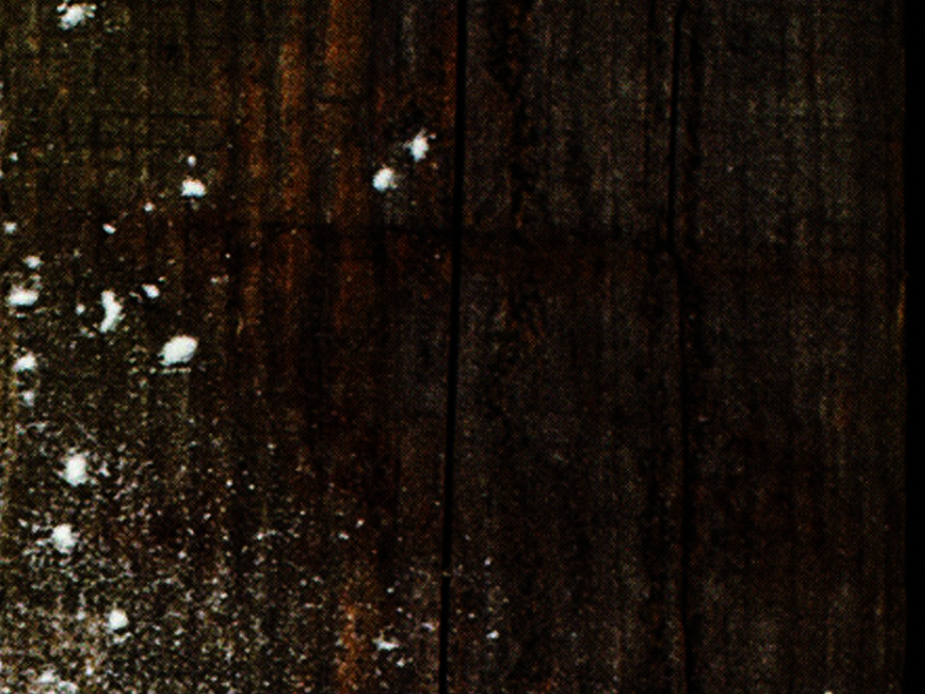
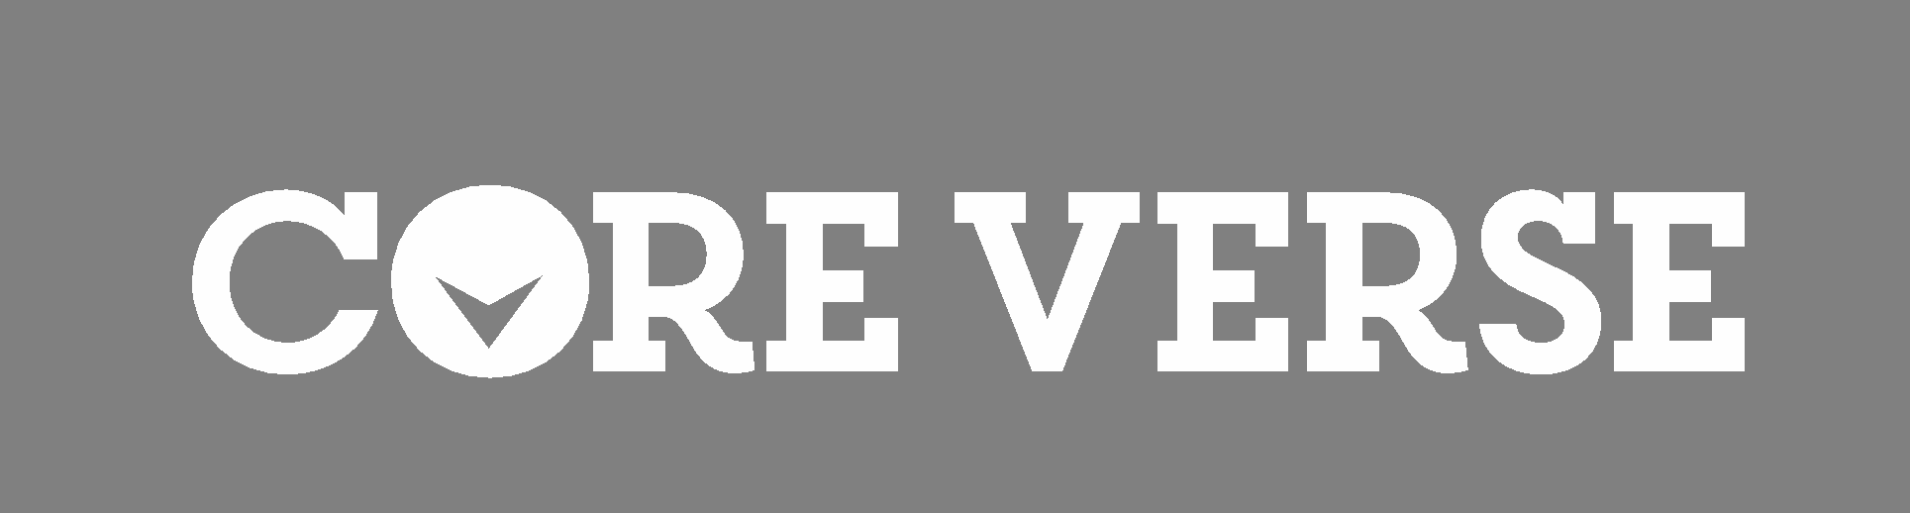
1 Corinthians 11:24-25

Slide 3

I CAN’T PARTICIPATE IN COMMUNION BECAUSE I’M NOT GOOD ENOUGH.

Slide 4
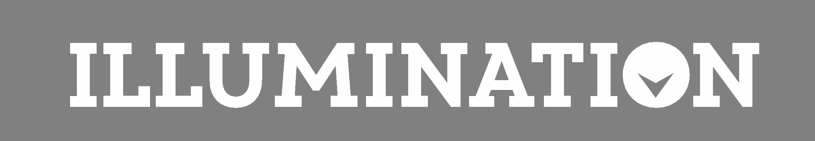
WE ARE MADE WORTHY BY JESUS’ SACRIFICIAL DEATH ON THE CROSS.

Slide 5
TEMPLATE
•
•
•

