Slide 1


Slide 2
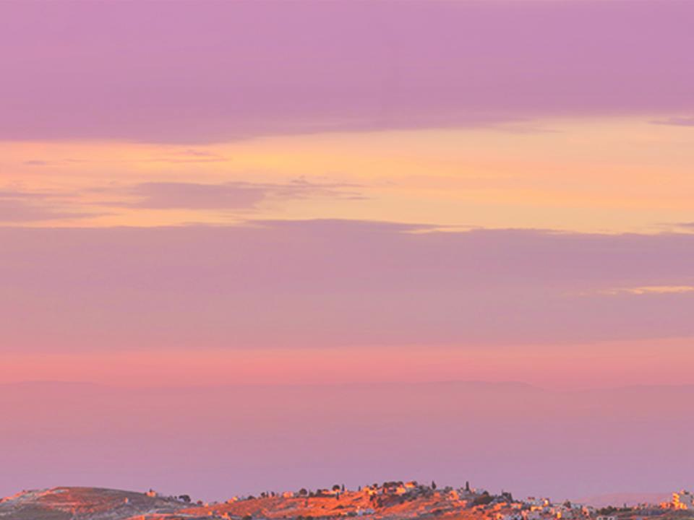

Acts 10:34-35

Slide 3

I CAN’T RELATE TO PEOPLE OUTSIDE OF MY REGULAR CIRCLE.

Slide 4

THE GOSPEL IS FOR ALL PEOPLE EVERYWHERE.

Slide 5
TEMPLATE
•
•
•

