Slide 1


Slide 2
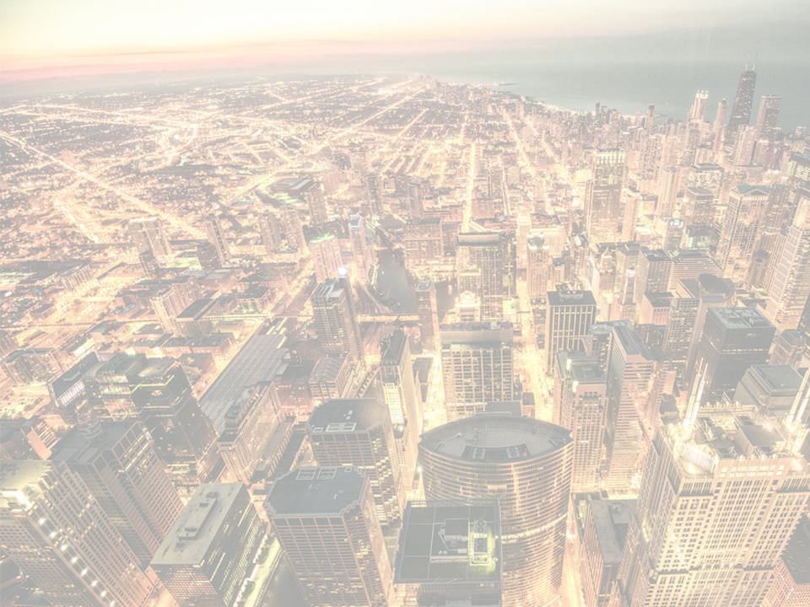

Acts 1:8

Slide 3

I CAN’T HAVE THAT BIG OF AN IMPACT ON
THE WORLD.

Slide 4

YOU HEARD ABOUT CHRIST BECAUSE A HANDFUL OF PEOPLE FAITHFULLY SHARED THE GOSPEL.

Slide 5
TEMPLATE
•
•
•

